Slide 1
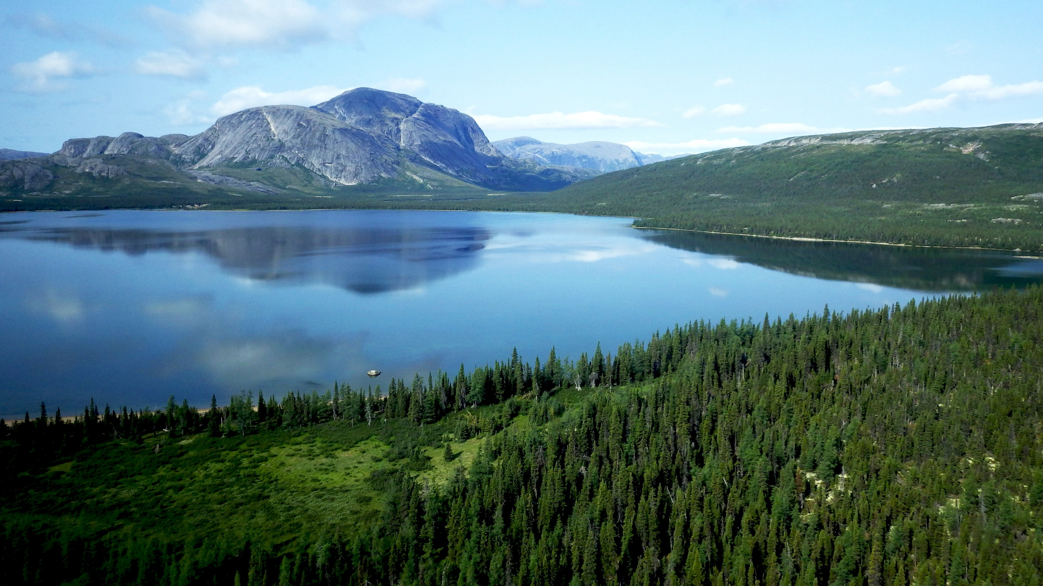

TSX: ALS | OTCQX: ATUSF
July 20, 2022
Coal to Renewable Power | Clean Steel | Potash | Copper | Lithium | Nickel | Cobalt

Slide 2
Forward Looking Statements
This document includes certain statements that constitute “forward- looking statements” and “forward-looking information” within the meaning of applicable securities laws (collectively, “forward-looking statements”). Forward-looking statements include statements regarding Altius Minerals Corporation’s (“Altius”) intent, or the beliefs or current expectations of Altius’ officers and directors. Such forward-looking statements are typically identified by words such as “believe”, “anticipate”, “estimate”, “project”, “intend”, “expect”, “may”, “will”, “plan”, “should”, “would”, “contemplate”, “possible”, “attempts”, “seeks” and similar expressions. Forward-looking statements may relate to future outlook and anticipated events or results.
By their very nature, forward-looking statements involve numerous assumptions, inherent risks and uncertainties, both general and specific, and the risk that predictions and other forward-looking statements will not prove to be accurate. Do not unduly rely on forward-looking statements, as a number of important factors, many of which are beyond Altius’ control, could cause actual results to differ materially from the estimates and intentions expressed in such forward-looking statements.
Forward-looking statements speak only as of the date those statements are made. Except as required by applicable law, Altius does not assume any obligation to update, or to publicly announce the results of any change to, any forward-looking statement contained herein to reflect actual results, future events or developments, changes in assumptions or changes in other factors affecting the forward-looking statements.
Non-GAAP Financial Measures
Attributable royalty revenue, adjusted EBITDA and adjusted operating cash flow is intended to provide additional information only and do not have any standardized meaning prescribed under IFRS and should not be considered in isolation or as a substitute for measures of performance prepared in accordance with IFRS. Other companies may calculate these measures differently. For a reconciliation of these Non-GAAP financial measures to various IFRS measures, please refer to our Management Discussion and Analysis.

Slide 3

Sustainable Natural Resource Royalty Leader
Enabling Change While Delivering Strong Returns For Shareholders
Invested in Key Sustainability Based Growth Trends
Specialized in long-life royalties on natural resources that are essential to the world meeting its sustainability objectives
Track record of generating strong returns through counter-cyclical investment discipline - proving that making a difference does not have to mean sacrificing returns
Business model offers superior long-term risk protection while providing free upside optionality to growth
Natural inflation hedge due to price based revenue growth without exposure to capital and operating cost inflation
Renewable Energy Projects support the decarbonization of Power Generation
Copper, Nickel, Lithium and Cobalt are critical metals to the EV Transition
High-Purity Iron Ore allows infrastructure to be built with Cleaner Steel
Potash is a natural fertilizer that enables Food Sustainability and Limits Deforestation
TSX: ALS | OTCQX: ATUSF

Slide 4
Revenue to Date, NAV Relative to Purchase Price
Historic Acquisition | Acquisition Date | Purchase Price | Realized Net Revenue | Curent NAV (Analyst Average) | Realized Revenue & NAV
Voisey's Bay | 2003 | $13.6 million | $38.8 million | $19.1 million | $57.9 million
Chapada Stream | 2016 | $76.8 million | $71.6 million | $115 million | $186.6 million
Potash Portfolio | 2014 & 2018 | $138.2 million | $111.1 million | $223 million | $334.5 million
IOC | 2017, 2019, 2022 | $64.0 million | $60.7 million | $117 million | $177.7 million
Callinan Merger | 2015 | $70.9 million | $81.3 million | $73 million | $154 million
Coal Portfolio | 2014 & 2020 | $200.6 million | $125 million | $25 million | $150 million
Altius Renewable Royalties (ARR) ⁽⁴⁾ | 2019 & 2020 | $85.0 million | $1.9 million | $180 million | $180 million
 |  | $639.1 million | $490.5 million | $752.7 million | $1,243 million
^{(Note 1)}
^{(Note 2)}
^{(Note 3)}
  Note
    Purchase price is based on cash purchase price in CAD. For the acquisition of Callinan Royalties in 2015, the purchase price excludes cash and consideration allocated to non-royalty related assets. (see Note 9, 2016 Annual Financial Statements), and includes the cost to exercise the option increasing the Gunnison Gross Sales Royalty (exercised in 2018). The main producing royalty in Callinan is 777 with the Gunnison development stage royalty also part of that acquisition.
    Realized revenue is the cumulative (since acquisition) reported revenue up to June 30, 2022. For the Chapada copper stream, reported revenue is net of the 30% copper purchase cost, as per the contract.
    Analyst average NAV by asset based on analysts reports from June/July 2022. The Callinan NAV consensus is based on NAV ascribed to 777 and to Gunnison.
    Realized Net Revenue for ARR reflects Altius Minerals’ 59% equity ownership of ARR; ARR has not yet established a dividend or other distribution policy, so this number is meant to show revenue that is accumulating to ARR, while ARR is growing and building market share. For that reason, the Realized Revenue & NAV column for ARR shows NAV only as revenue has not been distributed
TSX: ALS | OTCQX: ATUSF

Slide 5

Renewables & Other
5%
Royalty Revenue Growth
Inflation Protection
Renewables & Other
4%
Power generation
(coal + renewables)
16%
Power generation
(coal)
10%
Copper
23%
Ni-Zn-Cu
7%
Copper
36%
Ni-Zn-Cu
6%
Structural demand accelerating for most of our commodity exposures while industry capital and operating costs and other challenges are mounting
Royalties provide full benefit of rising prices with no exposure to inflationary costs
Q2 2021 Royalty
Revenue
$22M
+31%
Q2 2022 Royalty
Revenue
$29M
Ni-Zn-Co
3%
Iron Ore
10%
Potash
21%
Iron Ore
23%
Potash
40%
Quarterly Royalty Revenue ($ millions)

Slide 6
Returns of Capital ($m)
*
* Includes Q3 expected dividend at $0.08 per share, after increased dividend announced Aug 8 2022

Slide 7
Balance Sheet
  Cash at June 30, 2022 includes $28 million cash (excluding cash held by ARR) and PG equities valued at $47M (excluding other public and private holdings)

Slide 8

Altius’s Long-Term, Counter-Cyclical Royalty Growth Focus
Disciplined Royalty Acquisition History
Cycle I
Cycle II (Super-Cycle)
Cycle III
Royalty Acquisition
Interpreted Cyclical Position
$1.19/share
Potash, Thermal (Electrical) Coal
Copper, Zinc
Potash
Nickel, Copper, Cobalt
Copper
Iron Ore
Operating CF /share
2000
2005
2010
2015
2020
TSX: ALS | OTCQX: ATUSF

Slide 9










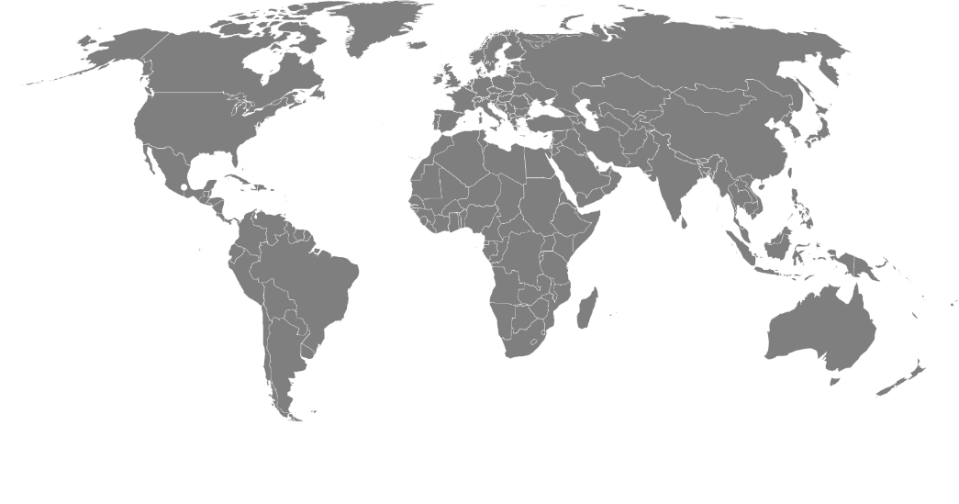










Project Generation Business
Royalty Pipeline Growth and Strong Cash Returns
PG Junior Equities Portfolio Performance
Exploration & Development Pipeline
~5x
$43
Net Monetization
Objective
$47
Current Equities
Value ($MM)
$22
Starting Equities
Value ($MM)
Apr 2016
June 2022
PG Junior Equities Portfolio Exposures
(By Commodity at Dec 31, 2021)
Portfolio of 50+ pre-production stage royalties and 18 junior equity positions provide excellent free option value exposure to discovery and development

Slide 10
Project Generation – Net Investment Year-to-date
Net outflows $2.6 M YTD
Orogen Royalties (Altius position 16.5%) reported $738k in first full quarter of revenue from Ermitaño royalty
Sterling Metals raised ~$5 M in new exploration funding to advance Sail Pond
Labrador Uranium commenced exploration on Labrador properties including Central Mineral Belt properties
Junior Equity Portfolio Growth
Net Monetization
Net Investments
Apr 2016
Apr 2017
Dec 2018
Dec 2019
Dec 2020
Dec 2021
June 2022

Slide 11
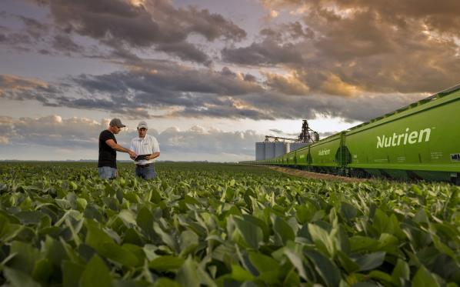
Potash – Growth in a Rising Price Environment
US Midwest Avg. Price: $249/ST
2020 Royalty Revenue: C$14.6 million
US Midwest Avg. Price: $504/ST
2021 Royalty Revenue: C$19.3 million
Granular, FOB Midwest
Production - Tonnes KCl

Slide 12

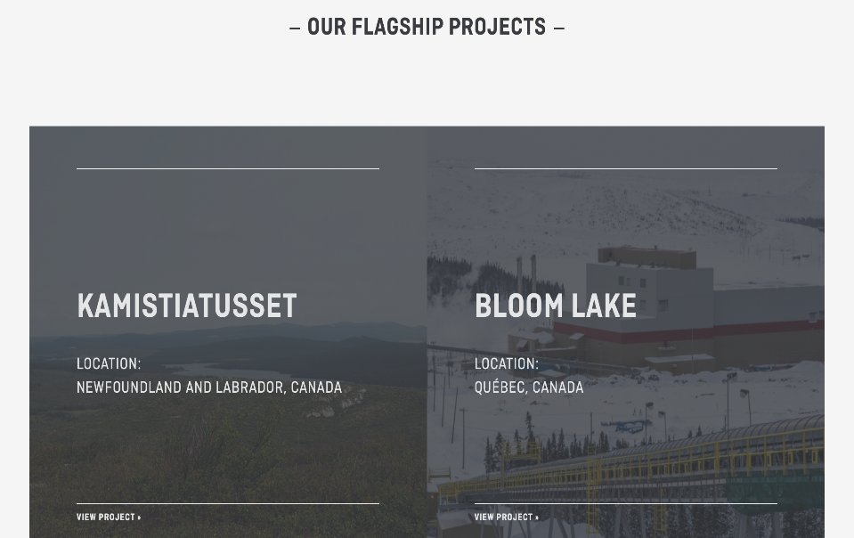
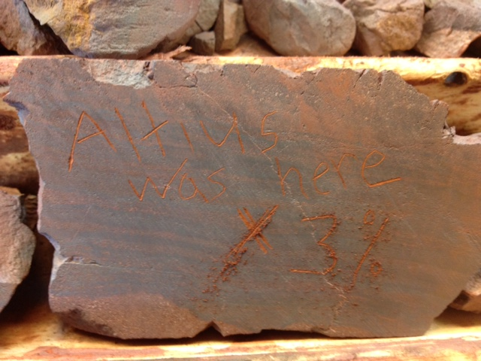
Kami
Iron Ore | Iron | Oxygen | Impurities
Low Quality | 58% | 25% | 17% Iron to Impurities Ratio - 3.4:1
‘Benchmark’ Quality | 62% | 27% | 11% Iron to Impurities Ratio - 5.6:1
High-Quality | 66% | 28% | 6% Iron to Impurities Ratio - 11:1
The relative impurity content of 58% vs 66% grade iron ore is almost 3 times higher
Updated Feasibility Study expected later this year
Previous operator feasibility study target 8MT/year production rate for stage 1 and 16MT/year following a stage 2 expansion
Champion targeting a DR pellet feed concentrate
IOC has now started to also step up in incremental growth projects

Slide 13

Chapada and the Saúva Discovery
Chapada total copper in resources and reserves (all categories) has grown by 48% since our acquisition in 2016 and has never decreased YoY despite 8 years of steady mine production.
Current mine life with no additional resources is presently 32 years.
On Feb 10th, Lundin reported a new discovery at Saúva citing:
  “the potential for significant, shallow and high-grade copper-gold mineralization”
  “numerous opportunities exist to increase the size and quality of our Mineral Resource base at Chapada”.
  "A scoping study is ongoing and will continue into 2022 to assess various expansion scenarios, including a possible 24 Mtpa greenfield process plant”. Lundin’s 2021 AIF.
Current Chapada Resources and Reserves

Slide 14
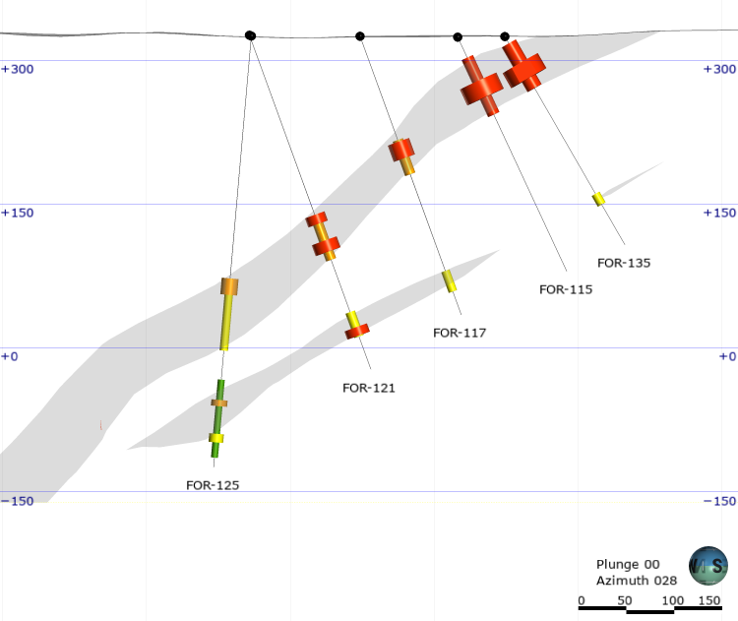
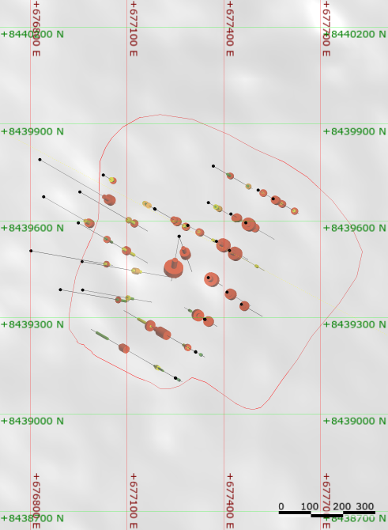

Chapada and the Saúva Discovery
A
B
FOR-135: 0.79% Cu and 1.06 g/t Au over 53.71m
Including 1.27% Cu and 1.98 g/t Au over 17.95m
FOR-115: 0.61% Cu and 0.70 g/t Au over 65.45m
Including 1.26% Cu and 1.92 g/t Au over 18.41m
A
High-grade mineralized footprint (assays)
FOR-135: 0.44% Cu and 0.11 g/t Au
over 12.8m
FOR-125: 0.41% Cu and 0.22 g/t Au over 75.49m
Including 0.53% Cu and 0.6 g/t Au over 16.49m
B
FOR_125: 0.34% Cu and 0.15 g/t Au over 81.61m
Including 0.51% Cu and 0.36 g/t Au over 6.52m
Including 0.46% Cu and 0.38 g/t Au over 9.00m
*See Lundin Mining Corporations press release dated February 10, 2022 and First Quarter 2022 Results Presentation dated April 28, 2022 for more information

Slide 15
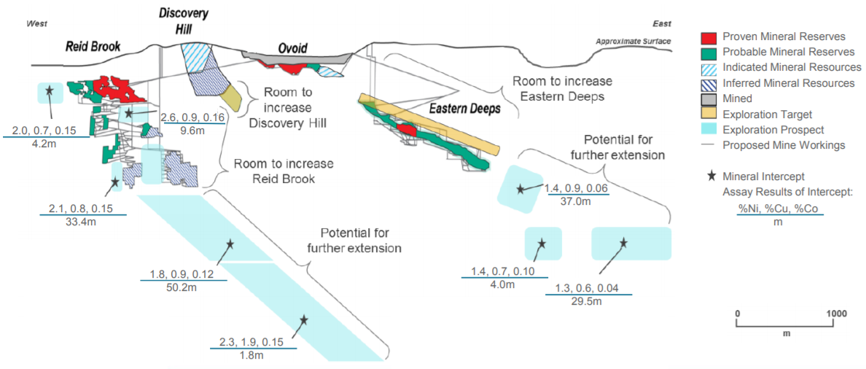


Voisey’s Bay Upside
West-East Longitudinal Section
Mine limit at 2034
Source: Wheaton Precious Metals (2018)

Slide 16
Silicon
Inferred Resources at Silicon total 3.37 Moz gold. Mineralization remains open to the northwest, southeast and at depth, where, notably, high grade veins are present. Silicon moved from Concept Study to PFS this year.
Merlin appears to have a larger footprint than Silicon and we expect to see a maiden resource here by year end as part of a Concept Study
Several other targets identified and subject to evaluation
Current drilling on south side of Silicon, looking west

Slide 17
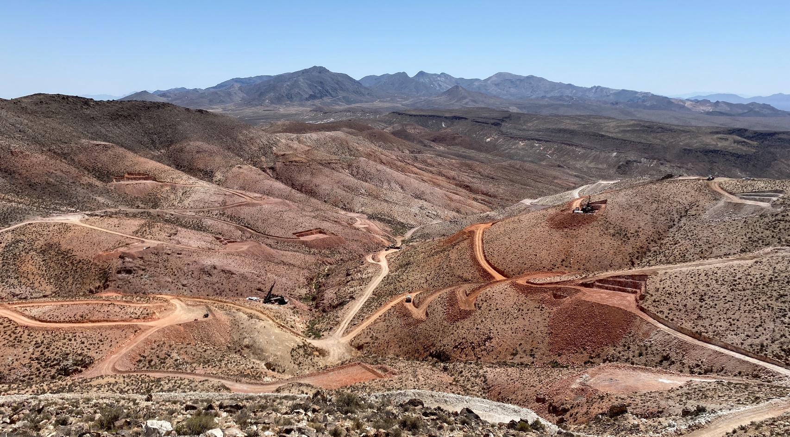
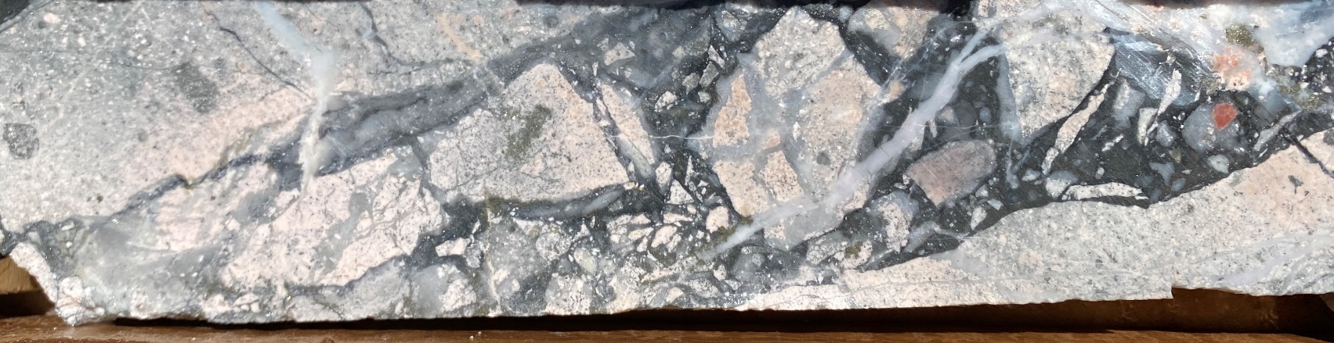
Silicon
AngloGold Ashanti stated on May 9th that it’s new discovery at Silicon and the completion of the Corvus acquisition will “establish the largest new gold district in Nevada in recent years. This provides AngloGold Ashanti the opportunity to create, in the medium and longer term, a meaningful, low-cost, long-life production base in a premier mining jurisdiction.
Top: Current drilling on south side of Silicon, looking west;
Bottom: High grade breccia ore from Silicon.

Slide 18
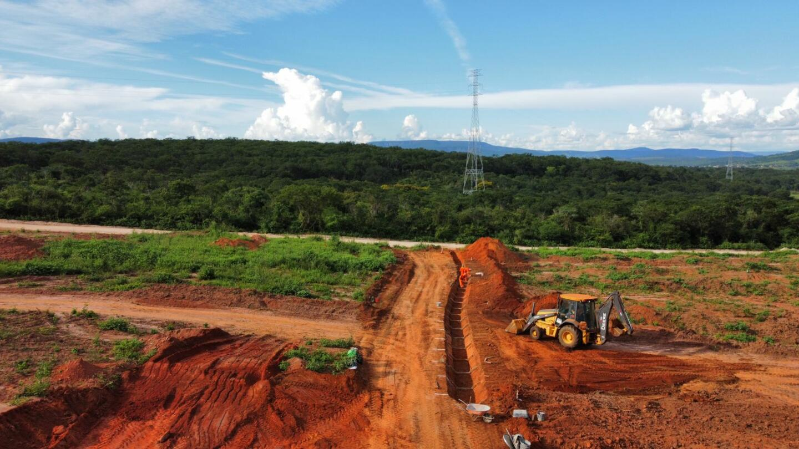
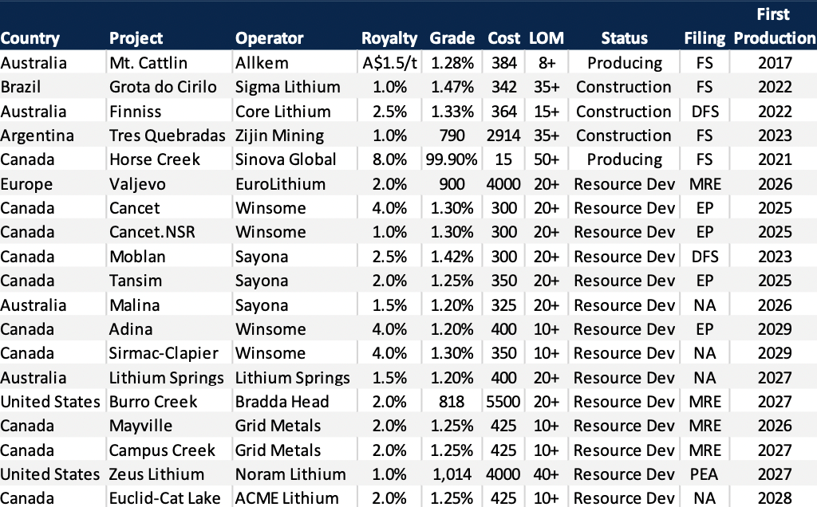
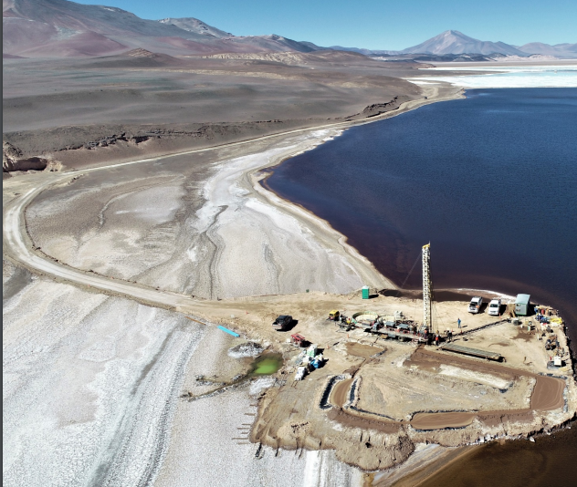
Lithium Royalty Corporation
Construction at Sigma Lithium Grota do Cirilo project
Large portfolio built since co-founding investment made with strong cash flow build up projected
Dual track IPO/Corporate transaction process planned for later this year could crystallize significant value for Altius
Development at Zijin Mining’s Tres Quebradas

Slide 19
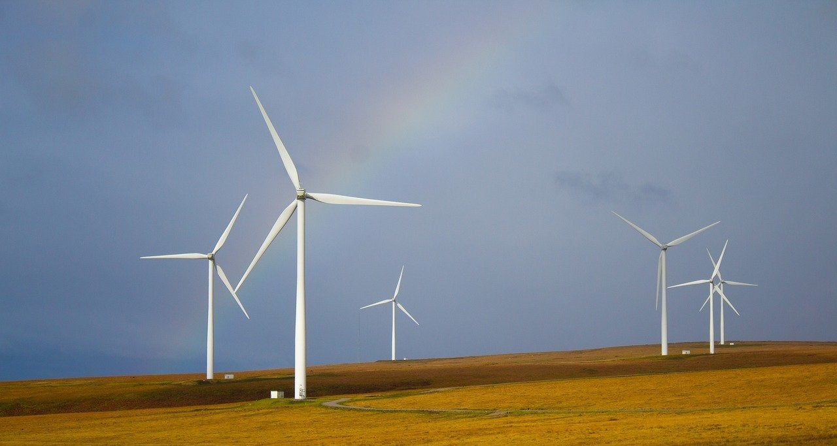
Renewable Energy
(59% Owner of Altius Renewable Royalties)
GBR (operating company) to be cash flow positive 2022
US$72.5M new capital deployed in last quarter: Bluestar Energy Capital and Hodson Energy
Renewable Energy Megawatts Under Royalty ¹
3,510 MW
¹ Megawatts total reflects royalties received by the ARR / Apollo JV stemming from APEX and TGE project sales as well as direct royalty purchases from Longroad Energy and Northleaf Capital Partners. For further details visit www.arr.energy . 2 Mid-stage development activities include, but are not limited to, determining project size, costs, equipment and layout, conducting environmental studies, and applying for interconnection approvals. 3. Late-stage development activities include, but are not limited to, determining the offtake strategy, finalizing and optimizing project size, costs, equipment and layout, finalizing interconnection approvals and costs, and seeking tax equity and other investors.

Slide 20
Summary of Operating and Development Stage Royalties
Property | Project Originator | Location | Renewable Energy Source | Owner/Developer | Facility Size | Status | Expected COD | Royalty Basis
Clyde River | Great Bay | Vermont | Hydro | Gravity Renewables | 5 MW | Operational | N/A | 10% of revenue
Prospero 2 | Longroad Energy | Texas | Solar | Longroad Energy | 250 MW | Operational | N/A | Variable
Old Settler | Northleaf Capital | Texas | Wind | Northleaf Capital | 150 MW | Operational | N/A | Variable
Cotton Plains | Northleaf Capital | Texas | Wind | Northleaf Capital | 50 MW | Operational | N/A | Variable
Phantom | Northleaf Capital | Texas | Solar | Northleaf Capital | 15 MW | Operational | N/A | Variable
Jayhawk | Apex | Kansas | Wind | WEC Energy / Invenergy | 195 MW | Operational | N/A | 2.5% of revenue
TBA | TBA | Texas | Wind | TBA | 500 MW | Late-stage Development | TBA | 2.5% of revenue
Canyon | TGE | Texas | Wind | TBA | 360 MW | Late-stage Development | Q3 2023 | 3% of revenue
Flatland | TGE | Texas | Solar | TBA | 180 MW | Mid-stage Development | Q2 2023 | 1.5% of revenue
Panther Grove | TGE | Illinois | Wind | Copenhagen Infrastructure Partner | 400 MW | Mid-stage Development | Q4 2023 | 3% of revenue
Honey Creek | TGE | Indiana | Solar | Leeward | 400 MW | Mid-stage Development | Q4 2023 | 1.5% of revenue
Appaloosa | TGE | Texas | Wind | NextEra Energy | 175 MW | Late-stage Development | Q4 2022 | 1.5% of revenue
Hoosier Line | TGE | Indiana | Wind | Leeward | 180 MW | Mid-stage Development | Q4 2023 | 3% of revenue
Blackford Wind | TGE | Indiana | Wind | Leeward | 200 MW | Mid-stage Development | Q4 2023 | 3% of revenue
Blackford Solar | TGE | Indiana | Solar | Leeward | 150 MW | Mid-stage Development | Q4 2023 | 1.5% of revenue
El Sauz | Apex | Texas | Wind | JERA Renewables | 300 MW | Late-stage Development | Q4 2022 | 2.5% of revenue

Slide 21
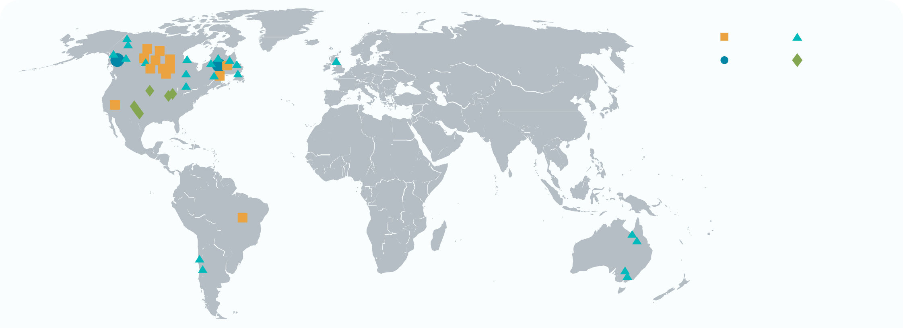
Producing Royalties
Development Royalties
Project Generation
Renewable Energy Portfolio
Flora Wood
Director, Investor Relations
Phone: (416) 346-9020
Email: flora@altiusminerals.com

