Slide 1
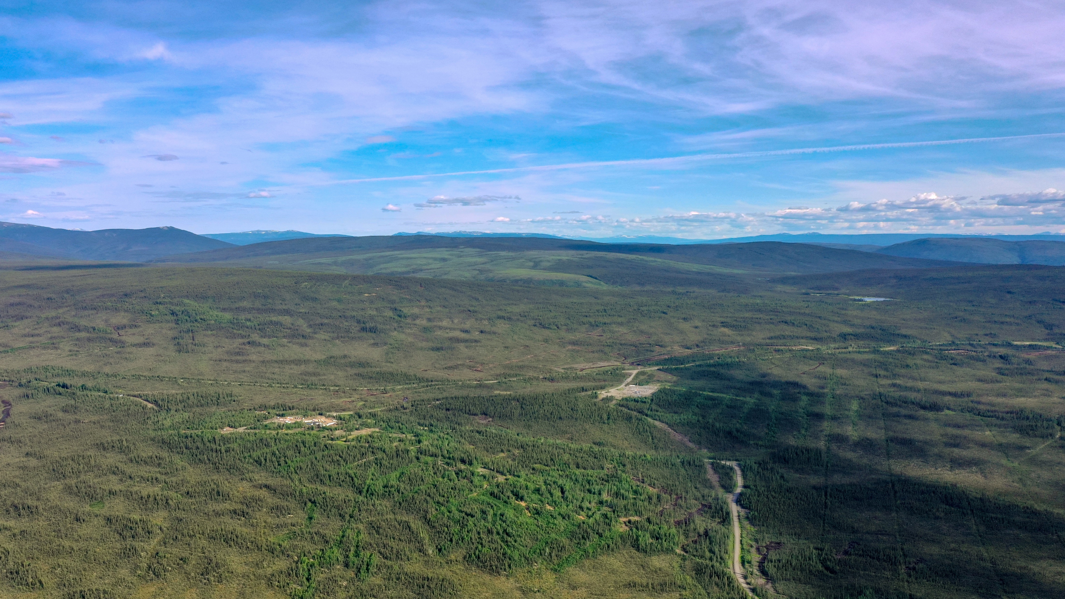
John Tumazos Very Independent Research October 12, 2022
TSXV : BYN | OTCQB : BYAGF
THE NEW YUKON GOLD RUSH

Slide 2
FORWARD LOOKING STATEMENTS
This presentation contains forward-looking information, which is not comprised of historical facts. Such information can generally be identified by the use of forwarding-looking wording such as “may”, “will”, “expect”, “estimate”, “anticipate”, “intend”, “believe” and “continue” or the negative thereof or similar variations. Forward-looking information involves risks, uncertainties and other factors that could cause actual events, results, performance, prospects and opportunities to differ materially from those expressed or implied by such forward-looking information. Forward looking information in this presentation includes, but is not limited to, the potential for the Powerline and Airstrip Deposits and Aurex Hill Zone to host on-surface and near-surface gold mineralization; the future expansion of the mineralized footprint at the Powerline and Airstrip Deposits; future drilling at the AurMac Property and the expected timing thereof; the timing and expected scope of the planned 2022 AurMac Property exploration program; Banyan’s objectives, goals or future plans; statements regarding exploration expectations, exploration or development plans; and mineral resource estimates. Factors that could cause actual results to differ materially from such forward-looking information include, but are not limited to, uncertainties inherent in resource estimates, capital and operating costs varying significantly from estimates, the preliminary nature of metallurgical test results, delays in obtaining or failures to obtain required governmental, environmental or other project approvals, political risks, uncertainties relating to the availability and costs of financing needed in the future, changes in equity markets, inflation, changes in exchange rates, fluctuations in commodity prices, environmental liability and insurance; reliance on key personnel; the potential for conflicts of interest among certain officers, directors or promoters with certain other projects; competition; dilution; the volatility of common share price and volume, delays in the development of projects and the other risks involved in the mineral exploration and development industry, enhanced risks inherent to conducting business in any jurisdiction, and those risks set out in Banyan’s public documents filed on SEDAR. Although Banyan believes that the assumptions and factors used in preparing the forward-looking information in this presentation are reasonable, undue reliance should not be placed on such information, which only applies as of the date of this presentation, and no assurance can be given that such events will occur in the disclosed time frames or at all. Banyan disclaims any intention or obligation to update or revise any forward-looking information, whether as a result of new information, future events or otherwise, other than as required by law.
Cautionary Note to U.S. Investors Concerning Estimates of Measured, Indicated and Inferred Resources: This presentation uses the terms “Measured”, “Indicated” and “Inferred” Resources. U.S. investors are advised that while such terms are recognized and required by Canadian regulations, the Securities and Exchange Commission does not recognize them. “Inferred Resources” have a great amount of uncertainty as to their existence, and great uncertainty as to their economic and legal feasibility. It cannot be assumed that all or any part of an inferred resource will ever be upgraded to a higher category. Under Canadian rules, estimates of Inferred Resources may not form the basis of feasibility or other economic studies. U.S. investors are cautioned not to assume that all or any part of an Inferred Mineral Resource exists, or is economically or legally mineable.
Qualified Person:
Paul D. Gray, P.Geo. is a “qualified person” within the meaning of such term as set forth in National Instrument 43-101 of the Canadian Securities Administrators, has verified and supervised the preparation of all of the scientific and technical information contained in this presentation.

Slide 3
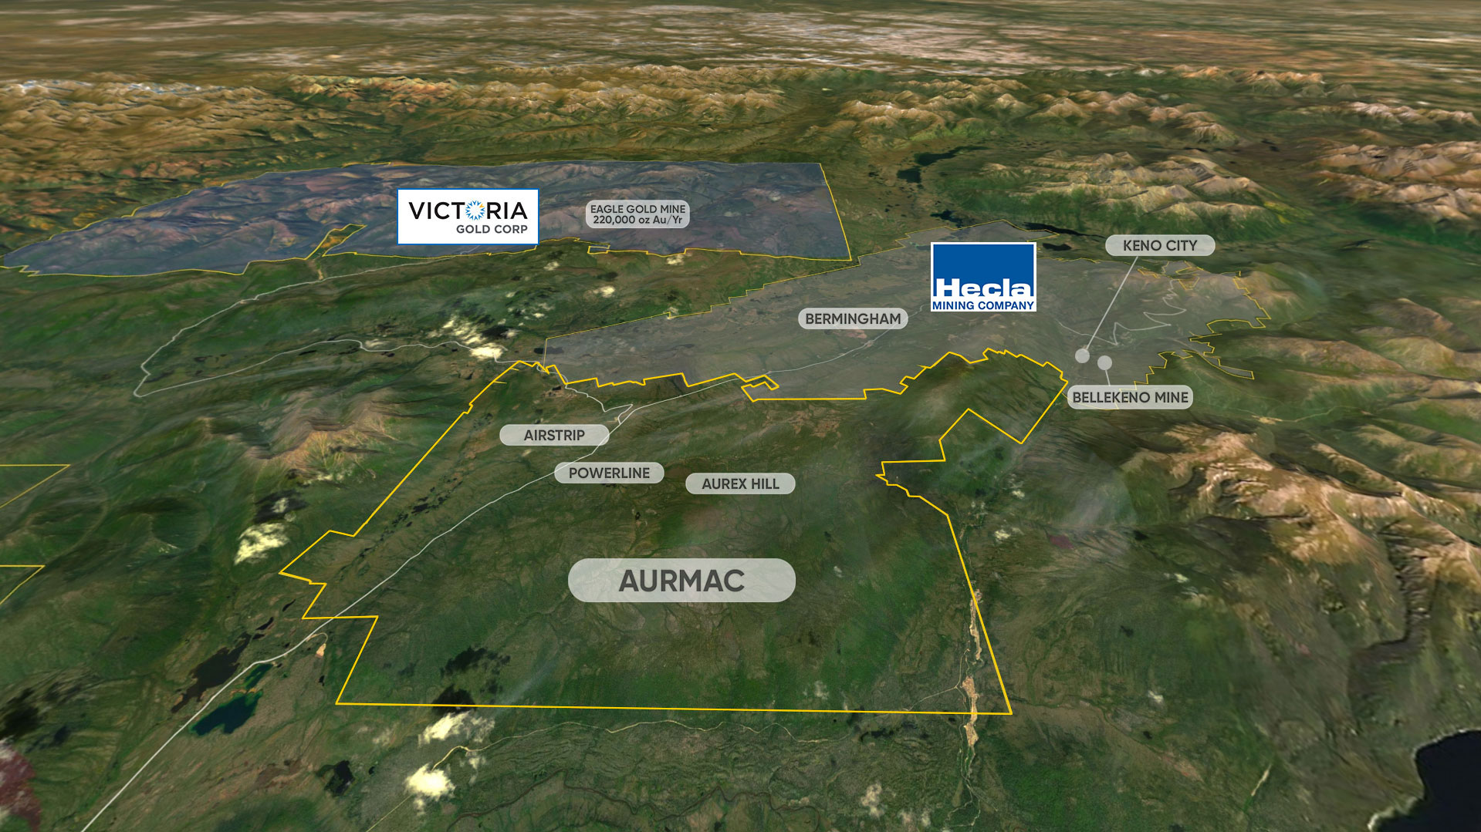
STRATEGIC ADVANTAGE: TOP 5 REASONS TO INVEST
TIER 1 Jurisdiction
Adjacent to 2 mines, permitting
YEAR-ROUND
Exploration & Catalysts
INFRASTRUCTURE
Roads, Power, Communications
4 MILLION OZ RESOURCE
Expansion Potential to Tier 1 Status
LEADERSHIP
Track Record of Value Creation
MAY 2022 AURMAC INFERRED RESOURCE
Pit Constrained Resource: 4 Million Ounces @ 0.6 g/t Au
Aurex Hill – 215,000 oz at 0.53 g/t at 0.3 g/t Au cutoff
Airstrip – 874,000 oz at 0.64 g/t Au at 0.2 g/t Au cutoff
Powerline – 2,897,000 oz Au at 0.59 g/t Au at 0.2 g/t Au cutoff
(Prepared in accordance with NI-43-101 standards)
Reference News Release :May 17, 2022. Marc Justras, P.Eng, M.A.Sc., Ginto Consulting Inc.
Technical Report filed June 29, 2022

Slide 4
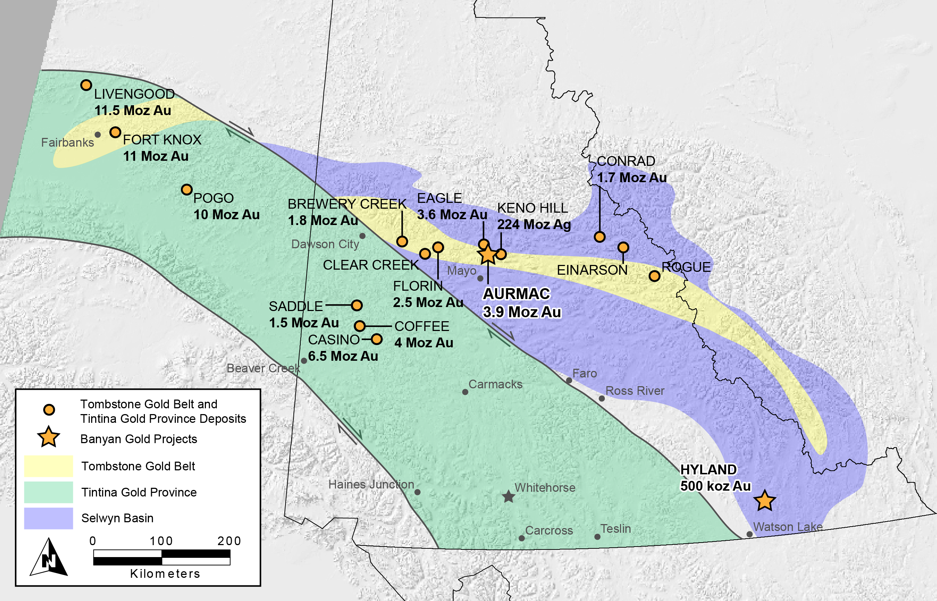
CANADA’S NEWEST GROWING MINING DISTRICT
NEW YUKON GOLD RUSH
Prolific Tombstone Gold Belt
Newmont Gold Corp. (Coffee - $520 M), Agnico-Eagle, Barrick, Coeur, Kinross & Osisko
Underexplored
13 M Au Eq within 40 km radius of Aurmac
SUPPORTIVE/STABLE JURISDICTION
Existing Roads and Power Infrastructure
Established Permitting process
ADJACENT TO PRODUCING MINES
Victoria Gold Corp. – Planning 250,000 oz/year by 2023
Hecla Mining Company – high grade silver mine

Slide 5
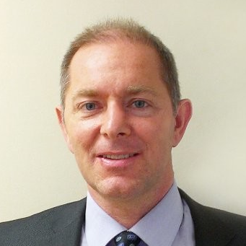
LEADERSHIP – Record of Value CReation
Management
Management | Tara Christie M.A.Sc., P.Eng President & CEO, Director | Paul D. Gray P.Geo VP, Exploration | David Rutt CMA, CPA Chief Financial Officer | Jasmine Sangria MBA VP, Corporate Communications
OPERATIONS
DIRECTORS | James Thom M.Sc. Sr Geologist & Field Manager
DIRECTORS
DIRECTORS | Marc Blythe P.Eng. | Steve Burleton M.B.A., CFA | David Reid
Advisor
DIRECTORS | Jason Neal

Slide 6
INDUSTRY LEADING
Release of Maiden AurMac Resource May 25, 2020
Validation by some of the best in the business
20+ Industry professionals & mining CEOs as shareholders
Market Capitalization | Current Price | $0.475 | 52 Week High/Low | $0.57 / 0.25
 | Shares Outstanding (Basic) | 258.8 M | Market Capitalization | ~$120 M
 | Fully Diluted | 275 M | Cash | $18 M
 | Options Outstanding | 16.6 M | Warrants | 0
Recent Financings | June 2022 - $17 M – (16.2 M Charity at $0.63, 5.3 M FT at $0.55, and 8.6 M at $0.45) Fully subscribed announced June 27, 2022 July/Aug 2021 - $16 M – ($11.5 M Charity at 0.38, $2.2 M FT at 0.35, and $2.2 M at 0.28) December 2020 - $2.5 M ($1 M Charity at 0.325, $1.5 M FT at 0.28)
Analysts / News Writers | Cormark – Emerging Ideas – Richard Gray – Price target $1.25 Gwen Preston – Resource Maven

Slide 7
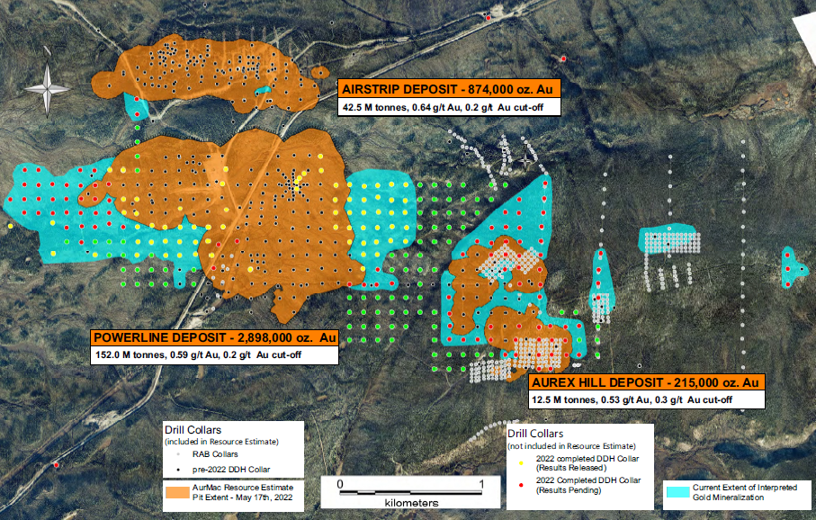
AURMAC GOLD – 4 Million Ounce Resource
Pit Constrained Resource Estimate:
4 Million Ounces @ 0.6 g/t Au May 17, 2022
Note: 40,000 m of drilling added over 3 M ounces Au from 2020 resource
Reference May 17, 2022 Marc Jutras, P.Eng, M.A.Sc., Ginto Consulting Inc.
US$/CAN$ exchange rate of 0.75 and constrained within an open-pit shell optimized with the Lerchs-Grossman algorithm to constrain the Mineral Resources
Parameters: gold price of US$1,700/ounce, US$2.50/t mining cost, US$5.50/t processing cost, US$2.00/t G+A, 80% heap leach recoveries, and 45° pit slope.
LG pit shell at Gold price $1700 USD/oz., Mining Costs $10. Technical Report to be filed within 45 days
Deposit | Strip Ratio
Airstrip | 1.40 : 1
Powerline | 0.34 : 1
Aurex Hill | 1.50 : 1
Total Combined | 0.63 : 1

Slide 8
AurMAC Rapidly Growing Resource

Slide 9
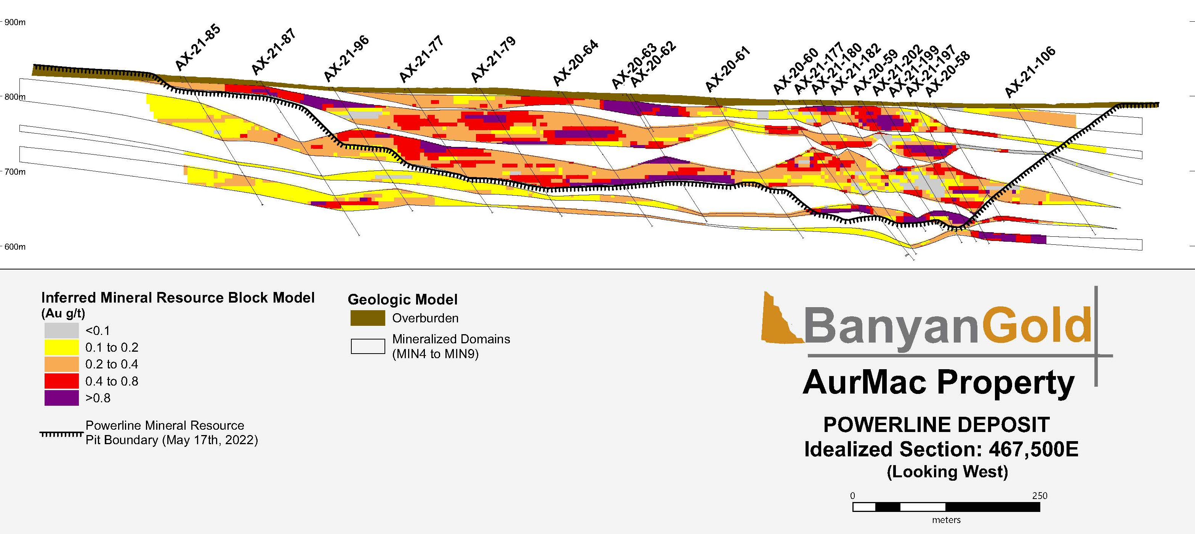
GROWTH AT POWERLINE – Cut–oFF Grades
Pit-Constrained Inferred Mineral Resources Powerline Deposit
Au Cut-Off (g/t) | Tonnage (tonnes) | Average Au Grade (g/t) | Au Content (oz)
0.1 | 190,905,921 | 0.503 | 3,087,297
0.15 | 172,955,984 | 0.542 | 3,013,879
0.2 | 151,984,708 | 0.593 | 2,897,648
0.25 | 133,368,315 | 0.644 | 2,761,401
0.3 | 114,974,053 | 0.704 | 2,602,337
0.35 | 99,180,749 | 0.764 | 2,436,193
0.4 | 85,881,004 | 0.825 | 2,277,939
0.45 | 73,227,267 | 0.894 | 2,104,754
0.5 | 62,852,644 | 0.963 | 1,945,991
Higher Grade Near Surface
Potential Starter Pits
NS Section Through Powerline
9

Slide 10
ADVANCING TO a TIER 1 ASSET
Funded for +60,000 m Drilling
Resource Expansion
High Grade Potential Starter Areas
Support PEA/Economics
3 Drills Turning +45,000 m Drilled +180 Holes – Results of 74 Released
Next Target: 6 - 7 Million Ounces in Inferred
COMPARABLE: Victoria Gold - Eagle
Grade of deposit: 0.64 g/t
Recoveries: 74%, Strip Ratio: <1:1
FS: 200K ounces Au/year, 10 years
Actual Build and Operating Costs of similar modern project

Slide 11
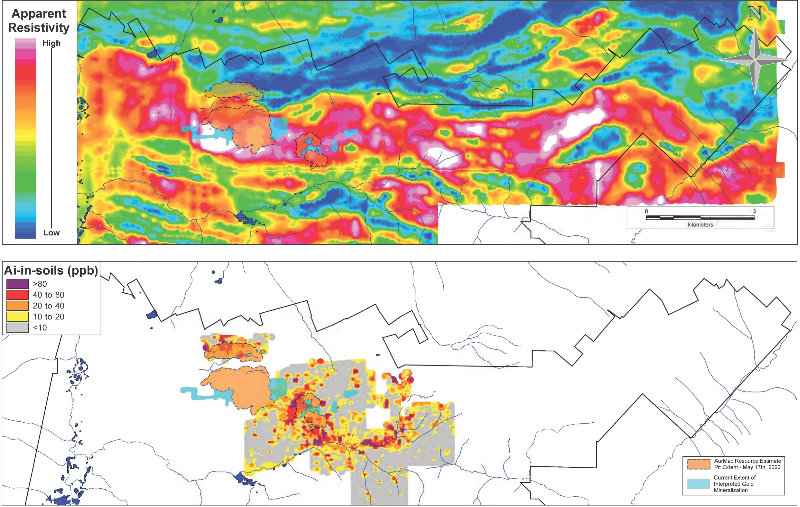
Multi-Million ounce and District Scale RESOURCE POTENTIAL
ALL RESOURCES OPEN
>10 km sq. gold soil anomaly to East with known RAB drill results
POWERLINE AND AUREX HILL
Powerline and Aurex Hill - resistive (siliceous) package of rocks - 16.5 km strike
Intrusion Related Gold Mineralization of Tombstone Gold belt
Same age mineralization as VGCX

Slide 12
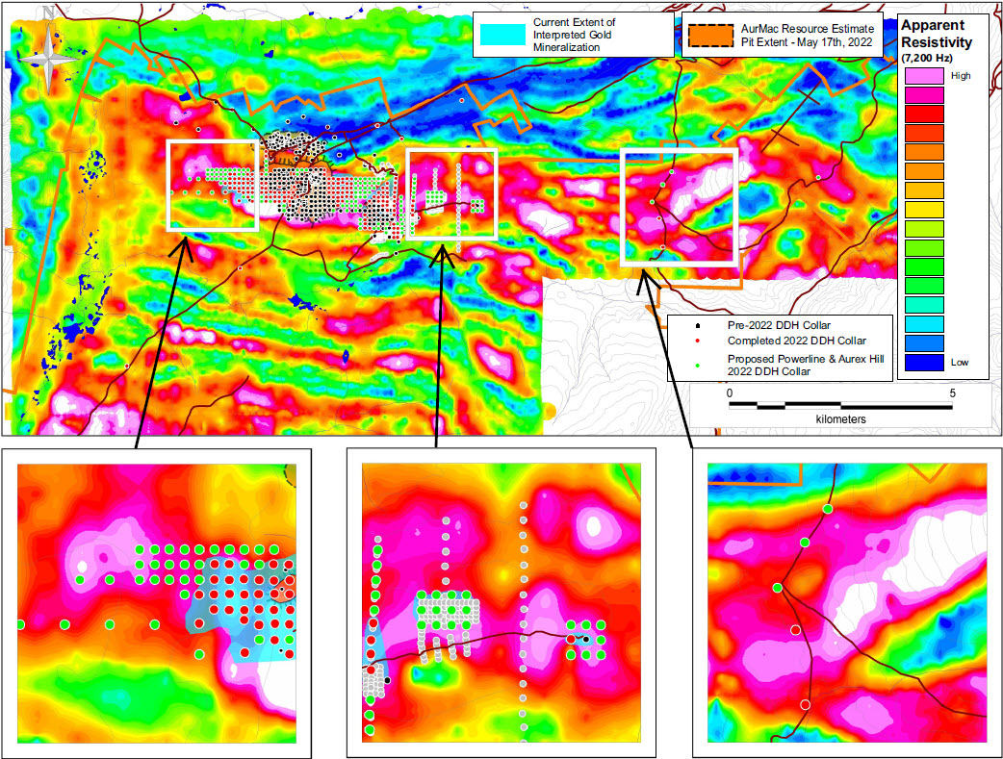
TESTING REGIONAL POTENTIAL IN 2022
2022 program focused on resource growth and potential starter pits
Target Areas
West Powerline
Aurex Hill
East Aurex (Keno)
High value structural and geophysical drill targets identified with easy access - underway

Slide 13
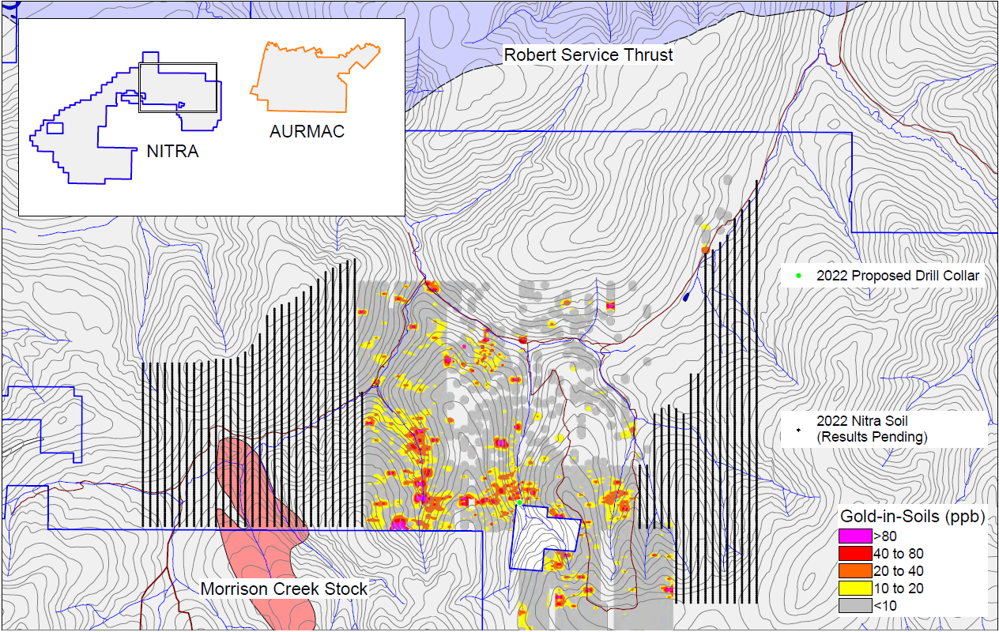
Nitra project - 100% OWNED
As-in-soil anomaly, coincident with similarly oriented Pb- and Zn-in-soil anomalies.
Dominant NNW mineralized trend
AurMac Geological model
Soil sampling, trenching and drill ready targets
TSXV: BYN | OTCQB: BYAGF
13

Slide 14
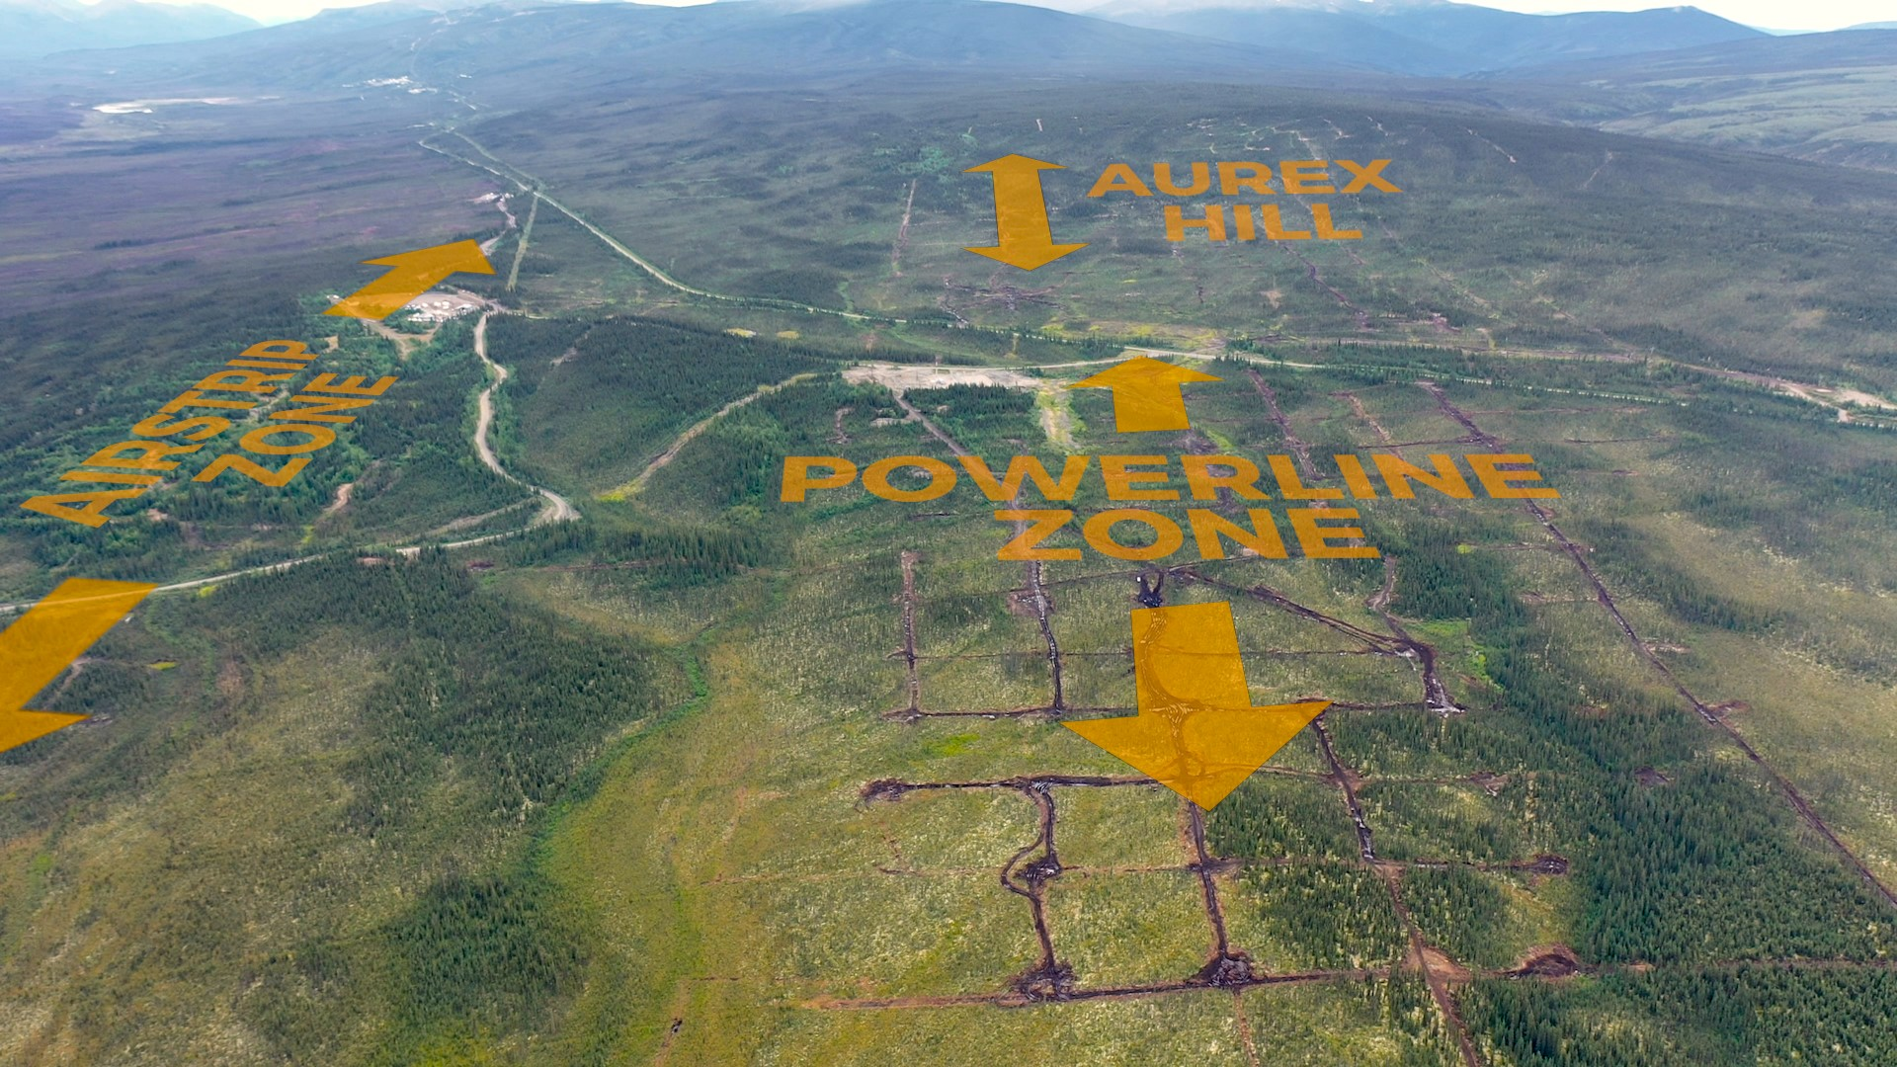
AURMAC GOLD – Infrastructure Advantages
INFRASTRUCTURE
Continued road upgrades
New powerline to hydroelectric dam (138 kvA Energized to 69 kVa)
In discussions to get connected in 2023
Cell phone/ Fiber optic phone

Slide 15
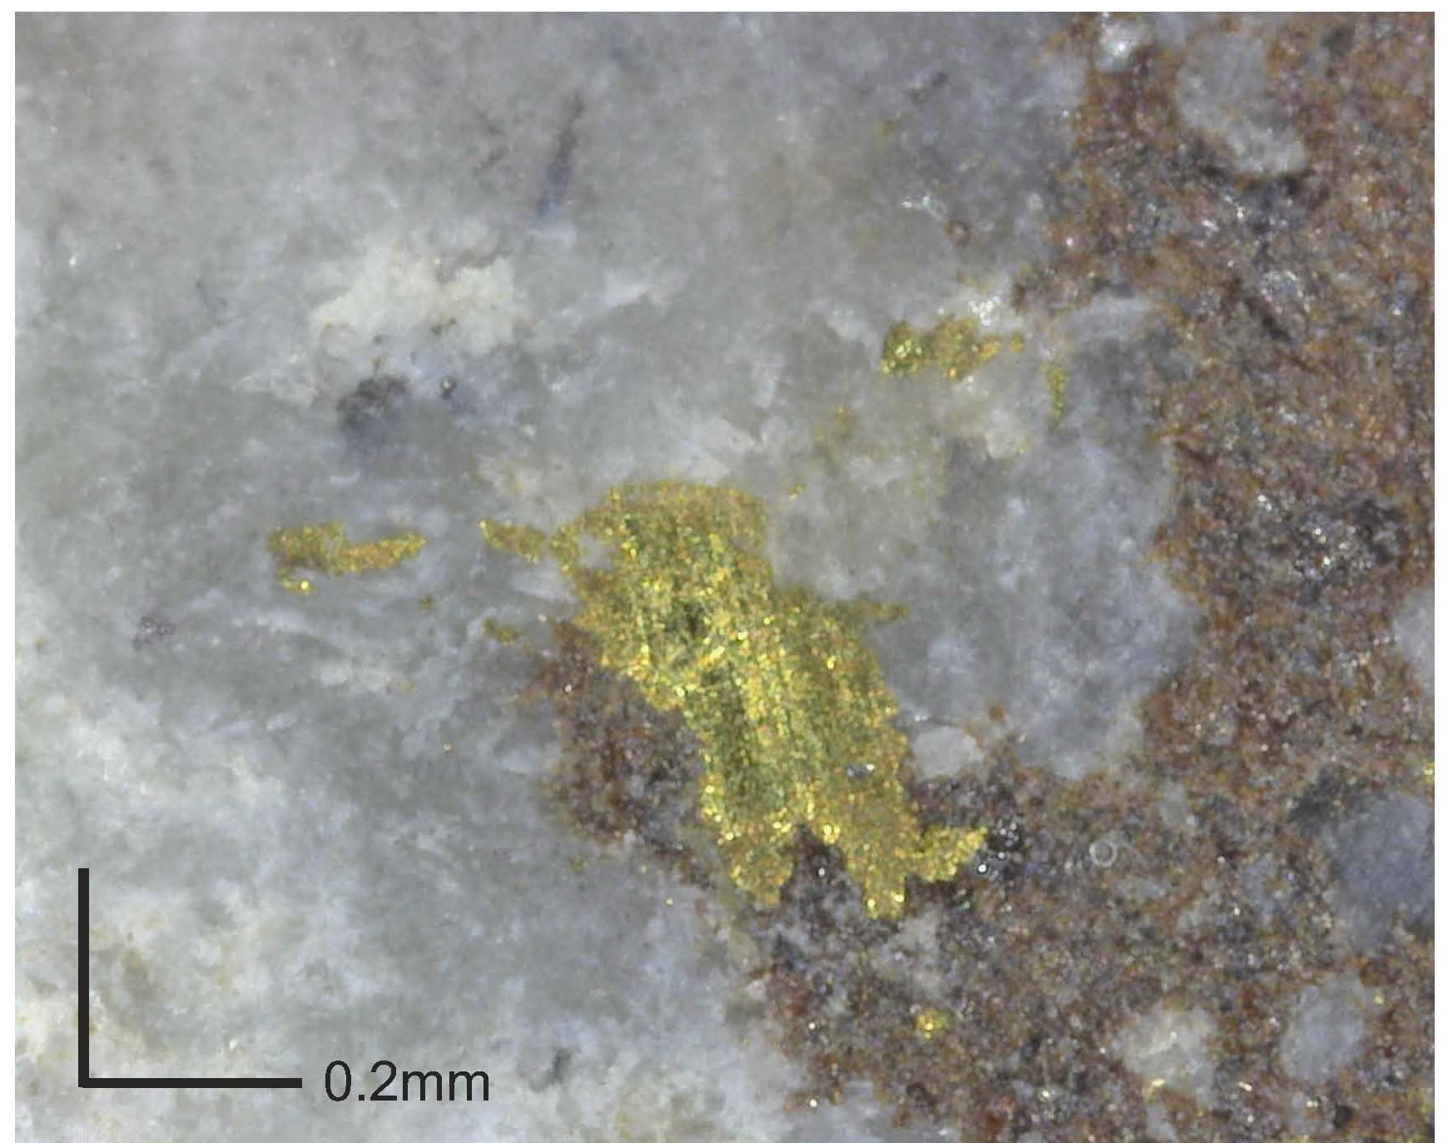
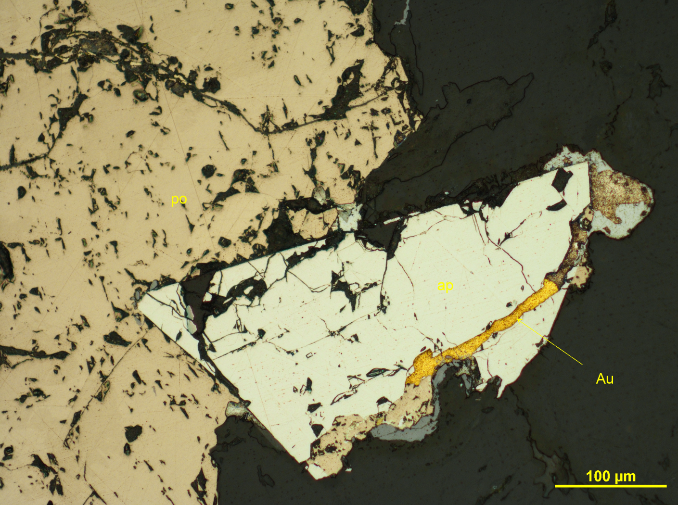
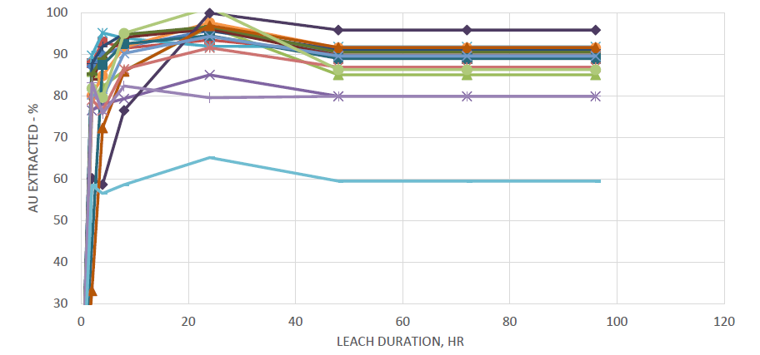
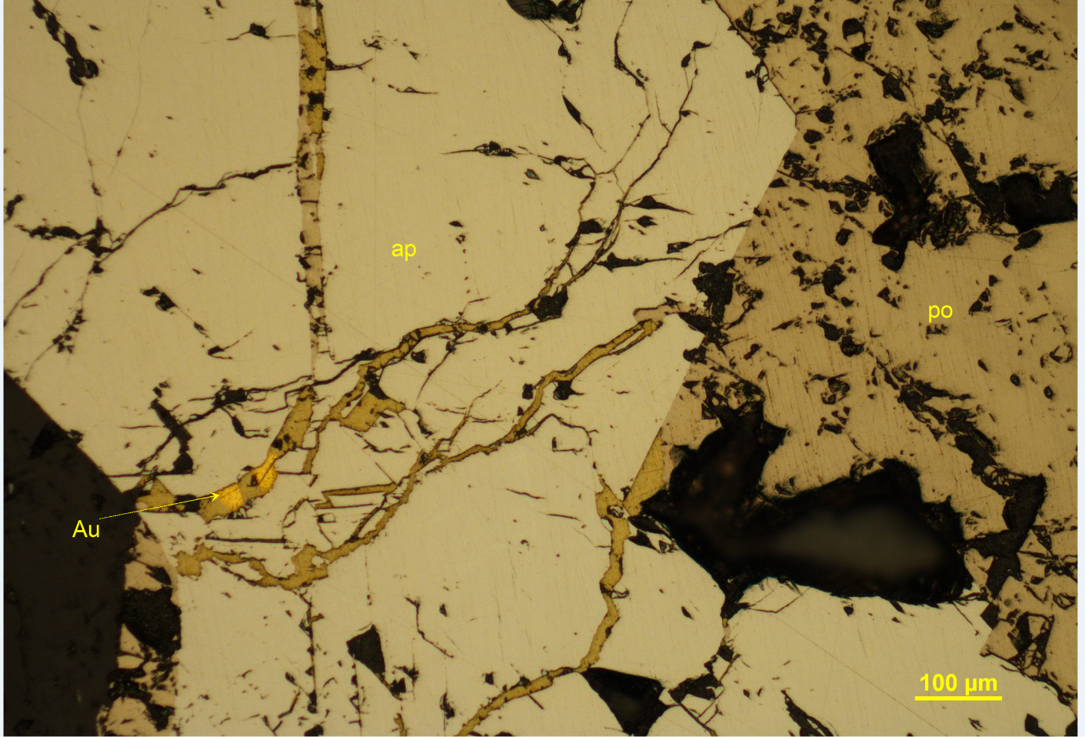
METALLURGy – 90% GOLD EXTRACTIONS
90% average recovery from Airstrip and Powerline (Oxide and Sulphide) Bottle Rolls on Pulps - Forte Analytical, Colorado
Additional work underway
VAT testing – by size fraction
Gold Deportment Studies
Bottle Rolls
Column Tests for 2023
Visible Gold
Not refractory
Rapid leaching
Gold in fractures
10 Airstrip Zone samples gold extraction ranged from 80% to 96%, average 90%
5 Powerline Zone samples gold extraction ranged from 86% to 92%, average 89%

Slide 16
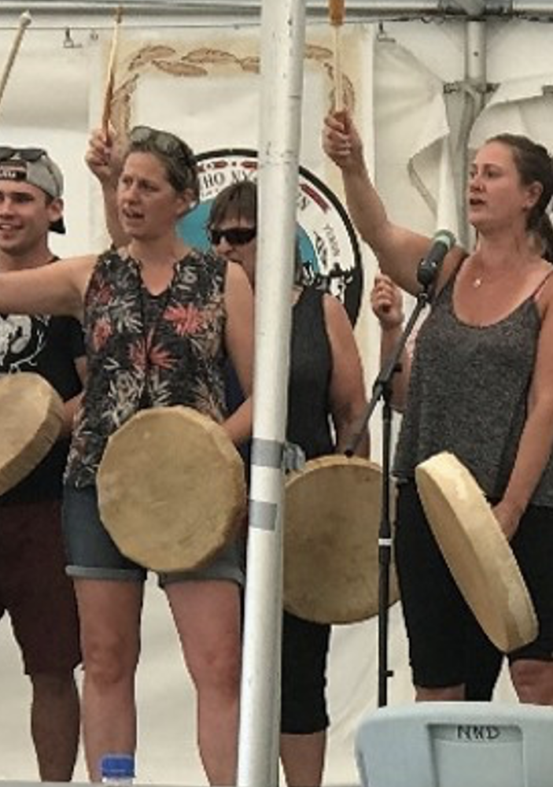
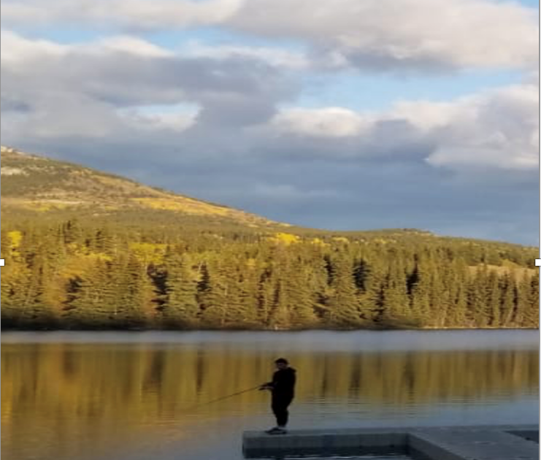
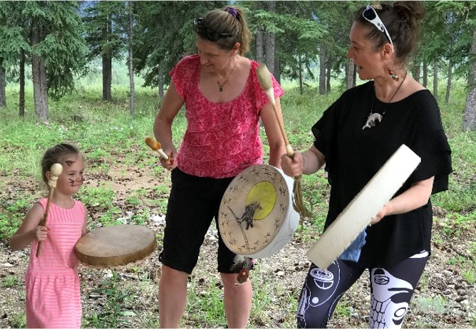
NEXT GENERATION EXPLORER
ENVIRONMENT
SOCIAL
GOVERNANCE
Exceed industry best practices
Minimize roads and trails – winter work
Baseline – 2 years
Permit to May 2028
Baseline surveys/ extensive regional data
Powerlines to Hydroelectric dam Reduce footprint (re-use oil, metal utensils
Making a difference in community
Every Student, Every Day
Training
Safety
Strong relationships
Local labour
Code of Conduct
Fiscal management
Diversity
Over $1,500,000 distributed - to fund projects to help address student attendance – all across the Yukon

Slide 17
THE ROAD AHEAD
2023
2024+
2017
2018
2019
2020
2021
2022
Update Resource
Increase ounces
De-risk
Project
+20,000 m Drill program
Option AurMac Underlying Properties
Re-log Core
Examine Old data
Drill program 1,422m
Refine Geological Model
Drill program 1,326 m
Test Geological Model
New Discovery at Powerline
Fall Financing
Drill program 4,835 m
903,000 Oz.
Au at 0.54
Begin Baseline Environmental and Metallurgical work
Drill program 10,000 m
16M Financing
Expansion of Powerline Mineralization, Aurex Hill
Baseline Environmental & Metallurgical work
Drill program 30,000 m
4 Million Oz Resource
Baseline Environmental
& Metallurgy
Geotechnical
Drill program +50,000 m
PEA
Feasibility Study
Environmental Assessment
& Start Permitting
17

Slide 18
WHY INVEST IN BANYAN?
PERFECT STORM FOR RE-RATE
(EXTERNAL DRIVERS)
CATALYSTS
LACK OF PROJECTS +6M Oz
In a Tier 1 Location
Existing Infrastructure – lower capital
VICTORIA GOLD & HECLA MINING
COMPELLING CURRENT VALUATION
Approx. $15/oz enterprise value
YEAR-ROUND EXPLORATION
<$5/ounce – advance rapidly
EXPLORATION RESULTS
Year-Round News
Funded for 2023 Drill program
4 M Oz INFERRED RESOURCE
50,000m DRILL PROGRAM UNDERWAY
Resource Expansion
Higher Grade Starter Area(s)
Regional Targets
Metallurgy and Technical Work
INCREASING OZ & QUALITY
4M
50K+

