Slide 1

Turbo-Charged by Copper
Increasing Au & Ag Production
Decreasing Cost /oz
Reducing Debt
John Tumazos
Very Independent Research Conference
April 12, 2023

Slide 2
Cautionary Statement
This presentation and the information included herein do not constitute an offer to buy or the solicitation of an offer to subscribe for or to buy any of the securities described herein, nor shall there be any sale of these securities in any jurisdiction in which such offer, solicitation or sale would be unlawful prior to registration or qualification under the securities laws of any such jurisdiction.
This presentation contains certain forward-looking statements and information, including "forward-looking statements" within the meaning of the Private Securities Litigation Reform Act of 1995 ("Forward-looking Statements"). The Forward-looking Statements are intended to be subject to the safe harbor provided by Section 27a of the Securities Act of 1933, Section 21e of the Securities Exchange Act of 1934 and Private Securities Litigation Reform Act of 1995. The Forward-looking Statements express, as at the date of this presentation, McEwen Mining Inc. (the "Company") estimates, forecasts, projections, expectations or beliefs as to future events and results. Forward-looking Statements are necessarily based upon a number of estimates and assumptions that, while considered reasonable by management, are inherently subject to significant business, economic and competitive uncertainties, risks and contingencies. There can be no assurance that such statements and information will prove to be accurate. Therefore, actual results and future events could differ materially from those anticipated in such statements and information. Risks and uncertainties that could cause results or future events to differ materially from current expectations expressed or implied by the Forward-looking Statements include, but are not limited to, factors associated with fluctuations in the market price of precious metals, mining industry risks, political, economic, social and security risks associated with foreign operations, the ability of the corporation to receive or receive in a timely manner permits or other approvals required in connection with operations, risks associated with the construction of mining operations and commencement of production and the projected costs thereof, risks related to litigation, the state of the capital markets, environmental risks and hazards, uncertainty as to calculation of mineral resources and reserves, risk of delisting from a public exchange, and other risks. Readers should not place undue reliance on Forward-looking Statements, which speak only as of the date hereof. The Company undertakes no obligation to reissue or update Forward-looking Statements as a result of new information or events after the date hereof, except as required by law. See McEwen Mining's Annual Report on Form 10-K/A for the fiscal year ended December 31, 2022, the Quarterly Report on Form 10-Q for the quarter ended March 31, 2022, June 30, 2022, September 30, 2022 and other filings with the Securities and Exchange Commission (the “SEC”), under the caption "Risk Factors", for additional information on risks, uncertainties and other factors relating to the Forward-looking Statements. All Forward-looking Statements made in this presentation are qualified by this cautionary statement. Unless otherwise stated, all currency information quoted in this presentation is in U.S. dollars.
The technical contents of this presentation, including reserves, have been reviewed and approved by William Shaver, COO; the exploration technical contents of this presentation including resources content have been reviewed and approved by Stephen McGibbon, EVP Exploration and Luke Willis, P. Geo., Director of Resource Modelling; all are Qualified Persons as defined by Canadian Securities Administrators National Instrument 43-101 "Standards of Disclosure for Mineral Projects".
Securities and Exchange Commission (“SEC”).We are subject to the reporting requirements of the Securities and Exchange Act of 1934, as amended (the “Exchange Act”) and applicable Canadian securities laws, and as a result, we have reported our mineral reserves and mineral resources according to two different standards. U.S. reporting requirements are governed by Item 1300 of Regulation S-K (“S-K 1300”), as issued by the U.S. Securities and Exchange Commission (“SEC”). Canadian reporting requirements for disclosure of mineral properties are governed by National Instrument 43-101 Standards of Disclosure for Mineral Projects (“NI 43-101”), as adopted from the definitions provided by the Canadian Institute of Mining, Metallurgy and Petroleum. Both sets of reporting standards have similar goals in terms of conveying an appropriate level of confidence in the disclosures being reported, but the standards embody slightly different approaches and definitions. All disclosure of mineral resources and mineral reserves in this report are reported in accordance with S-K 1300.
Investors should be aware that the estimation of measured resources and indicated resources involve greater uncertainty as to their existence and economic feasibility than the estimation of proven and probable reserves, and therefore investors are cautioned not to assume that all or any part of measured or indicated resources will ever be converted into S-K 1300- compliant reserves. The estimation of inferred resources involves far greater uncertainty as to their existence and economic viability than the estimation of other categories of resources, and therefore it cannot be assumed that all or any part of inferred resources will ever be upgraded to a higher category. Therefore, investors are cautioned not to assume that all or any part of inferred resources exist, or that they can be mined legally or economically.

Slide 3
MUX: Cautionary Note Regarding
NON-GAAP Measures
In this presentation, we have provided information prepared or calculated according to U.S. GAAP, as well as provided some non-U.S. GAAP ("non-GAAP") performance measures. Because the non-GAAP performance measures do not have any standardized meaning prescribed by U.S. GAAP, they may not be comparable to similar measures presented by other companies.
Total Cash Costs per GEO, and All-in Sustaining Costs (“AISC”) per GEO.
Total cash costs consist of mining, processing, on-site general and administrative costs, community and permitting costs related to current explorations, royalty costs, refining and treatment charges (for both doré and concentrate products), sales costs, export taxes and operational stripping costs. All-in sustaining cash costs consist of total cash costs (as described above), plus environmental rehabilitation costs, amortization of the asset retirement costs related to operating sites, sustaining exploration and development costs, and sustaining capital expenditures. In order to arrive at our consolidated all-in sustaining costs, we also include corporate general and administrative expenses. Depreciation is excluded from both total cash costs and all-in sustaining cash costs. For both total cash costs and all-in sustaining costs we include our attributable share of total cash costs from operations where we hold less than a 100% economic share in the production, such as MSC, where we hold a 49% interest. Total cash cost and all-in sustaining cash cost per GEO sold are calculated on a co-product basis by dividing the respective proportionate share of the total cash costs and all-in sustaining cash costs for the period attributable to each metal by the ounces of each respective metal sold. We use and report these measures to provide additional information regarding operational efficiencies both on a consolidated and an individual mine basis, and believe that these measures provide investors and analysts with useful information about our underlying costs of operations. A reconciliation to the nearest U.S. GAAP measure is provided in McEwen Mining's Annual Report on Form 10-K/A for the year ended December 31, 2022.
Earnings from Mining Operations
The term Earnings from Mining Operations used in this presentation is a non-GAAP financial measure. We use and report this measure because we believe it provides investors and analysts with a useful measure of the underlying earnings from our mining operations. We define Earnings from Mining Operations as Gold and Silver Revenues from our El Gallo Mine, Black Fox Mine, and our 49% attributable share of the San José Mine's Net Sales, less their respective Production Costs Applicable to Sales. To the extent that Production Costs Applicable to Sales may include depreciation and amortization expense related to the fair value increments on historical business acquisitions (fair value paid in excess of the carrying value of the underlying assets and liabilities assumed on the date of acquisition), we deduct this expense in order to arrive at Production Costs Applicable to Sales that only include depreciation and amortization expense incurred at the mine-site level. The San José Mine Net Sales and Production Costs Applicable to Sales are presented, on a 100% basis, in Note 5 of McEwen Mining's Annual Report on Form 10-K/A for the year ended December 31, 2022.
Cash, Investments and Precious Metals
The term cash, investments and precious metals used in this presentation is a non‑GAAP financial measure. We report this measure to better understand our liquidity in each reporting period. Cash, investments and precious metals is calculated as the sum of cash, investments and ounces of doré held in inventory, valued at the London P.M. Fix spot price at the corresponding period. A reconciliation to the most directly comparable U.S. GAAP measure, Sales of Gold and Silver, is provided in McEwen Mining's Annual Report on Form 10-K/A for the year ended December 31, 2022.

Slide 4
Full Disclosure
CEO’s Financial Commitment
$220 M
17.3%
$1/ Yr
Investment ¹
Ownership
Salary
MUX Shares
Ownership Distribution
Top 10 Holders
Outstanding | : | 47.4 M
Fully Diluted | : | 50.9 M
ADTV ² | : | 386,000
Price | : | US$9.39
Market Cap | : | US$445 M
Rob McEwen | 8.2 M
Van Eck Associates | 2.1 M
Mirae Asset Global | 1.1 M
Jane Street | 0.6 M
ALPS Advisors | 0.6 M
BlackRock | 0.5 M
Vanguard | 0.5 M
AIFM Capital | 0.4 M
Geode Capital | 0.3 M
Two Sigma | 0.3 M
¹ - Rob McEwen’s investments: $140 million in McEwen Mining shares and $40 million (Aug 13, 2018 & Apr 5, 2022 press releases), plus $40 million in McEwen Copper shares
+ $15 million unsecured subordinated promissory note (April 5, 2022 press release"). ² - Average Daily Trading Volume over 3 months. Source: Bloomberg, as of April 11, 2023.

Slide 5
The Sun Is Starting to Shine Again!
After 3 Horrible Years
Up 225%, Sep 27, 2022 – Apr 11, 2023. With Still a Lot of Room on the Upside
Share
Price
US$
As of Apr 11, 2023. Source: Bloomberg.

Slide 6
Significant Developments
McEwen Mining
August 31, 2022
McEwen Copper Completes Oversubscribed US$82 Million Offering Including a US$25 Million Investment by Nuton, a Rio Tinto Venture
Bloomberg
August 31, 2022
McEwen Lands Rio Tinto Venture for Argentina-Focused Copper Unit
Rio’s copper leaching technology venture takes 10% stake for US$25 Million
Mining Journal
September 6, 2022
McEwen Signs Another Rio Earn-in Deal
McEwen Copper entered option agreement for Rio Tinto to earn 60% interest in Elder Creek property, Nevada, USA by spending US$18 Million over 7 years
McEwen Copper
February 27, 2023
McEwen Signs Deals with Rio & Stellantis Totalling US$185 Million
Closing of a US$155 Million investment by Stellantis (Arg$30B), one of the world’s leading and most innovative automakers and mobility providers &
Signing a binding agreement for US$30 Million investment by Nuton, a Rio Tinto Venture and existing shareholder of McEwen Copper

Slide 7
Selected Proforma Financial Information
Post Purchases of McEwen Copper by Stellantis & Rio Tinto’s Nuton
Impact on McEwen Copper
Increased Implied Value
from $260 M to $550 M
Impact on MUX
Stronger Balance Sheet
Ownership of McEwen Copper reduced
Value of Ownership Increased by 80%
Reducing Debt by 38%
Unconsolidated Cash²
from 68.1% to 51.9%
from $160 M to $290 M
($3.14 to $5.70/ shr¹)
from $65 M to $40 M
$30 M
1 – calculation per fully diluted MUX shares; 2 – as of Mar 31, 2023

Slide 8
We Believe MUX’s Share Value Is:
US $8 and $34
Between
Share Price $9.39
Apr 11, 2023
Current
Based on recent market valuations / transactions

Slide 9
Possible Share Value of MUX
Sum of the Parts
MUX’s Assets | MUX’s Assets |  | Value Range Per MUX Share¹
 |  |  | Low |  | High
McEwen Copper² | Los Azules |  | $2.47³ |  | $23.20⁴
 | Elder Creek |  | $0.31⁵ |  | $0.31⁵
Royalty Portfolio |  |  | $0.69⁶ |  | $0.69⁶
Gold & Silver |  |  | $4.66⁷ |  | $9.32⁸
 |  |  | $8.15 |  | $33.54
Notes
McEwen Mining has 51 million fully diluted shares
McEwen Mining owns 51.9% of McEwen Copper which owns 100% of Los Azules and Elder Creek
Josemaria purchase price was US $485 million. (US $485M x 50% x 51.9%) / 51M
Filo Mining market capitalization US $2.28 billion. (US $2.28 B x 51.9%) / 51M. As of April 11, 2023.
Elder Creek value is based on earn-in (($18M / 60%) x 51.9%) / 51M
Royalties: 1.25% NSR on Los Azules and Elder Creek, plus three other royalties. Est. $35M / 51M
Average peer group EV/GEO x 50% of the high value
Average peer group (Jaguar Mining, Silvercorp, Fortitude, Gold Resource, Endeavour Silver) EV/GEO multiple 1.11 x higher than MUX

Slide 10
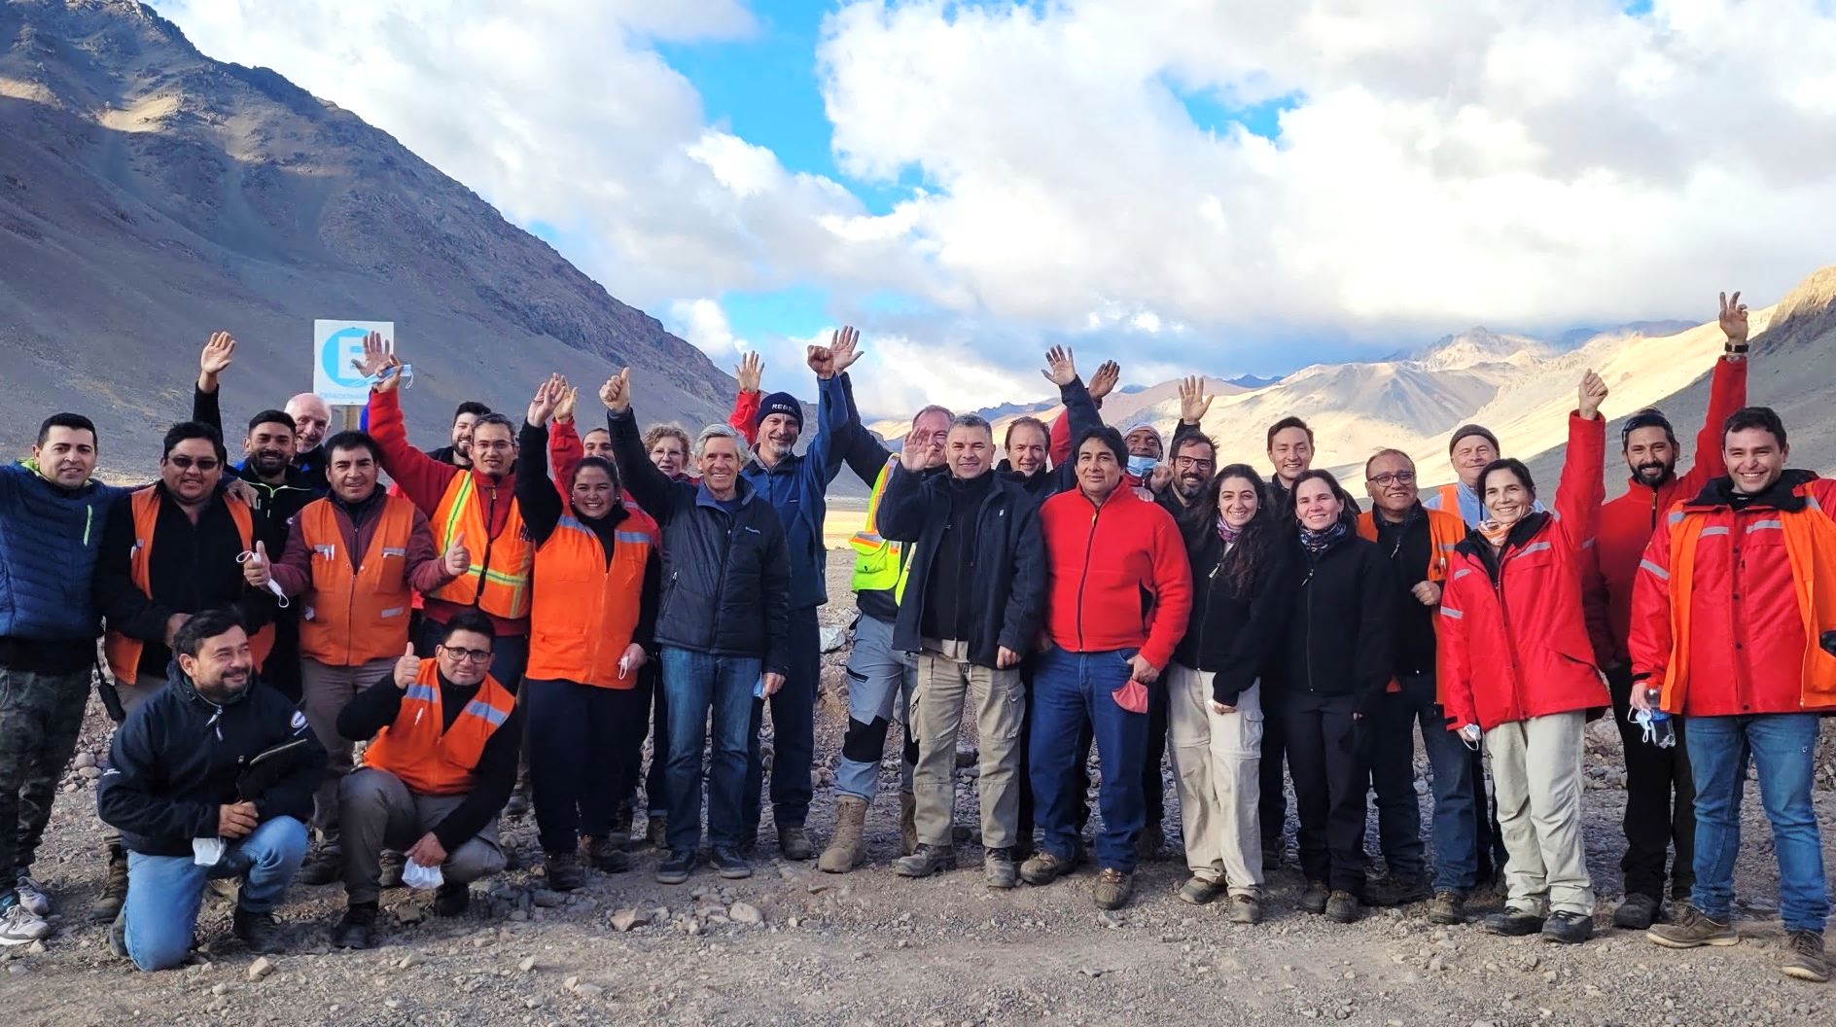


Slide 11
McEwen Copper Ownership
McEwen Copper Total Shares Outstanding 28.9 M
McEwen Copper owns 100% of the Los Azules and the Elder Creek copper projects
Elder Creek was optioned by Kennecott Exploration Co, a subsidiary of Rio Tinto, to earn 60% interest in the property by spending US $18 million over a 7-yr period.

Slide 12
Los Azules
It’s Amongst the World's Largest
Chile & Peru Produce 40% of World’s Annual Copper Production
PERU
Rank*
Legend
Antamina Teck
Las Bambas MMG
Antapaccay Glencore
Cerro Verde Freeport-McMoRan
6
8
5
MINE
DEVELOPMENT
Taca Taca First Quantum
Escondida BHP/Rio Tinto
Lindero Fortuna Silver
MARA Yamana Glencore & Newmont
1
ARGENTINA
Josemaria Lundin Mining
Filo del Sol Filo Mining (BHP)
Pascua Lama Barrick
Veladero Barrick Shandong
CHILE
11
11
Los Azules McEwen Copper
(MUX, Rio Tinto, Stellantis)
Los Pelambres Antofagasta
Andina Codelco
Los Bronces Anglo American
San Juan
Altar Aldebaran Resources
El Pachón Glencore
*Rank based on 2021 top 20 largest copper mines in the world by production capacity. https://elements.visualcapitalist.com/the-largest-copper-mines-in-the-world-by-capacity/

Slide 13
Los Azules
It’s BIG!
World’s 9th Largest Undeveloped Copper Project
 | Project | Country | Majority Owner | Development Status | Geology
1 | Pebble | United States | Northern Dynasty Minerals | Preliminary Economic Assessment | Porphyry, Supergene Copper
2 | Resolution | United States | Rio Tinto | Feasibility | Porphyry
3 | La Granja | Peru | Rio Tinto | Advanced Exploration | Porphyry
4 | Kerr-Sulphurets-Mitchell (KSM) | Canada | Seabridge Gold | Prefeasibility | Porphyry, Skarn
5 | Nueva Union | Chile | Teck Resource/Newmont | Prefeasibility | Porphyry
6 | Tampakan | Philippines | Sagittarius | Feasibility | Porphyry
7 | El Pachon | Argentina | Glencore | Advanced Exploration | Porphyry
8 | Lessard | Canada | Landore Resources | Advanced Exploration | Volcanic Hosted Massive Sulfide
9 | Los Azules | Argentina | McEwen Copper | Preliminary Economic Assessment | Porphyry, Supergene Copper
10 | Twin Metals Minnesota | United States | Antofagasta | Prefeasibility | Magmatic Sulfide
Source: Mining Intelligence 2022
Notes: | Pebble and KSM are also ranked top 10 for gold Lessard has only inferred resources, as no work has been done on the project since 2008

Slide 14
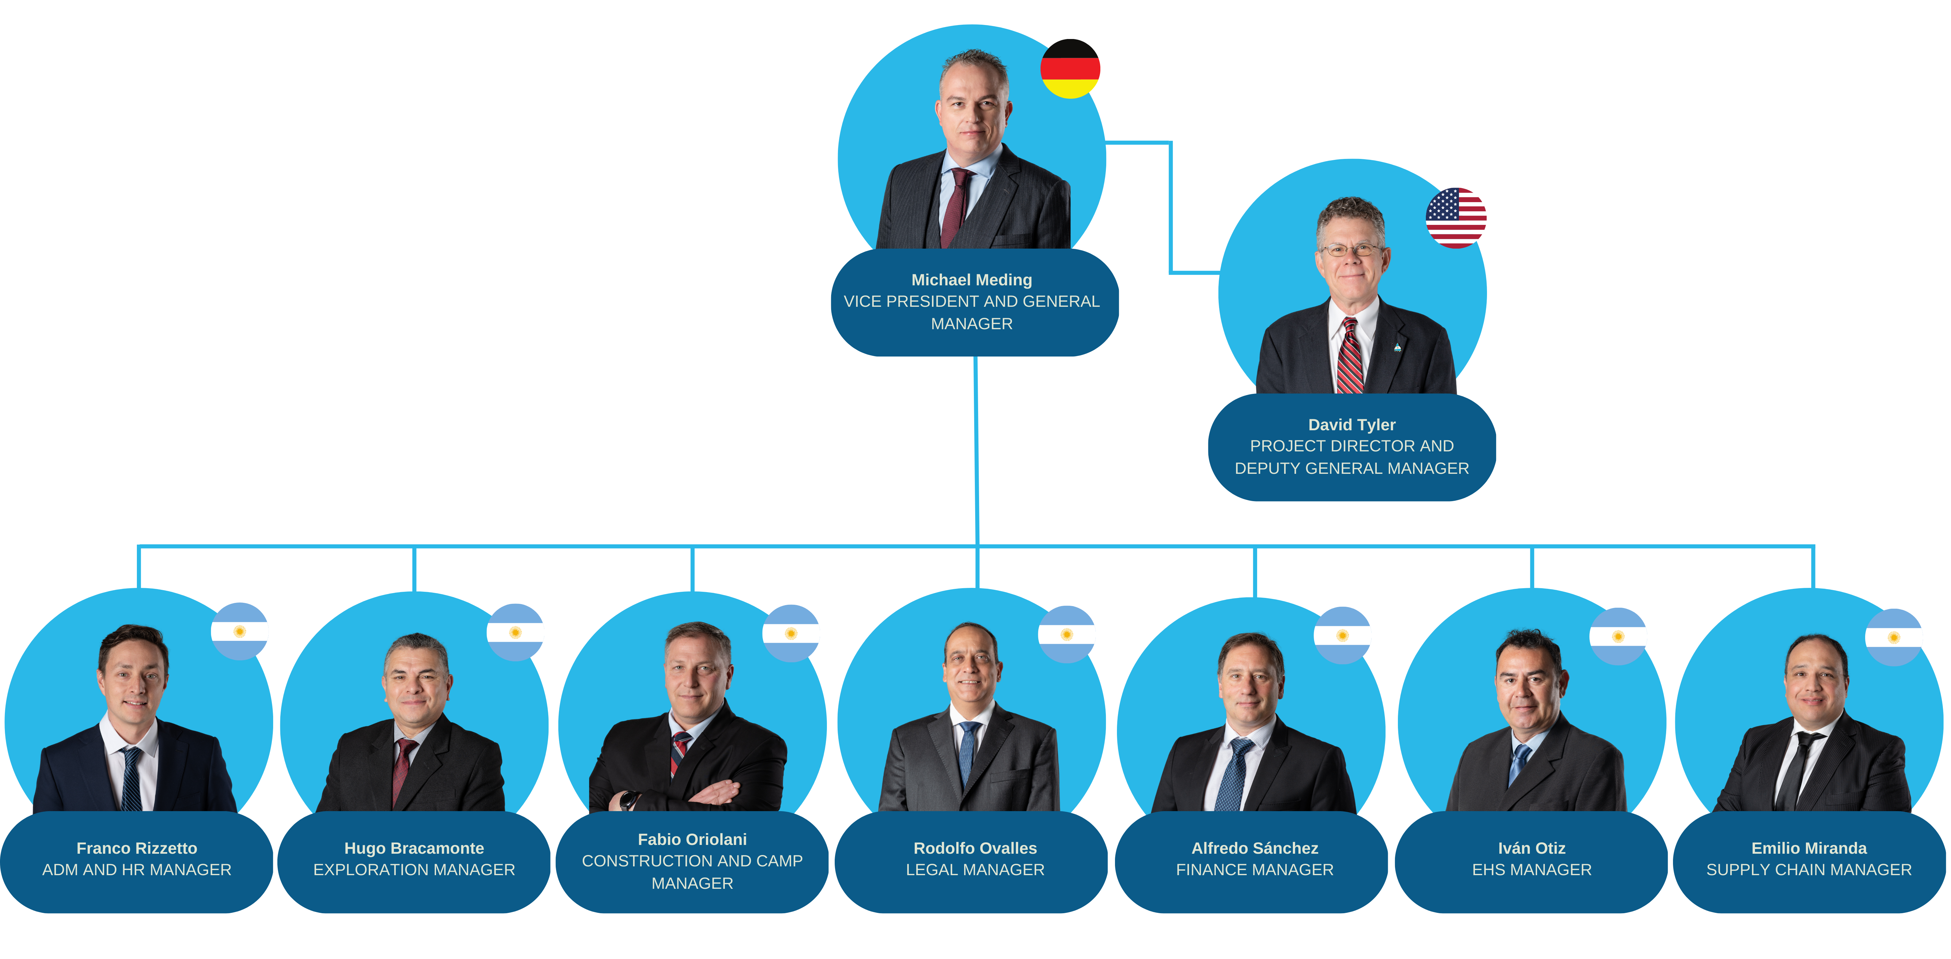
Los Azules Org Chart – Executive Team
Strong Local Management Experience
180 years of combined experience in mining projects and Operations.
Strong team with experience in San Juan Argentina at tier one operations

Slide 15







Los Azules
Robust Economics
Highlights of the 2017 PEA¹ (Hatch Engineering)
Being Updated
Q2 2023
Avg. Annual Production 1st 13 Years | 415 Million lbs Cu at $1.14/lb cash cost
Mine Life | 36 years
Initial Capex | $2.4 Billion
Base Case Cu Price | $3.00/lb
Payback | 3.6 years
After-Tax IRR | 20.1%
After-Tax NPV 8% | $2.2 Billion
The 2023 PEA will be published in Q2 and foresees initial long life copper cathode production
1. NI 43-101 Technical Report-Preliminary Economic Assessment Update for the Los Azules Project, Argentina. September 1, 2017.

Slide 16
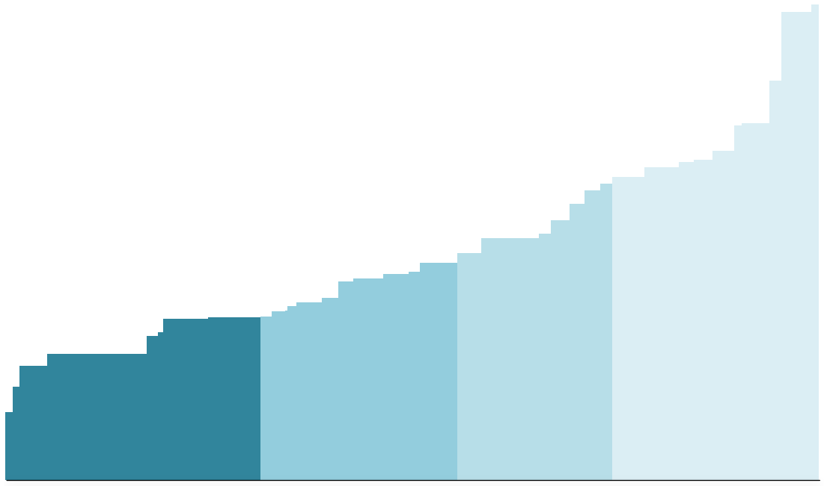
Los Azules
Low Cost!
Lowest Cost Quartile
14,000
13,000
12,000
11,000
10,000
9,000
8,000
7,000
6,000
5,000
4,000
3,000
2,000
7
King King
Aynak
#
2022 Mining Intelligence ranking of size of resource
Josemaria
6
Cerro Casale
Centinala DMC
El Pachon
Price Required at Risked-IRR (12%)*
Taca Golpe
Andina Phase 2
Wafi Golpu
Required Copper Price (US$/t Cu)
Frieda RIver
Los Pelambres 205
Tampakan
Zafranal
Quebrada Blanca II
4
3
Cristalino
Cotabambas
Inca de Oro
Agua Rica
Udokan
La Granja
Los Calatos
Mina Justa
Spot Copper Price
Schaft Creek
9
5
Michiquillay
Collahuasi GL4
Haquira
Radomiro Tomic
2
Kerr-Sulphurets-Mitchell
Kansanshi Sulphide
Cuajone
Koksay
Los Helados
Ajax
Galeno
Ann Mason
Rosemont
Kamoa-Kakula
Nueva Union
Harper Creek
Canaria Norte
Resolution
San Nicolas
Los Azules
1
Salobo 3
Los Chancas
Galore Creek
El Abra Mill
Pebble
Al Arco
Tenke Phase 3
New Prosperity
Q1
Q2
Q3
Q4
Source: Oct 4, 2018 Copper Top Projects Report by Goldman Sachs Global Investment Research.
*According to Apr 13, 2021 Goldman Sachs Report. Based on Los Azules 2017 PEA
Cumulative Production (Paid kt Cu)

Slide 17

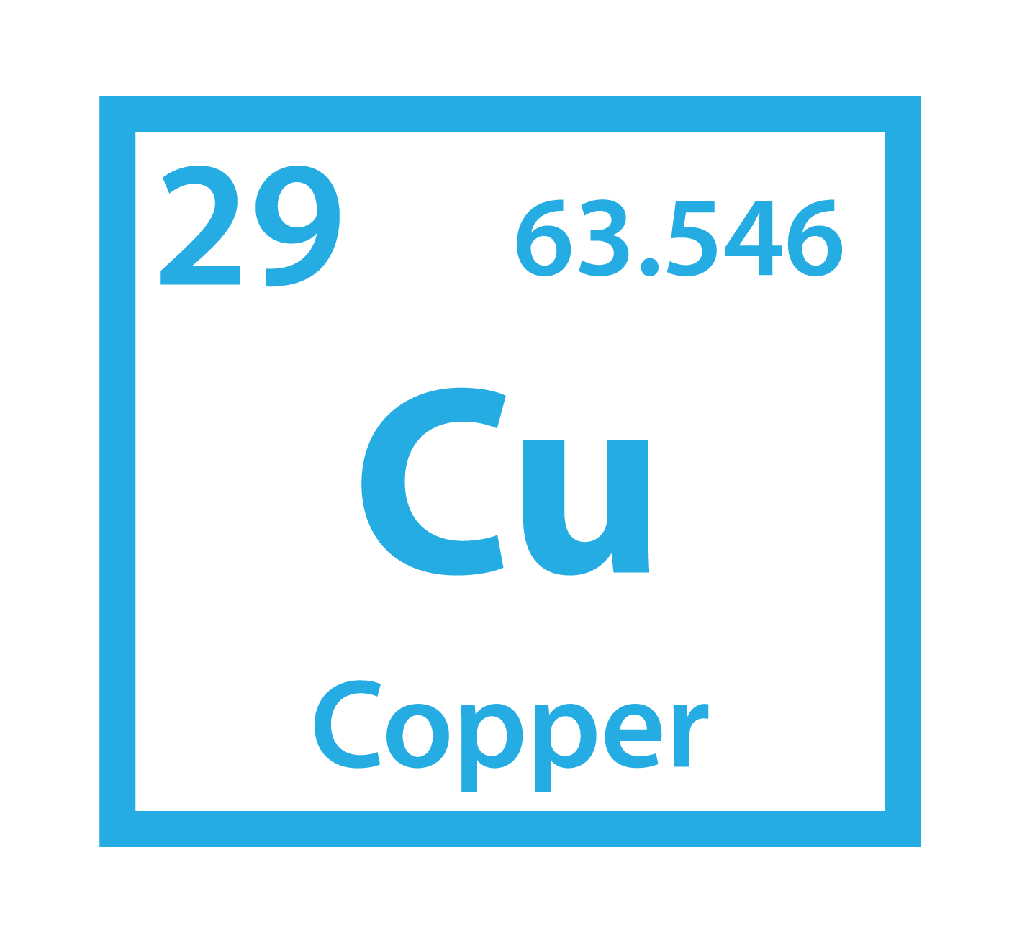

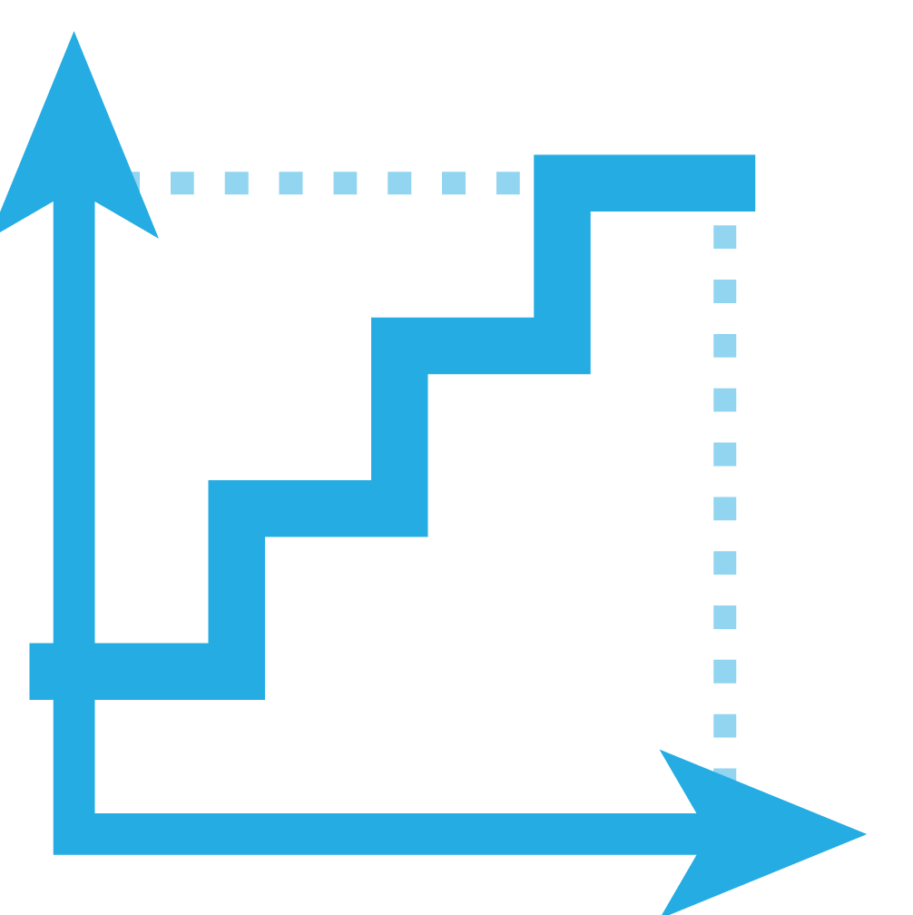
Los Azules
It’s Valuable
Between 2 Value Reference Points, US$485 M and $2.28 B
McEwen Copper's implied market cap US$550 M, based on financing announced Feb 27, 2023
Comparison of Los Azules With Filo Mining's Josemaria & Filo del Sol
In Same San Juan Province, Argentina
Altitude
ASL
Copper Resources & Grades¹
 | M&I |  | Inferred
Josemaria | 7.4 B lbs Cu | 0.29% | 2.9 B lbs Cu | 0.13%
Los Azules | 10.2 B lbs Cu | 0.48% | 19.3 B lbs Cu | 0.33%
Filo del Sol | 3.1 B lbs Cu | 0.33% | 1.0 B lbs Cu | 0.27%
Josemaria | 4,000 - 4,900 m³
Los Azules | 3,100 - 3,600 m
Filo del Sol | 4,900 - 5,400 m²
Distance From
Power Grid, Roads
Development Stage
$ Cost Quartile*
US$ Value⁴
$
Josemaria | - 244³ km
Los Azules | - 70 km
Filo del Sol | - 77² km (Chile)
Josemaria | - FS
Los Azules | - PEA
Filo del Sol | - PFS
Josemaria | - Highest
Los Azules | - Lowest
*Goldman Sachs | - PFS
Josemaria | - $485 M
Los Azules | - $550 M
Filo del Sol | - $2.28 B
Source: company website. Los Azules cut-off grade 0.20% Cu. Filo del Sol cut-off grade 0.15% CuEq. Josemaria cut-off grade 0.1% CuEq.
Source: Filo del Sol PFS Technical Report 22 Feb 2019. 3. Source: Josemaria FS Technical Report Nov 2020 4. Market cap as of April 11, 2023.

Slide 18
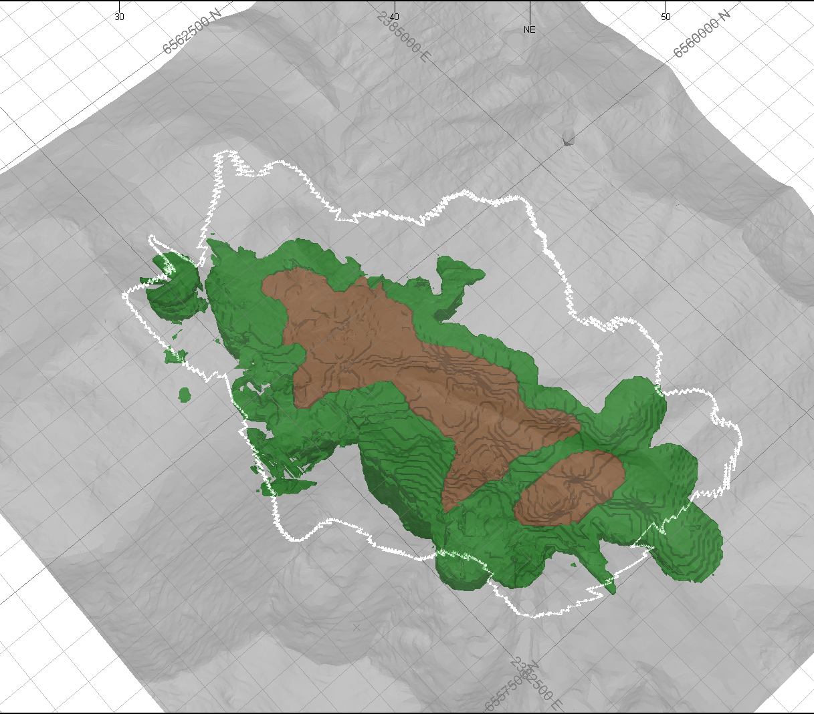
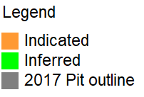
Los Azules – Drilling
Resources | Tonnes | Copper lbs | Gold oz | Silver oz
Indicated | 962 Million | 10.2 Billion 0.48% | 1.7 Million 0.06 g/t | 55.7 Million 1.8 g/t
Inferred | 2,666 Million | 19.3 Billion 0.33% | 3.8 Million 0.04 g/t | 135.4 Million 1.6 g/t
Drilling Objectives
Resource upgrade
Metallurgy, geotech and hydrology
Testing for extensions of the mineral resources
Oct 2022 – May 2023 Drill Campaign
97 holes completed to date
27,000 meters
Infill drilling to upgrade the resource categories from inferred to indicated to measured
See appendix for infill drill results and figures
0 1000m

Slide 19
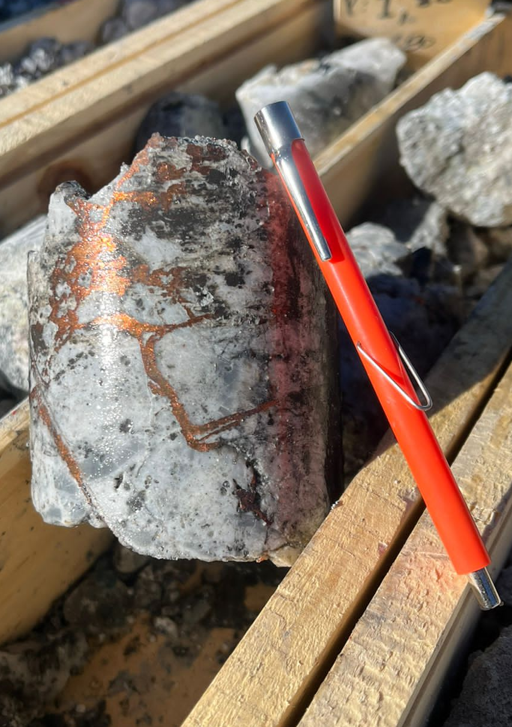
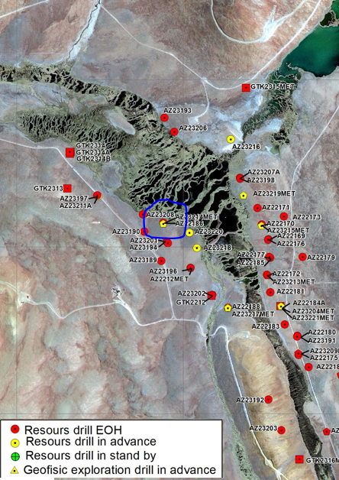
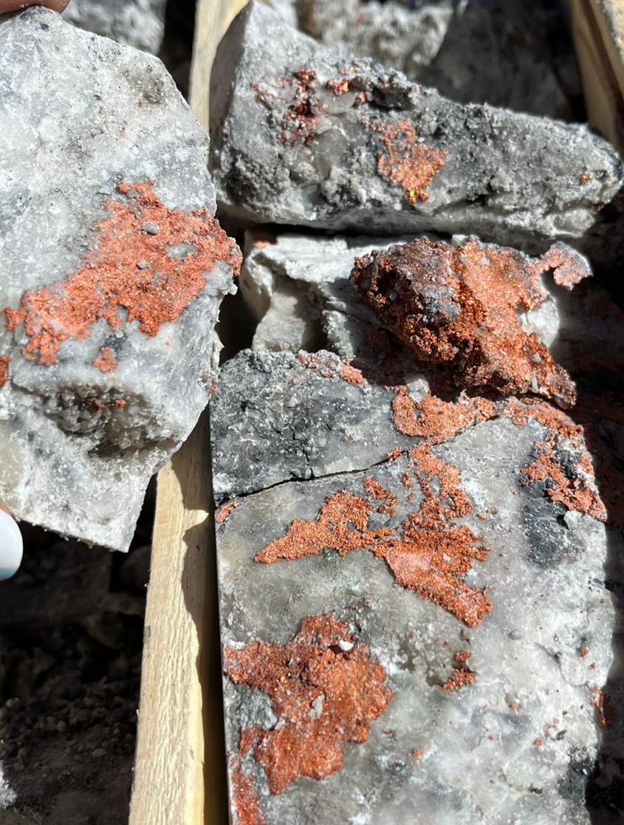
Los Azules - Initial Visual Results From Payback Pit
1. NI 43-101 Technical Report-Preliminary Economic Assessment Update for the Los Azules Project, Argentina. September 1, 2017.

Slide 20
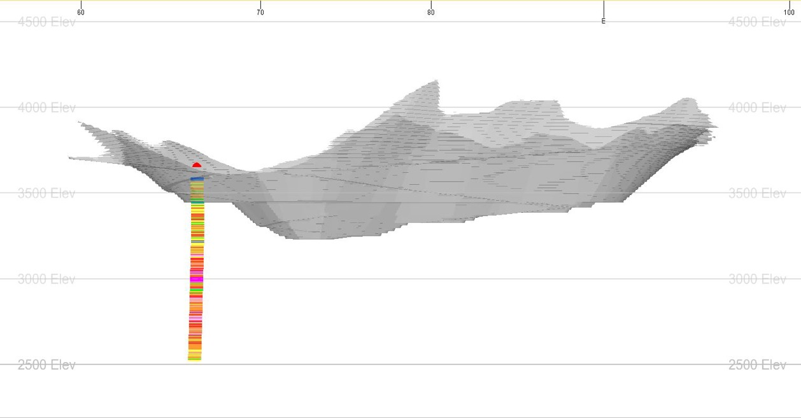
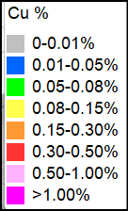
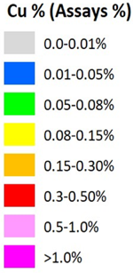
Los Azules
Recent Exploration Results – March 6, 2023
Exploration: 1,052 meters grading 0.29% Cu including 480 meters grading 0.42% Cu (AZ22174),
coincident with a prominent deep geophysical anomaly and showing the potential to meaningfully expand Los Azules
30-year PEA Pit (2017)
4000 m Elev
3500 m Elev
including 1.46% Cu over 26 m
3000 m Elev
0.29% Cu
1,052 m
0.42% Cu over 480 m
2500 m Elev
AZ22174 (1,128 m)
Longitudinal Section
1,000 meters
Looking East

Slide 21
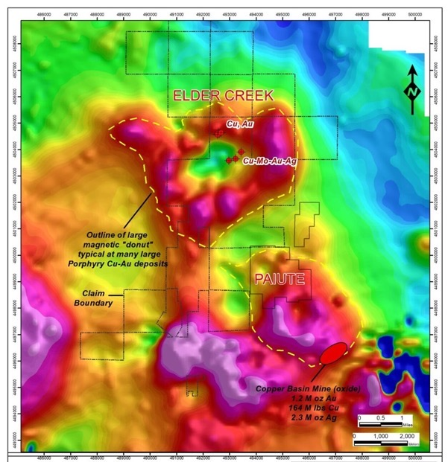
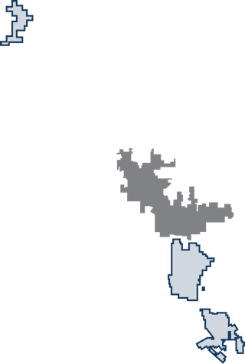
Elder Creek Project, Nevada
Classic Porphyry Copper – Gold Signature
Recently Optioned to Rio Tinto’s Subsidiary
Kennecott Exploration Company for US $18 M to earn 60% interest
McEwen Copper
Elder Creek
Airborne magnetics @ Elder Creek illustrate a classic porphyry system magnetic “donut” pattern
2018 Drill Highlights
0.21% Cu over 152.4 m including
0.44% Cu over 33.5 m
0.15% Cu over 200.3 m including
1.20% Cu over 14.2 m
Recent Drill Intersections
1.2% Cu over 14.2 m
0.25% Cu over 93.0 m
0.44% Cu over 33.5 m
Geochemical zoning & drilling suggest Cu porphyry system with Mo
Lone Tree
Marigold
Phoenix
Nevada Gold's largest Gold Mine
Cortez Pipeline
Cortez
Gold Rush Discovery
Battle Mountain Cortez Trend
MUX Tonkin
MUX
Gold Bar
N
0
10
20
Ruby Hill
Miles

Slide 22
VISION for Los Azules
To build a mine for the future based on regenerative principles and innovative technologies, that can achieve net-zero carbon emissions by 2038. We are committed to delivering green copper to Argentina and the world, a product that will contribute to the electrification of transportation and the protection of our atmosphere.
Will be used to advance our Los Azules Copper Project in San Juan, Argentina and to strengthen McEwen Mining’s balance sheet.
Recent Investments

Slide 23
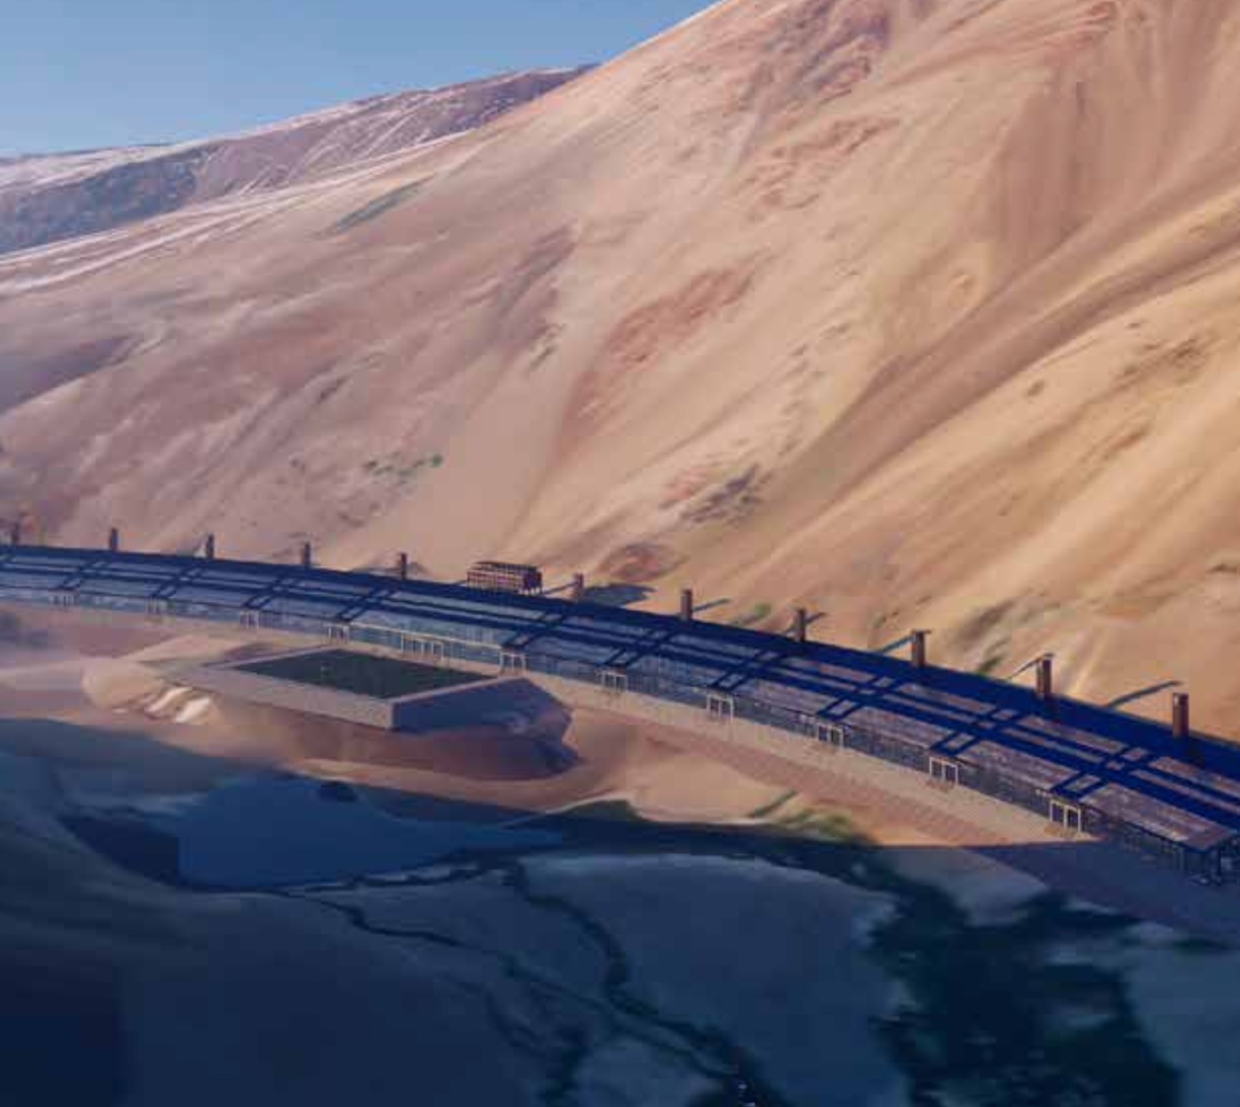


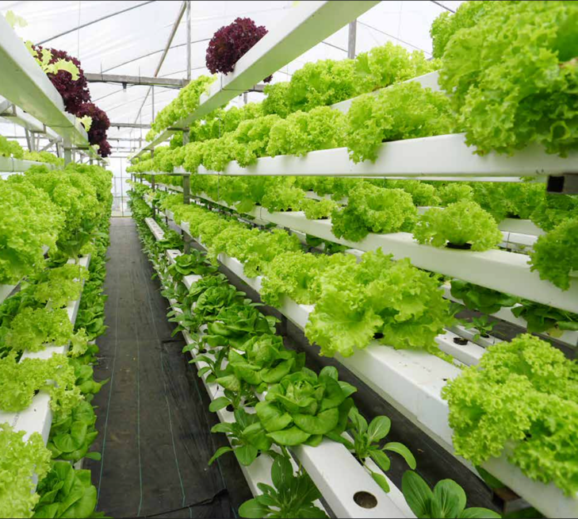
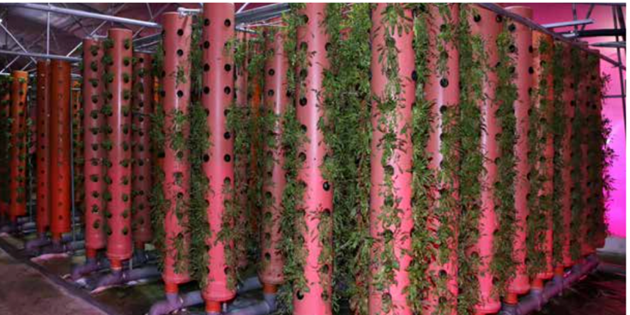
The Mine Camp Vision
The Los Azules Copper mine promises to be the
1st major copper mine in the world to be developed
around key regenerative principles.

Slide 24
MUX Properties
Asset Rich in Prime Real Estate
Au + Ag
3 Mines
Fox Complex (100%)
Gold Bar (100%)
San José (49%)
1 Development Project
El Gallo / Fenix (100%)
Elder Creek
Nevada
Fox Complex
Timmins, Canada (100%)
2023 Guidance
150,000-170,000 GEOs
Gold Bar
Nevada (100%)
Cu
El Gallo – Fenix Project
Mexico (100%)
Financings
McEwen Copper (51.9%)
Elder Creek
Los Azules
Aug 2022
US $82 Million @ $10/shr
Feb - Mar 2023
ARS $30 Billion &
US $30 Million
@ Approx. $19/shr
Los Azules
Argentina
San José
Argentina (49%)

Slide 25
MUX Production
 | 2021A | 2022A | 2023 Guidance | 2023 % Change²
Gold Bar Mine, Nevada
GEOs¹ | 43,900 | 26,620 | 42,000 – 48,000 | +58% to +80%
Cash Costs / GEO | $1,687 | $1,622 | $1,400 | -14%
AISC / GEO | $1,753 | $1,989 | $1,680 | -16%
Fox Complex, Canada
GEOs | 30,000 | 36,650 | 42,000 – 48,000 | +15% to +31%
Cash Costs / GEO | $1,108 | $1,020 | $1,000 | -1%
AISC / GEO | $1,461 | $1,465 | $1,320 | -10%
San José Mine, Argentina (49%)
GEOs | 76,100 | 69,130 | 66,000 – 74,000 | -5% to +7%
Cash Costs / GEO | $1,262 | $1,306 | $1,250 | -5%
AISC / GEO | $1,603 | $1,714 | $1,550 | -10%
Consolidated Production | 154,400 | 133,300 | 150,000-170,000 | +13% to +28%
1. Gold Equivalent Ounces are calculated based on 85:1 gold to silver price ratio. 2. Percentual change of 2023 relative to 2022.

Slide 26


Gold Bar – Premier Address
Gold Bar
Nevada, USA
On Trend - Similar Geology
Nevada Gold Mines
Cortez
50 M oz Au cluster¹
Criteria | Cortez & Gold Bar
Large footprint, shallow oxide gold | ✓
Host rock, alteration, mineralization style | ✓
Major faults, structural traps | ✓
Intrusions | ✓
Cortez
Four Mile Discovery
Goldrush
Cortez Fault
Legend
MUX Property
NGM Property
Faults
Mine or Deposit
Tonkin
Indicated Resource
1.45M oz @ 1.41 g/t
Gold Bar
Indicated Resource
452,000 oz Au @ 0.91 g/t
Historic & Recent Production
575,000 oz Au
Roberts Creek Fault
12 miles
Wall Fault
20 km
N
Atlas
1. Includes past production and current resources

Slide 27
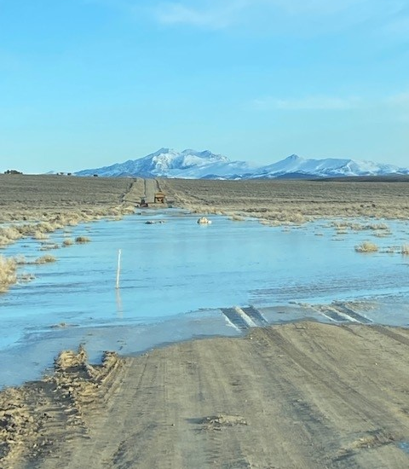
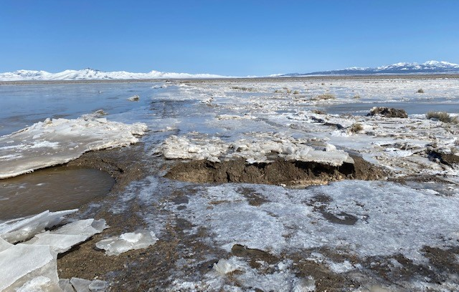
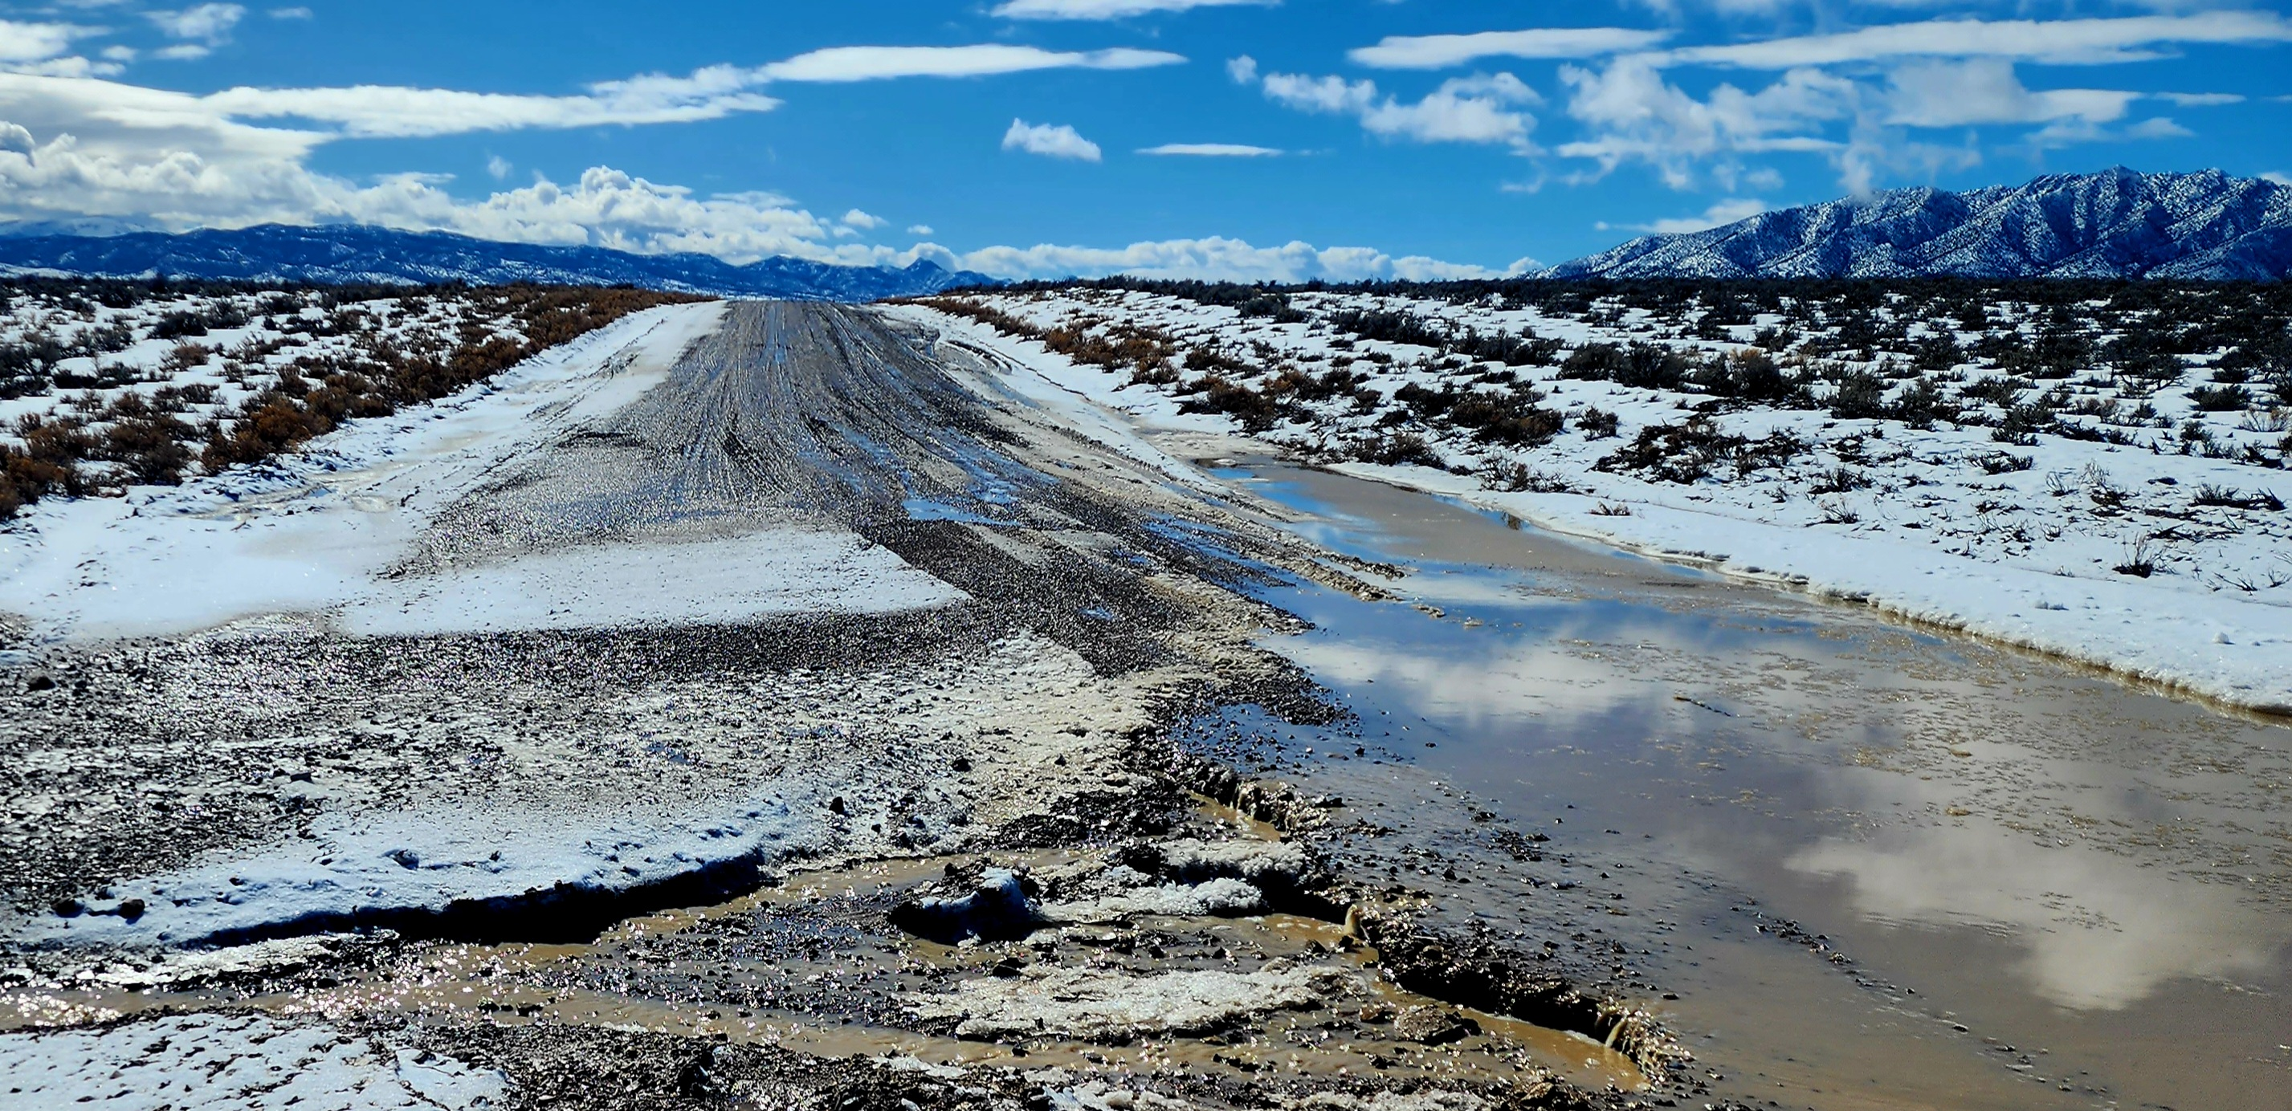
Gold Bar - Flood

Slide 28
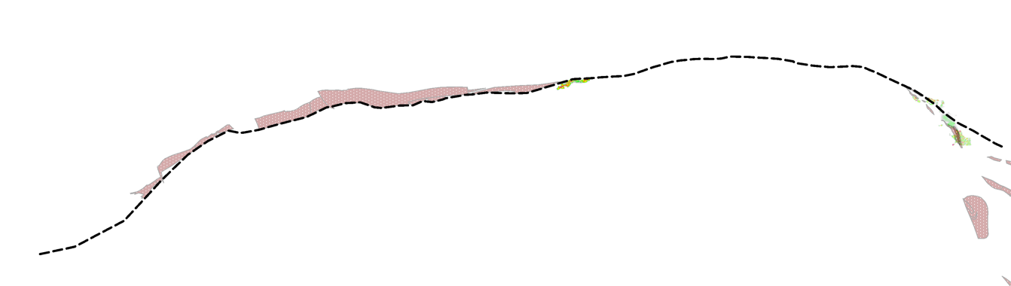

Fox Complex, Timmins - Another Great Address
Fox Complex
Ontario, Canada
70 million oz historic production in the Timmins Camp
>30 km of Primary & Secondary Structural Controls
3.3 M oz historic production including 1.0 M oz Fox East
Gold Resources: 1.90 M oz M+I @ 4.22 g/t, 0.49 M oz Inferred @ 3.86 g/t
$15 M Exploration Budget for 2023
Matheson
Fox
Stock Mine/Mill
(0.1M oz)
Fox East
Froome
Grey Fox
Black Fox
(1.0 M oz)
Destor-Porcupine Fault Zone
Timmins
M&I: 246,000 oz Au
Inferred: 109,000 oz Au
Fault Zone
Mine or Deposit
Temiskaming Sediments
Historic Production
6 miles
10 km
M&I: 1,431,000 oz Au
Inferred: 285,000 oz Au
Fox West
(2.2M oz)
N
M&I: 219,000 oz Au
Inferred: 91,000 oz Au
(1.0 M oz)
Notes:
Good afternoon all,
Our Fox Complex properties have more than 3.3M ounces of gold production and consistent exploration success. The map above shows our property locations well situated along the prolific Destor-Porcupine Fault Zone just south of Timmins, east of Matheson and at Stock property midway between the first two. The DPFZ and Temiskaming sediments are recognized as key geological elements associated with most of the 70 million ounces of gold that have been historically mined in this camp. These key geological elements reside on all three of our properties. Gold mineralization is structurally-controlled in primary faults and secondary splays in this region and we have more than 30-km of such structures on our properties.
Mineral resources on the Fox Complex properties include nearly two million ounces of gold in the Measured and Indicated categories and a further 500,000 ounces in Inferred. At the beginning of the year we earmarked some $7.5 M for exploration in 2022 and augmented that with a $16M flow-through financing in March.

Slide 29

Growth Potential @ Fox
Longer Mine Life, Higher Production, Lower Costs / oz
PEA Financial & Operating Metrics Post Froome Production (After-Tax):
Life of Mine (LoM) | 9.3 years
LoM Gold Production | 751,700 oz
Avg Annual Gold Production Over LoM | 80,800 oz
Avg Cash Costs per oz Over LoM | $769
Avg AISC per oz Over LoM | $1,246
Gold Price Sensitivity: | Downside Case $1,500/oz Au | Base Case $1,650/oz Au | Upside Case $1,800/oz Au
Net Present Value (5% discount) (NPV5%) | $81 million | $137 million | $192 million
Internal Rate of Return (IRR%) | 15% | 21% | 26%
Payback Period (Years) | 6.5 | 5.9 | 5.4

Slide 30

San José Mine
MUX 49% Ownership / Non-operator
Narrow Vein Underground Silver / Gold Mine
Large Property Package
Good Grade Mine
Surrounds Newmont’s Cerro Negro
Property
outline
San José
Argentina
San José
Mine
Reserve Grade ¹ | 342 gpt Silver 5.7 gpt Gold
Mine Life ² | 6 Years
2022E Production ^{3,4} | 2.6 - 2.7 Moz Silver & 38 - 40 Koz Gold
2023E Production ^{3,4} | 2.3 - 2.6 Moz Silver & 39 - 43 Koz Gold
Newmont
Cerro Negro Mine
2022 Production⁵
278,000 oz Au
12 miles
N
20 km
1., 2. Hochschild “Annual Report and Accounts 2021”. 3. Based on 49% MUX ownership basis. 4. MUX Dec 21, 2022 press release. 5. Newmont 2022 Annual Report.

Slide 31
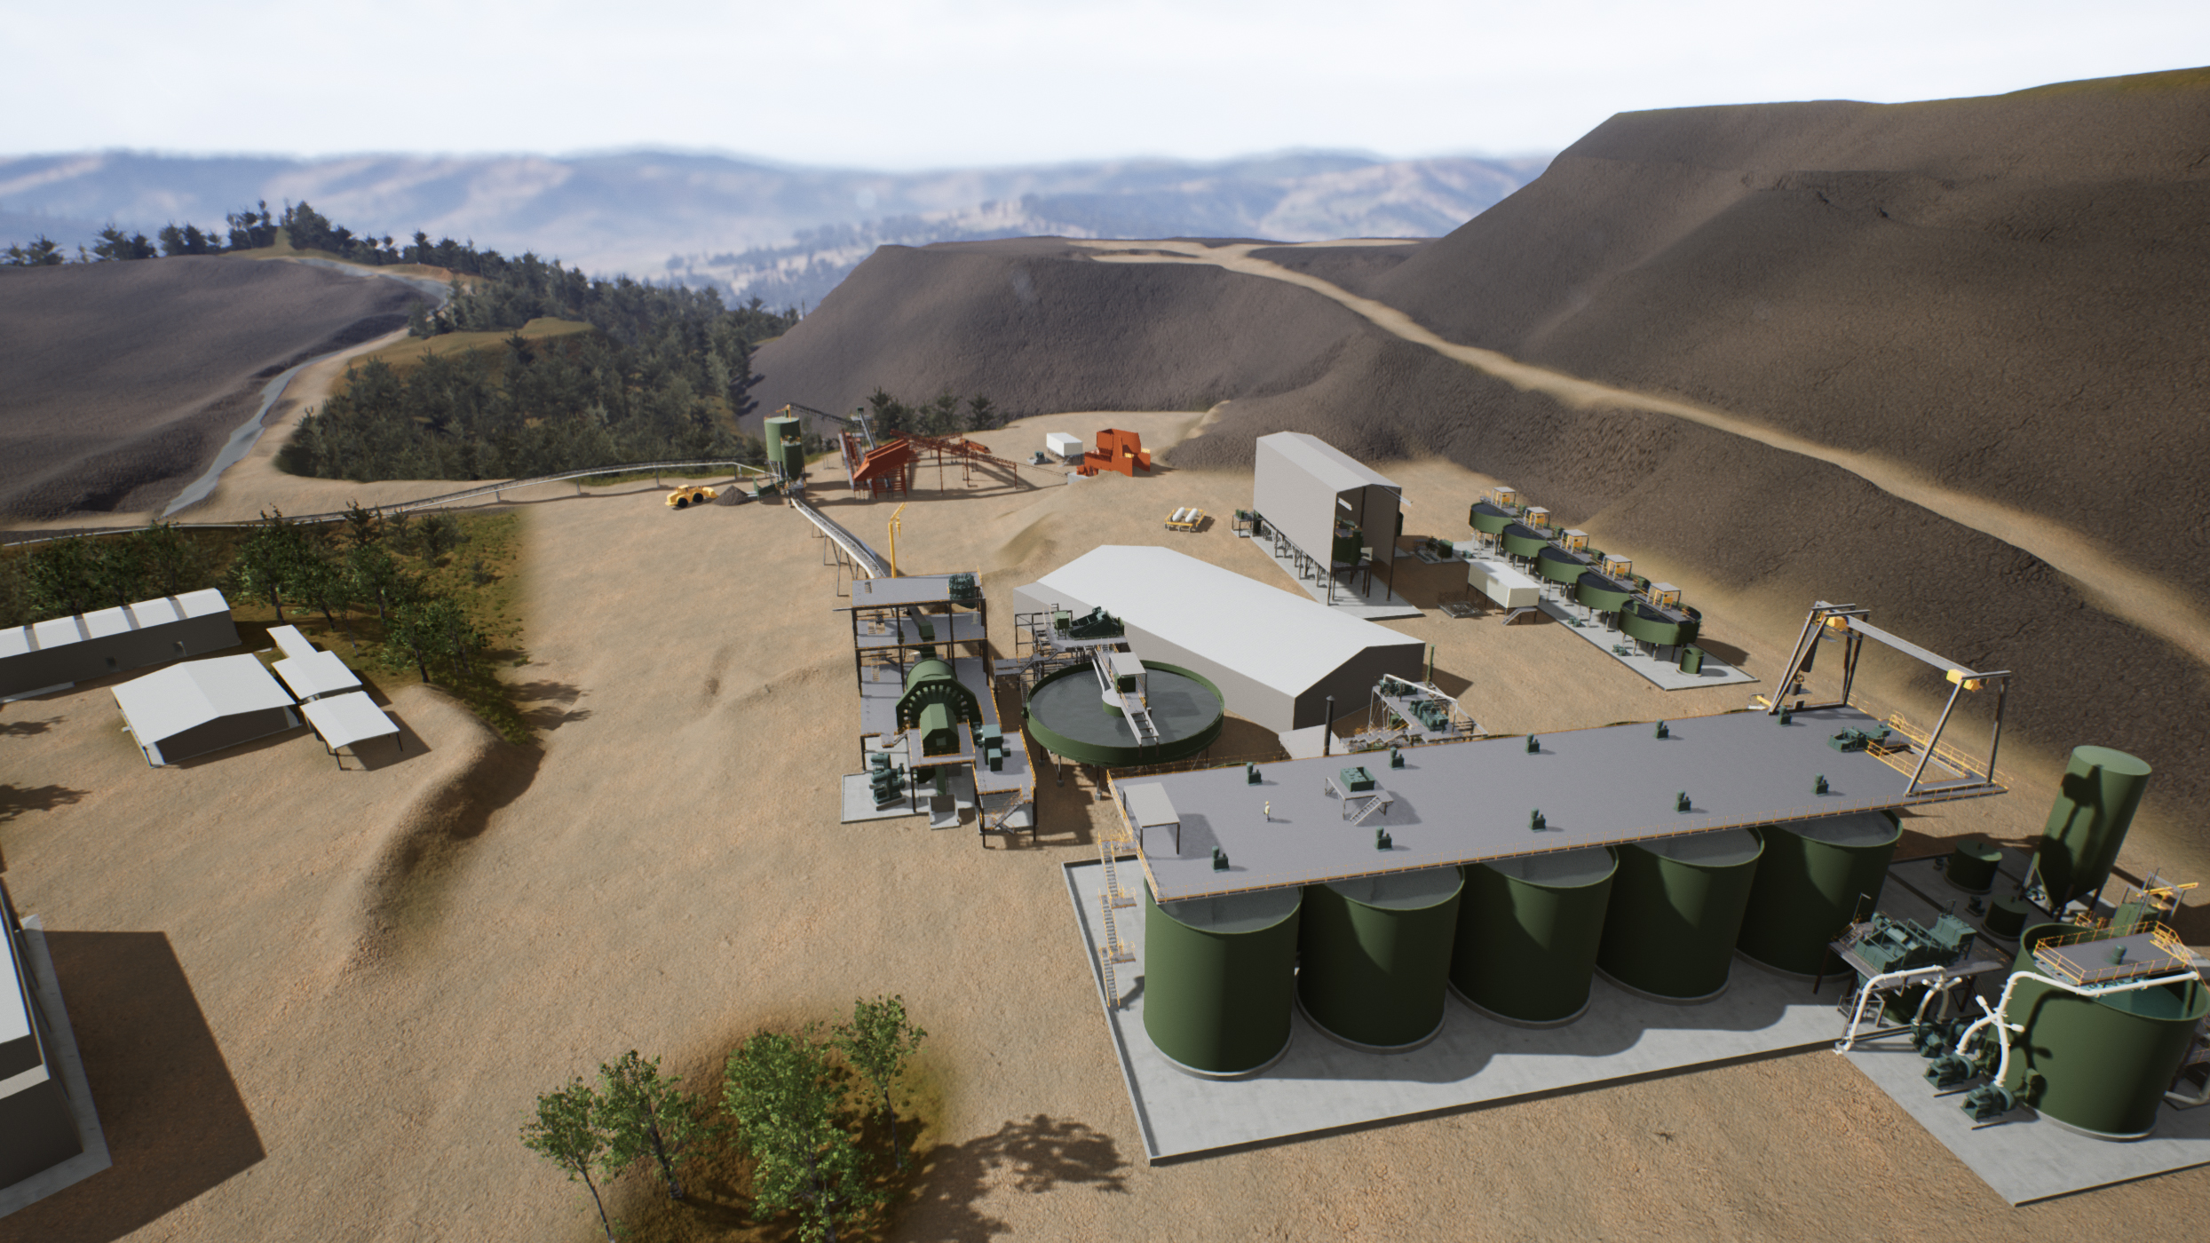
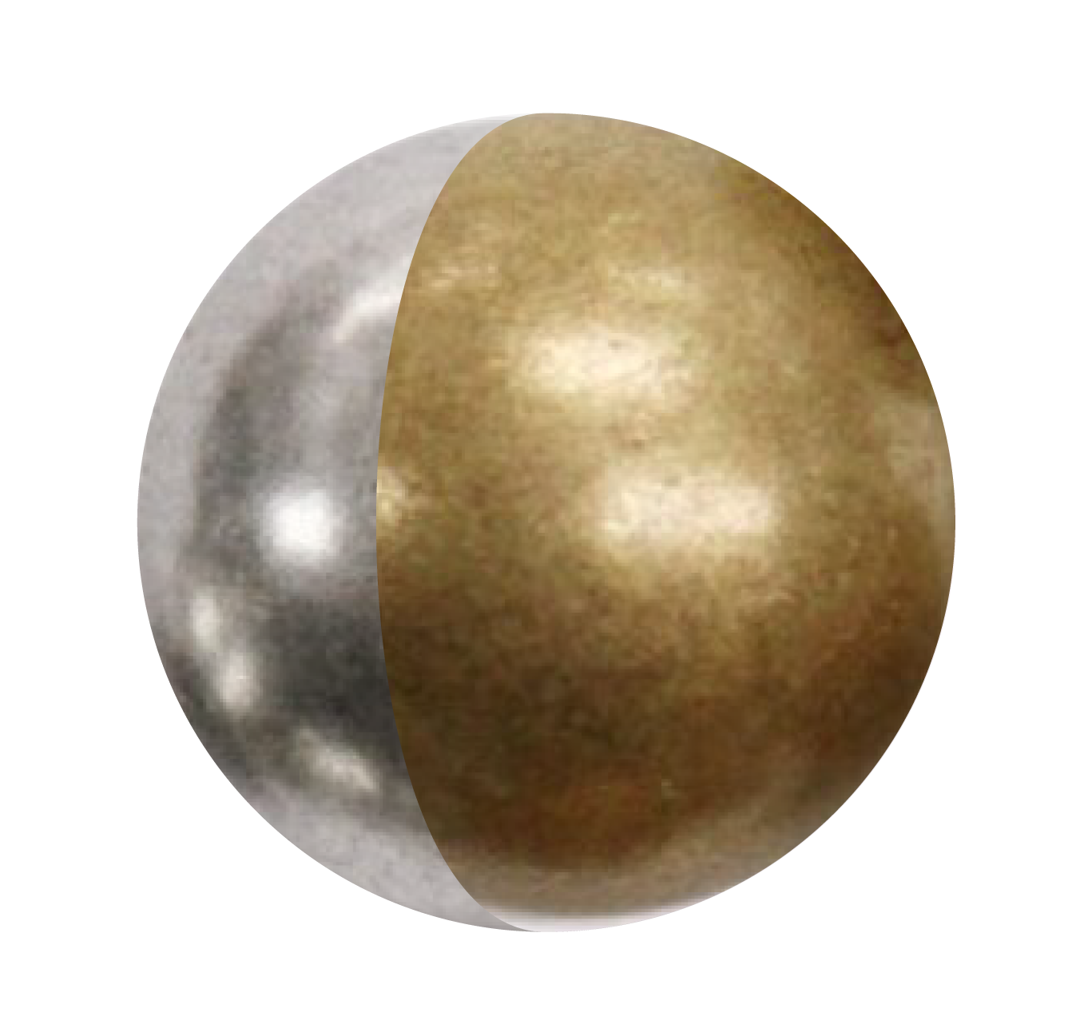

El Gallo – Fenix Gold & Silver Project
Acquired used mill and equipment from Argonaut for $2.8 million
Robust heap leach material
re-processing project
Mill creates optionality to exploit regional Au / Ag deposits
Preparing development schedule

Slide 32
There Are 2 Ways to Get Exposure to:
LOS AZULES, one of the world’s
largest undeveloped copper projects
Buy MUX Today
& Get 150 to 170 K GEOs / Yr as a Bonus
or
Wait for McEwen Copper IPO
1.
2.

Slide 33
Appendix

Slide 34
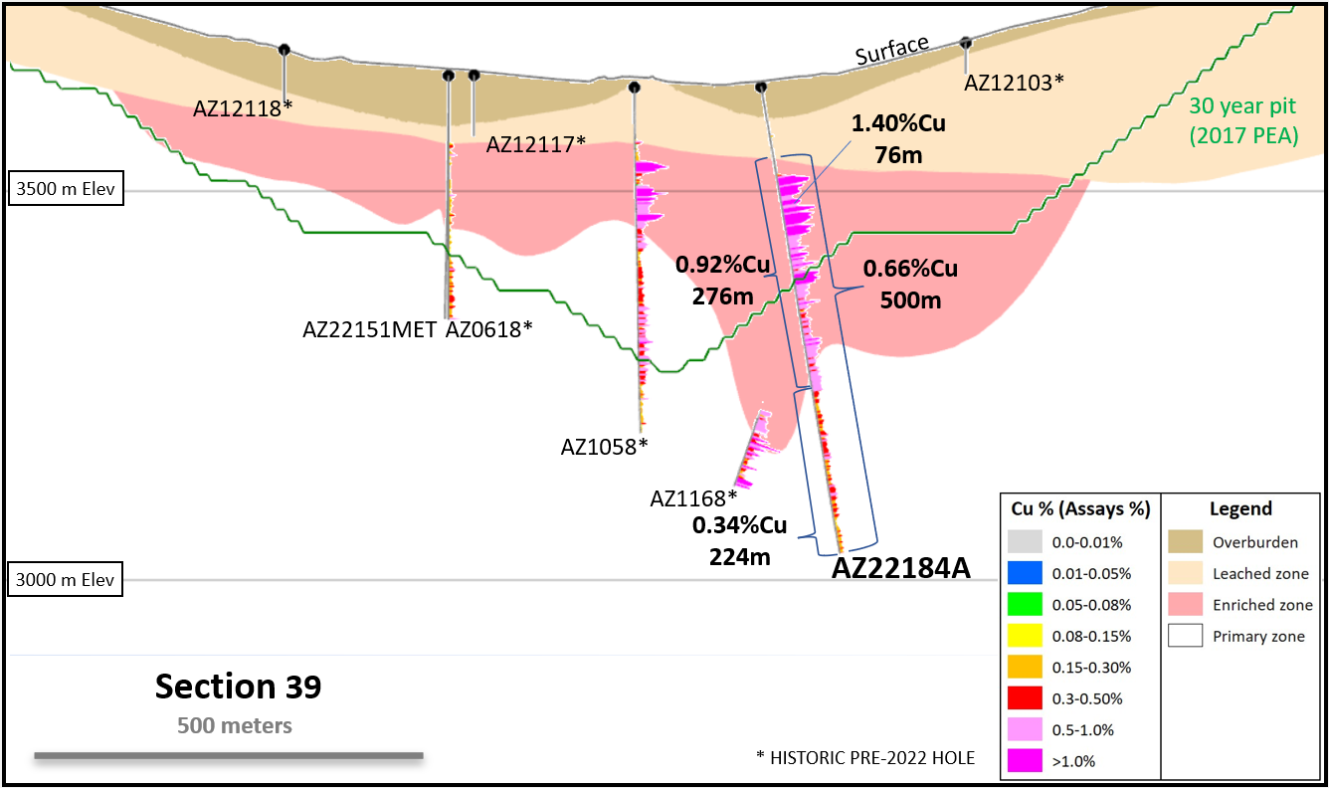
Los Azules
Exploration Highlights Feb – Mar 2023:
Recent Drill Results Confirming Continuity of Mineralization
Section 39 - AZ22184A:
500 m of 0.66% Cu incl 276 m of 0.92% Cu and 224 m of 0.34%
Section 38 - AZ22183:
152 m of 0.87% Cu
AZ1168:
333 m of 0.72% Cu
AZ1063:
313 m of 0.74% Cu
Section 40 - AZ22181:
502 m of 0.50% Cu incl
172 m of 0.87% Cu
AZ22188:
128 m of 0.78% Cu
Section 46 - AZ22186:
282 m of 1.00% Cu incl
172 m of 1.40% Cu

Slide 35
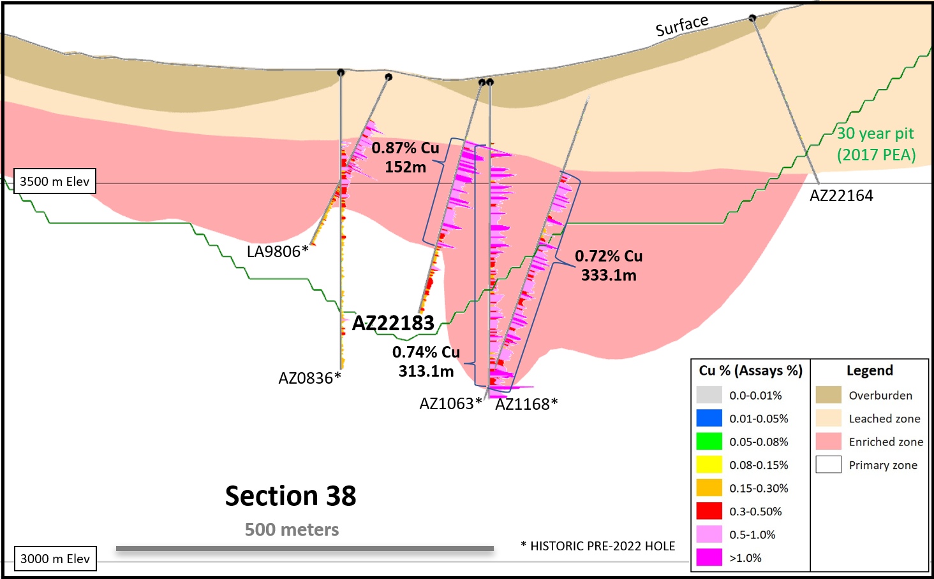
Los Azules
Exploration Highlights Feb – Mar 2023:
Recent Drill Results Confirming Continuity of Mineralization
Section 39 - AZ22184A:
500 m of 0.66% Cu incl 276 m of 0.92% Cu and 224 m of 0.34%
Section 38 - AZ22183:
152 m of 0.87% Cu
AZ1168:
333 m of 0.72% Cu
AZ1063:
313 m of 0.74% Cu
Section 40 - AZ22181:
502 m of 0.50% Cu incl
172 m of 0.87% Cu
AZ22188:
128 m of 0.78% Cu
Section 46 - AZ22186:
282 m of 1.00% Cu incl
172 m of 1.40% Cu

Slide 36
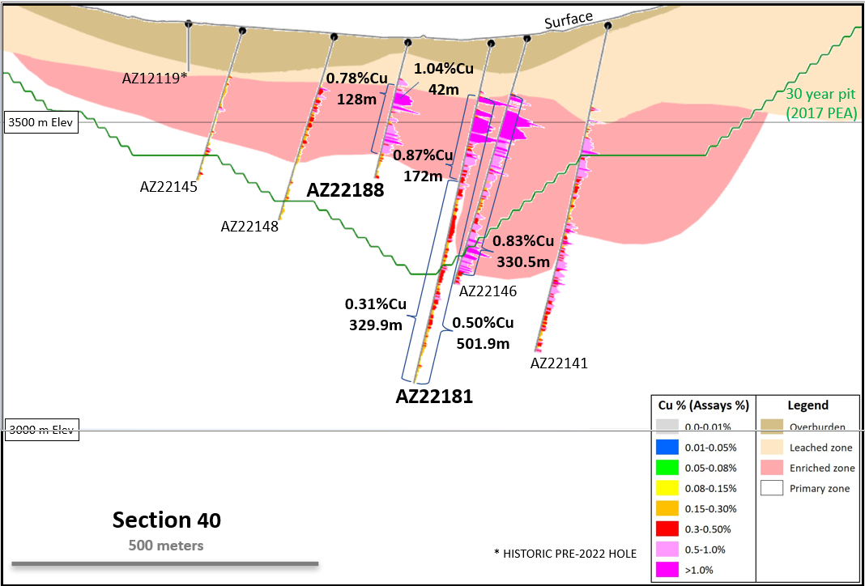
Los Azules
Exploration Highlights Feb – Mar 2023:
Recent Drill Results Confirming Continuity of Mineralization
Section 39 - AZ22184A:
500 m of 0.66% Cu incl
276 m of 0.92% Cu and 224 m of 0.34%
Section 38 - AZ22183:
152 m of 0.87% Cu
AZ1168:
333 m of 0.72% Cu
AZ1063:
313 m of 0.74% Cu
Section 40 - AZ22181:
502 m of 0.50% Cu incl
172 m of 0.87% Cu
AZ22188:
128 m of 0.78% Cu
Section 46 - AZ22186:
282 m of 1.00% Cu incl
172 m of 1.40% Cu

Slide 37
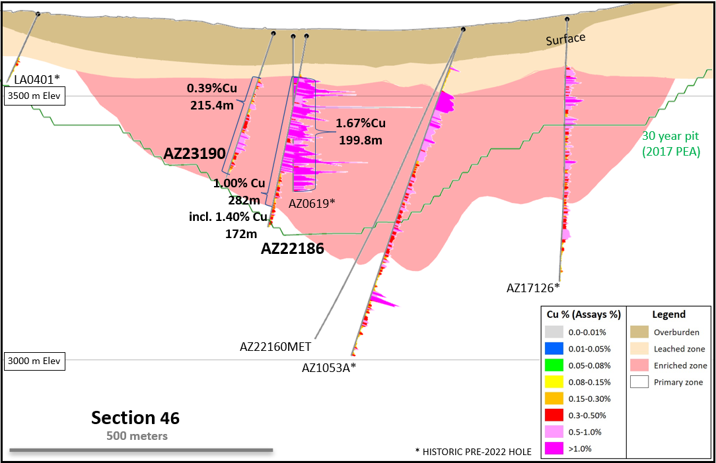
Los Azules
Exploration Highlights Feb – Mar 2023:
Recent Drill Results Confirming Continuity of Mineralization
Section 39 - AZ22184A:
500 m of 0.66% Cu incl 276 m of 0.92% Cu and 224 m of 0.34%
Section 38 - AZ22183:
152 m of 0.87% Cu
AZ1168:
333 m of 0.72% Cu
AZ1063:
313 m of 0.74% Cu
Section 40 - AZ22181:
502 m of 0.50% Cu incl
172 m of 0.87% Cu
AZ22188:
128 m of 0.78% Cu
Section 46 - AZ22186:
282 m of 1.00% Cu incl
172 m of 1.40% Cu

Slide 38
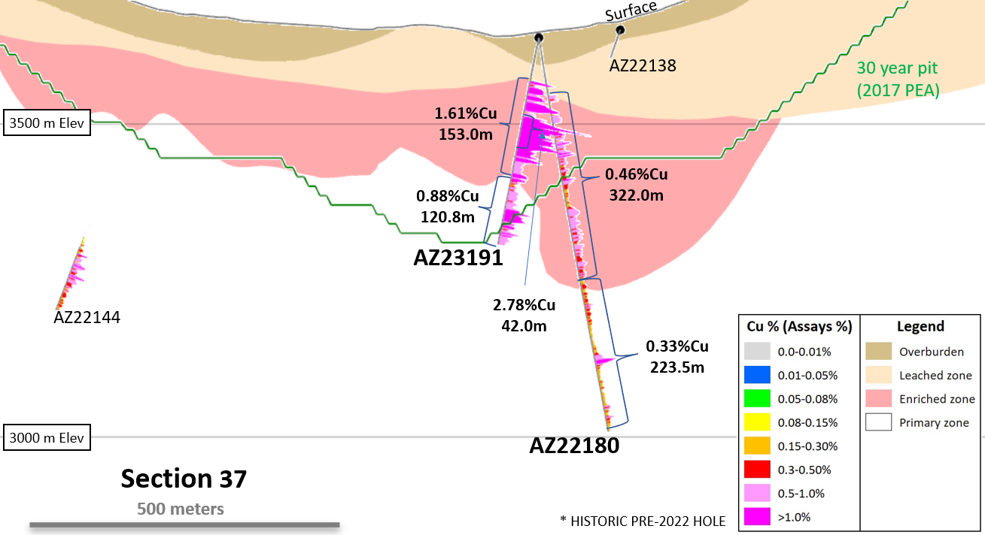
Los Azules
Recent Infill Drill Results – March 6, 2023
153.0m of 1.61% Cu including 42m of 2.78% Cu and 120.8m of 0.88% Cu (AZ23191)*
* - Highlighted intervals are updated from the March 6 2023 Press Release to include previously pending minor assays at the bottom of hole AZ23191.
Section 37 shown with mineral zones and 30-year PEA pit (looking north).

