Slide 1
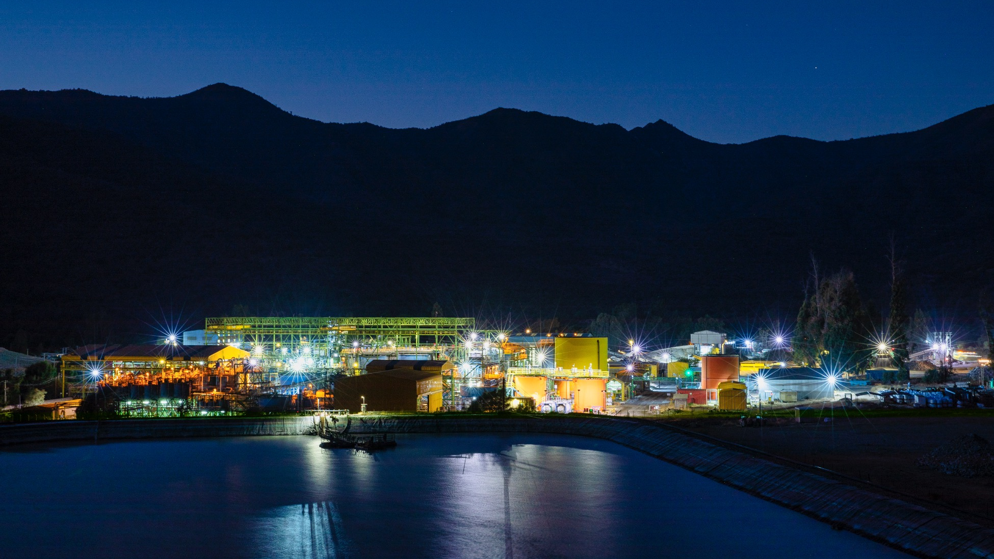

NYSE | TSX PAAS
THE WORLD’S PREMIER SILVER MINING COMPANY
THE WORLD’S PREMIER SILVER MINING COMPANY
INVESTOR PRESENTATION // FEBRUARY 2023
NASDAQ: PAAS
TSX: PAAS
INVESTOR PRESENTATION // OCTOBER 2023

Slide 2
CAUTIONARY NOTE
Non-GAAP Measures
This presentation of Pan American Silver Corp. and its subsidiaries (collectively, “Pan American”, “Pan American Silver”, the “Company”, “we” or “our”) refers to various non-GAAP measures, such as “AISC", “cash costs per ounce sold”, “adjusted earnings” and “basic adjusted earnings per share”, "total debt", "capital", “operating margin”, “free cash flow” and “working capital". These measures do not have a standardized meaning prescribed by IFRS as an indicator of performance, and may differ from methods used by other companies. Silver segment Cash Costs and AISC are calculated net of credits for realized revenues from all metals other than silver, and are calculated per ounce of silver sold. Gold segment Cash Costs and AISC are calculated net of credits for realized silver revenues, and are calculated per ounce of gold sold. Consolidated Cash Costs and AISC are based on total silver ounces sold and are net of by-product credits from all metals other than silver.
Readers should refer to the “Alternative Performance (Non-GAAP) Measures” section of the Company’s Management’s Discussion and Analysis (“MD&A”) for the period ended June 30, 2023, available at www.sedarplus.com.
Reporting Currency and Financial Information
Unless we have specified otherwise, all references to dollar amounts or $ are to United States dollars.
Cautionary Note Regarding Forward Looking Statements and Information
Certain of the statements and information in this presentation constitute "forward-looking statements" within the meaning of the United States Private Securities Litigation Reform Act of 1995 and "forward-looking information" within the meaning of applicable Canadian provincial securities laws. All statements, other than statements of historical fact, are forward-looking statements or information. Forward-looking statements or information in this presentation relate to, among other things: future financial or operational performance, and estimates of current production levels that remain subject to verification and adjustment, including our estimated production of silver, gold and other metals forecasted for 2023, our estimated Cash Costs, AISC and expenditures in 2023; future anticipated prices for gold, silver and other metals and assumed foreign exchange rates; estimated global silver inventories; estimated timing for publication of an updated technical report for La Colorada; estimated synergies following the acquisition of Yamana Gold Inc. (“Yamana”); whether Pan American will be able to complete the divestment of its interests in certain non-core assets, including Agua de la Falda, as well as the anticipated terms, economic returns, and timing for completion thereof; whether Pan American is able to maintain a strong financial condition and have sufficient capital, or have access to capital through our corporate credit facility or otherwise, to sustain our business and operations and complete any anticipate capital spending; the ability of Pan American to successfully complete any capital projects, including with respect to Jacobina and La Colorada and the expected economic or operational results derived from those projects, and the impacts of any such projects on Pan American; and the future results of exploration activities, including with respect to the Skarn exploration program at La Colorada.
These forward-looking statements and information reflect Pan American’s current views with respect to future events and are necessarily based upon a number of assumptions that, while considered reasonable by Pan American, are inherently subject to significant operational, business, economic and regulatory uncertainties and contingencies. These assumptions include: tonnage of ore to be mined and processed; ore grades and recoveries; prices for silver, gold and base metals remaining as estimated; currency exchange rates remaining as estimated; capital, decommissioning and reclamation estimates; our mineral reserve and resource estimates and the assumptions upon which they are based; prices for energy inputs, labour, materials, supplies and services (including transportation); no labour-related disruptions at any of our operations; no unplanned delays or interruptions in scheduled production; all necessary permits, licenses and regulatory approvals for our operations are received in a timely manner; our ability to secure and maintain title and ownership to properties and the surface rights necessary for our operations; the ability to satisfy the closing conditions and, where necessary, receive regulatory approval, to complete the sale of the non-core assets; and our ability to comply with environmental, health and safety laws. The foregoing list of assumptions is not exhaustive.
Pan American cautions the reader that forward-looking statements and information involve known and unknown risks, uncertainties and other factors that may cause actual results and developments to differ materially from those expressed or implied by such forward-looking statements or information contained in this presentation and Pan American has made assumptions and estimates based on or related to many of these factors. Such factors include, without limitation: fluctuations in silver, gold and base metal prices; fluctuations in prices for energy inputs, labour, materials, supplies and services (including transportation); fluctuations in currency markets (such as the PEN, MXN, ARS, BOB, GTQ, CAD, CLP, and BRL versus the USD); operational risks and hazards inherent with the business of mining (including environmental accidents and hazards, industrial accidents, equipment breakdown, unusual or unexpected geological or structural formations, cave-ins, flooding and severe weather); risks relating to the credit worthiness or financial condition of suppliers, refiners and other parties with whom Pan American does business; inadequate insurance, or inability to obtain insurance, to cover these risks and hazards; employee relations; relationships with, and claims by, local communities and indigenous populations; our ability to obtain all necessary permits, licenses and regulatory approvals in a timely manner; changes in laws, regulations and government practices in the jurisdictions where we operate, including environmental, export and import laws and regulations; changes in national and local government, legislation, taxation, controls or regulations and political, legal or economic developments in Canada, the United States, Mexico, Peru, Argentina, Bolivia, Guatemala, Chile, Brazil or other countries where Pan American may carry on business, including legal restrictions relating to mining, including in Chubut, Argentina, risks relating to expropriation, and risks relating to the constitutional court-mandated ILO 169 consultation process in Guatemala; diminishing quantities or grades of mineral reserves as properties are mined; increased competition in the mining industry for equipment and qualified personnel; and those factors identified under the caption "Risks Related to Pan American's Business" in Pan American's most recent form 40-F and Annual Information Form and those factors identified under the caption "Risks of the Business" in Yamana's most recent form 40-F and Annual Information Form filed with the United States Securities and Exchange Commission and Canadian provincial securities regulatory authorities, respectively.” filed with the United States Securities and Exchange Commission and Canadian provincial securities regulatory authorities, respectively. Although Pan American has attempted to identify important factors that could cause actual results to differ materially, there may be other factors that cause results not to be as anticipated, estimated, described or intended. Investors are cautioned against undue reliance on forward-looking statements or information. Forward-looking statements and information are designed to help readers understand management's current views of our near- and longer-term prospects and may not be appropriate for other purposes. Pan American does not intend, nor does it assume any obligation to update or revise forward-looking statements or information, whether as a result of new information, changes in assumptions, future events or otherwise, except to the extent required by applicable law.
CONTINUED ON NEXT PAGE

Slide 3
CONTINUED
NOT AN OFFER OR A SOLICITATION
THIS PRESENTATION DOES NOT CONSTITUTE (AND MAY NOT BE CONSTRUED TO BE) A SOLICITATION OR OFFER BY PAN AMERICAN OR ANY OF OUR RESPECTIVE DIRECTORS, OFFICERS, EMPLOYEES, REPRESENTATIVES OR AGENTS TO BUY OR SELL ANY SECURITIES OF ANY PERSON IN ANY JURISDICTION, OR A SOLICITATION OF A PROXY OF ANY SECURITYHOLDER OF ANY PERSON IN ANY JURISDICTION, IN EACH CASE, WITHIN THE MEANING OF APPLICABLE LAWS.
Technical Information
Scientific and technical information contained in this presentation has been reviewed and approved by Sébastien Bernier P. Geo., Senior Director, Reserves and Resources, Christopher Emerson, FAusIMM., Vice President of Exploration and Geology, and Martin Wafforn, P.Eng., Senior Vice President Technical Services and Process Optimization, who are each Qualified Persons for the purposes of National Instrument 43-101 - Standards of Disclosure for Mineral Projects ("NI 43-101").
For additional information regarding Pan American Silver's material mineral properties prior to the completion of the acquisition of Yamana (the “Yamana Transaction”), please refer to Pan American Silver’s Annual Information Form dated February 22, 2023, filed at www.sedarplus.com, or Pan American Silver's most recent Form 40-F filed with the SEC. For further information about the material mineral projects acquired pursuant to the Yamana Transaction, please refer to Yamana’s Annual Information Form dated March 29, 2023, filed at www.sedarplus.com or Yamana’s most recent Form 40-F filed with the SEC.
Cautionary Note to U.S. Investors Concerning Estimates of Mineral Reserves and Resources
Unless otherwise indicated, all reserve and resource estimates included in this presentation have been prepared in accordance with Canadian National Instrument 43-101 – Standards of Disclosure for Mineral Projects (‘‘NI 43-101’’) and the Canadian Institute of Mining, Metallurgy and Petroleum (the “CIM”) — CIM Definition Standards on Mineral Resources and Mineral Reserves, adopted by the CIM Council, as amended (the “CIM Standards”). NI 43-101 is a rule developed by the Canadian Securities Administrators that establishes standards for all public disclosure an issuer makes of scientific and technical information concerning mineral projects. Canadian standards, including NI 43-101, differ significantly from the requirements of the SEC, and reserve and resource information included herein may not be comparable to similar information disclosed by U.S. companies. In particular, and without limiting the generality of the foregoing, this presentation uses the terms “measured resources,” “indicated resources” and “inferred resources” as defined in accordance with NI 43-101 and the CIM Standards.
Further to recent amendments, mineral property disclosure requirements in the United States (the “U.S. Rules”) are governed by subpart 1300 of Regulation S-K of the U.S. Securities Act of 1933, as amended (the “U.S. Securities Act”) which differ from the CIM Standards. As a foreign private issuer that is eligible to file reports with the SEC pursuant to the multi-jurisdictional disclosure system (the “MJDS”), Pan American is not required to provide disclosure on its mineral properties under the U.S. Rules and will continue to provide disclosure under NI 43-101 and the CIM Standards. If Pan American ceases to be a foreign private issuer or loses its eligibility to file its annual report on Form 40-F pursuant to the MJDS, then Pan American will be subject to the U.S. Rules, which differ from the requirements of NI 43-101 and the CIM Standards.
Pursuant to the new U.S. Rules, the SEC recognizes estimates of “measured mineral resources”, “indicated mineral resources” and “inferred mineral resources.” In addition, the definitions of “proven mineral reserves” and “probable mineral reserves” under the U.S. Rules are now “substantially similar” to the corresponding standards under NI 43-101. Mineralization described using these terms has a greater amount of uncertainty as to its existence and feasibility than mineralization that has been characterized as reserves. Accordingly, U.S. investors are cautioned not to assume that any measured mineral resources, indicated mineral resources, or inferred mineral resources that Pan American reports are or will be economically or legally mineable. Further, “inferred mineral resources” have a greater amount of uncertainty as to their existence and as to whether they can be mined legally or economically. Under Canadian securities laws, estimates of “inferred mineral resources” may not form the basis of feasibility or pre-feasibility studies, except in rare cases. While the above terms under the U.S. Rules are “substantially similar” to the standards under NI 43-101 and CIM Standards, there are differences in the definitions under the U.S. Rules and CIM Standards. Accordingly, there is no assurance any mineral reserves or mineral resources that Pan American may report as “proven mineral reserves”, “probable mineral reserves”, “measured mineral resources”, “indicated mineral resources” and “inferred mineral resources” under NI 43-101 would be the same had Pan American prepared the reserve or resource estimates under the standards adopted under the U.S. Rules.

Slide 4

TRANSFORMATIVE YAMANA TRANSACTION
CANADA
Head Office
Timmins
Dolores
La Colorada
// The acquisition of Yamana Gold Inc. enhanced the scale and quality of Pan American’s portfolio in the Americas, where we have been operating for nearly 3 decades
Skarn Deposit
MEXICO
GUATEMALA
Escobal
(C&M)
4 producing mines: Jacobina, El Peñon, Minera Florida &
Cerro Moro
Enhanced diversification with addition of Chile & Brazil
Adds significant proven and probable reserves
Extensive exploration portfolio
Shahuindo
BRAZIL
La Arena
PERU
$639.9M
Q2 2023
Huaron
Jacobina
BOLIVIA
Mining Operations
Development Projects
Pro Forma Revenue does not exceed 25% from any single jurisdiction
( For the three months ended June 30, 2023)
El Peñon
San Vicente
CHILE
Minera Florida
ARGENTINA
Navidad
Manantial Espejo
(C&M)
Cerro Moro
  Pan American completed the sale of MARA on September 20, 2023 and the sale of Morococha on September 22, 2023.

Slide 5
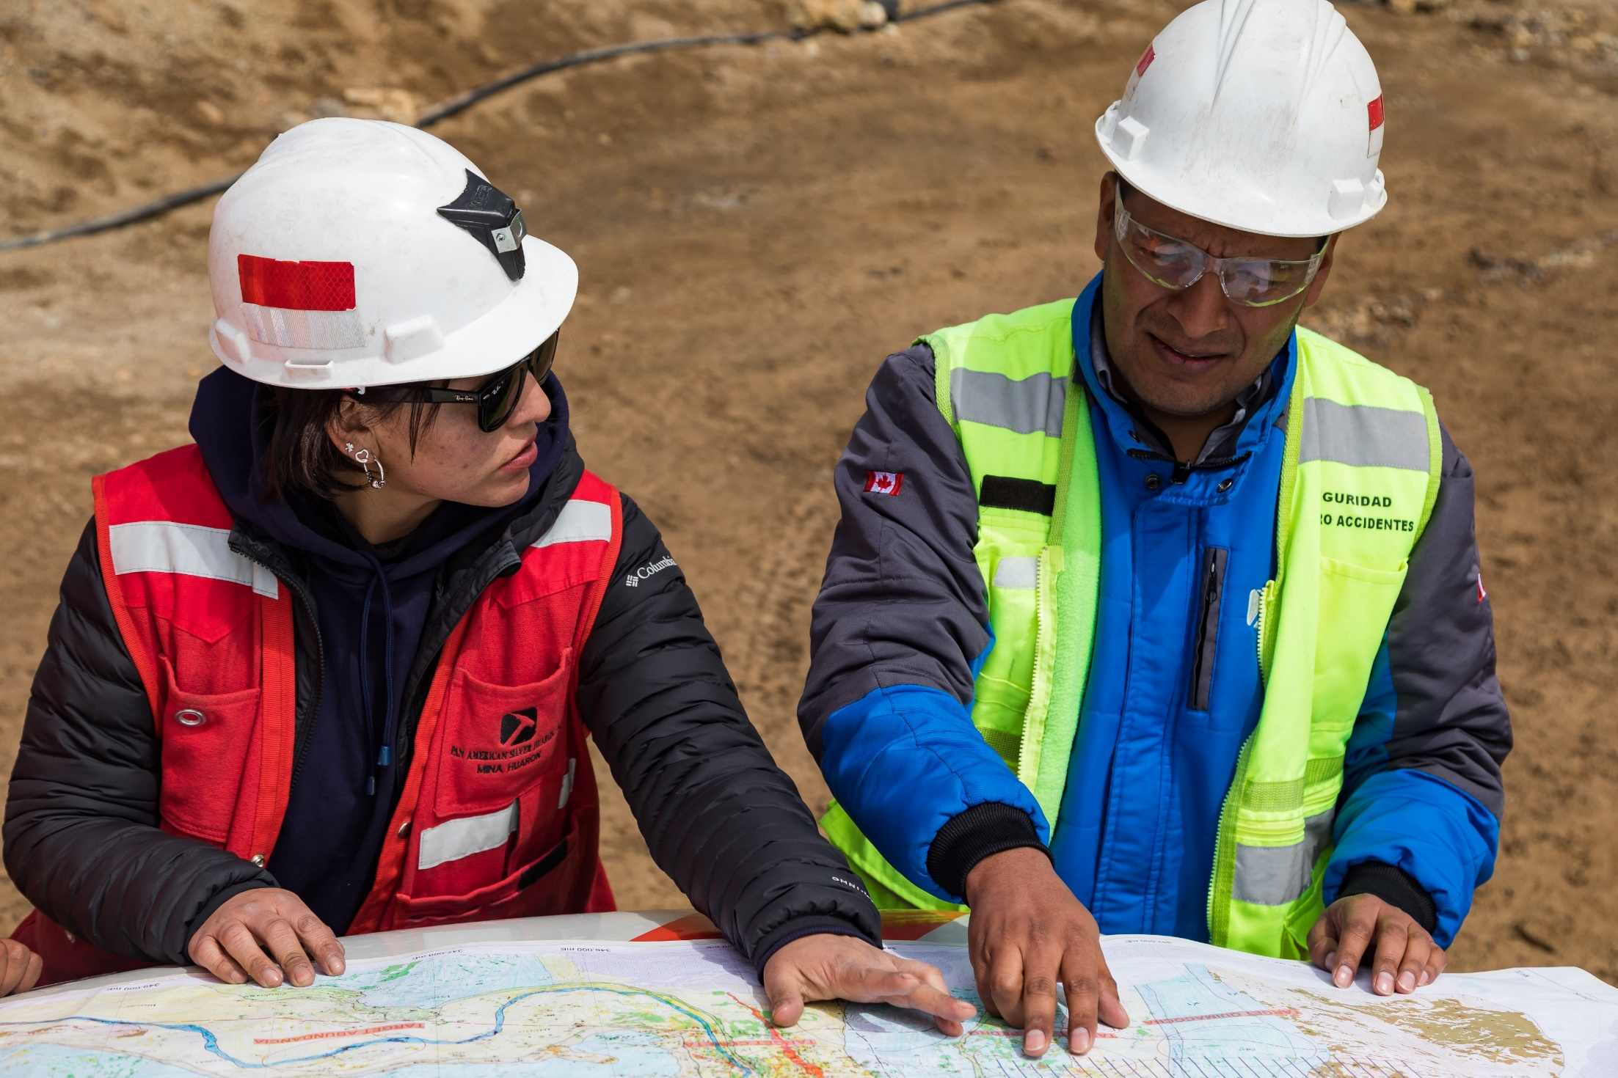
ACQUISITION CREATES CLEAR PATH TO UNLOCK VALUE
// Annual post-tax synergies of $40-$60 million
Established presence and expertise in Latin America will enable Pan American to leverage operational efficiencies and the growth potential of the acquired Yamana assets in the region
Synergies driven by streamlining corporate costs, cross-pollination of mining best practices and unification of regional mining hubs
Transaction was accretive on a per share basis with respect to key financial and operating metrics, even before considering synergies
YAMANA AQUISITION, 2023
4 PRODUCING MINES+EXTENSIVE EXPLORATION LANDS

Slide 6
ADVANCING PORTFOLIO OPTIMIZATION STRATEGY
// Sales of non-core assets focuses portfolio, improves the balance sheet and retains future upside
MARA
MOROCOCHA
AGUA DE LA FALDA
NON-CONTROLLING EQUITY INTERESTS
56.25% stake for:
$475M in cash
0.75% copper NSR royalty
92.3% interest for:
$25M in cash
57.74% interest for:
$45.55M in cash
1.25% precious metals
NSR royalty
0.2% base metals NSR royalty, subject to pro rata interest sold on certain concessions
$47.1M in proceeds
Total cash proceeds of $593 million, plus significant Care & Maintenance savings, strengthening free cash flow generation for the advancement of strategic growth projects
Note: Sale of MARA was completed on September 20, 2023 and the sale of Morococha on September 22, 2023. The sale of Agua de la Falda is expected to be completed in the fourth quarter of 2023.

Slide 7

7
2023 GUIDANCE MAINTAINED
// Q2 production and costs in line with annual guidance (9-months for Yamana acquired mines)
Ag
21.0 – 23.0 Moz
ANNUAL CONSOLIDATED PRODUCTION
$10.00 - $12.00 per oz
SILVER SEGMENT CASH COSTS⁽¹⁾
$14.00 - $16.00 per oz
SILVER SEGMENT AISC⁽¹⁾
Au
870 – 970 Koz
ANNUAL CONSOLIDATED PRODUCTION
$975 - $1,100 per oz
GOLD SEGMENT CASH COSTS⁽¹⁾
$1,275 - $1,425 per oz
GOLD SEGMENT AISC⁽¹⁾
Sustaining capital
of $305 - $320 million
Project capital
of $95 - $105 million
Reclamation expenditures of $18 - $20 million
Care & Maintenance costs of $98 - $109 million⁽²⁾
Cash Costs and AISC are non-GAAP measures. Please refer to the section “Alternative Performance (Non-GAAP) Measures” of the MD&A for the period ended June 30, 2023 for a detailed description of these measures and where appropriate a reconciliation of the measure to the Q2 2023 Financial Statements. The AISC forecast assumes metal prices of $22.00/oz for silver, $1,850/oz for gold, $3,000/tonne ($1.36/lb) for zinc, $2,100/tonne ($0.95/lb) for lead, and $8,000/tonne ($3.63/lb) for copper; and average annual exchange rates relative to 1 USD of 18.75 for the Mexican peso, 3.75 for the Peruvian sol, 270.00 for the Argentine peso, 7.00 for the Bolivian boliviano, $1.33 for the Canadian dollar, $800.00 for the Chilean peso and $5.00 for the Brazilian real.
Majority of care & maintenance costs relate to the MARA project; Pan American completed the sale of MARA on September 20, 2023.
NYSE | TSX PAAS

Slide 8
8
2023 MINERAL RESERVE AND MINERAL RESOURCES HIGHLIGHTS^{(1,2)}
// Significant increase in reserves and resources with addition of assets from the Yamana transaction
576.6 Mozs of silver mineral reserves and 12.9 Mozs of gold mineral reserves
Measured & indicated mineral resources, exclusive of mineral reserves, of 959.1 million ounces for silver and 17.5 million ounces for gold.
Inferred mineral resources of 479.4 million ounces for silver and 9.2 million ounces for gold
  As at June 30, 2023.
  See presentation Appendix for more detailed information on the Company's reserves and resources.
NYSE | TSX PAAS

Slide 9
STRONG FINANCIAL POSITION⁽¹⁾
// As at June 30, 2023, excluding cash proceeds from non-core asset sales
TOTAL CASH AND AVAILABLE CREDIT
$879.2M⁽³⁾
Revolving Credit Facility
Cash +
investments
Balance sheet management
Total debt⁽²⁾ of $1,135.3M related to senior notes ($783M), the SL-Credit Facility ($280M), and construction loans and leases
Sustainability-Linked Revolving Credit Facility aligns
Pan American’s ESG performance to its cost of capital
Strong liquidity – remain well positioned to fund planned capital expenditures and pay down debt
  As at June 30, 2023; excludes pro forma impact of asset divestments announced on July 31, 2023
  Total debt is a non-GAAP measure calculated as the total of amounts drawn on the SL-Credit Facility, finance lease liabilities and loans payable. See the “Non-GAAP Measures” section of our Cautionary Note on page 2 of this presentation.
  Total Cash and Available Credit is a non-GAAP measure calculated as cash and cash equivalents plus investments, including $192.9 million of cash held by the MARA Project, plus undrawn amounts under the SL-Credit Facility.

Slide 10
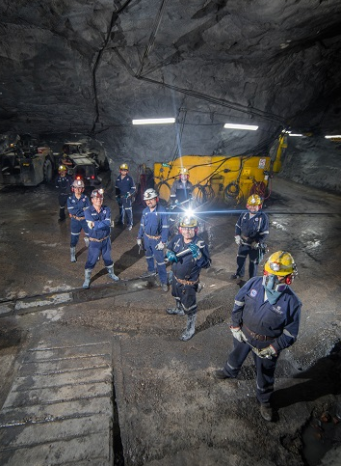
10
ZACATECAS, MEXICO
LA COLORADA SKARN PROJECT
// 100% owned, large, polymetallic deposit with potential for decades of production
Completed over 254,000 metres of drilling; higher-grade mineralised zones continue to be encountered in the drill program
Skarn footprint of 1,500 metres x 1,100 metres, open in all directions
Metallurgical tests show positive polymetallic flotation recoveries
Sub level caving mining method used to develop mining shapes that constrained the mineral resource volume, assuming a $45/tonne mining, processing and administration operating cost
Late 2023, aiming to provide an updated technical report for La Colorada, which will contain preliminary economics for the Skarn project
LA COLORADA SKARN PROJECT, MEXICO
INDICATED MINERAL RESOURCE EST. // 95.9MT
INFERRED MINERAL RESOURCE EST. // 147.8MT

Slide 11
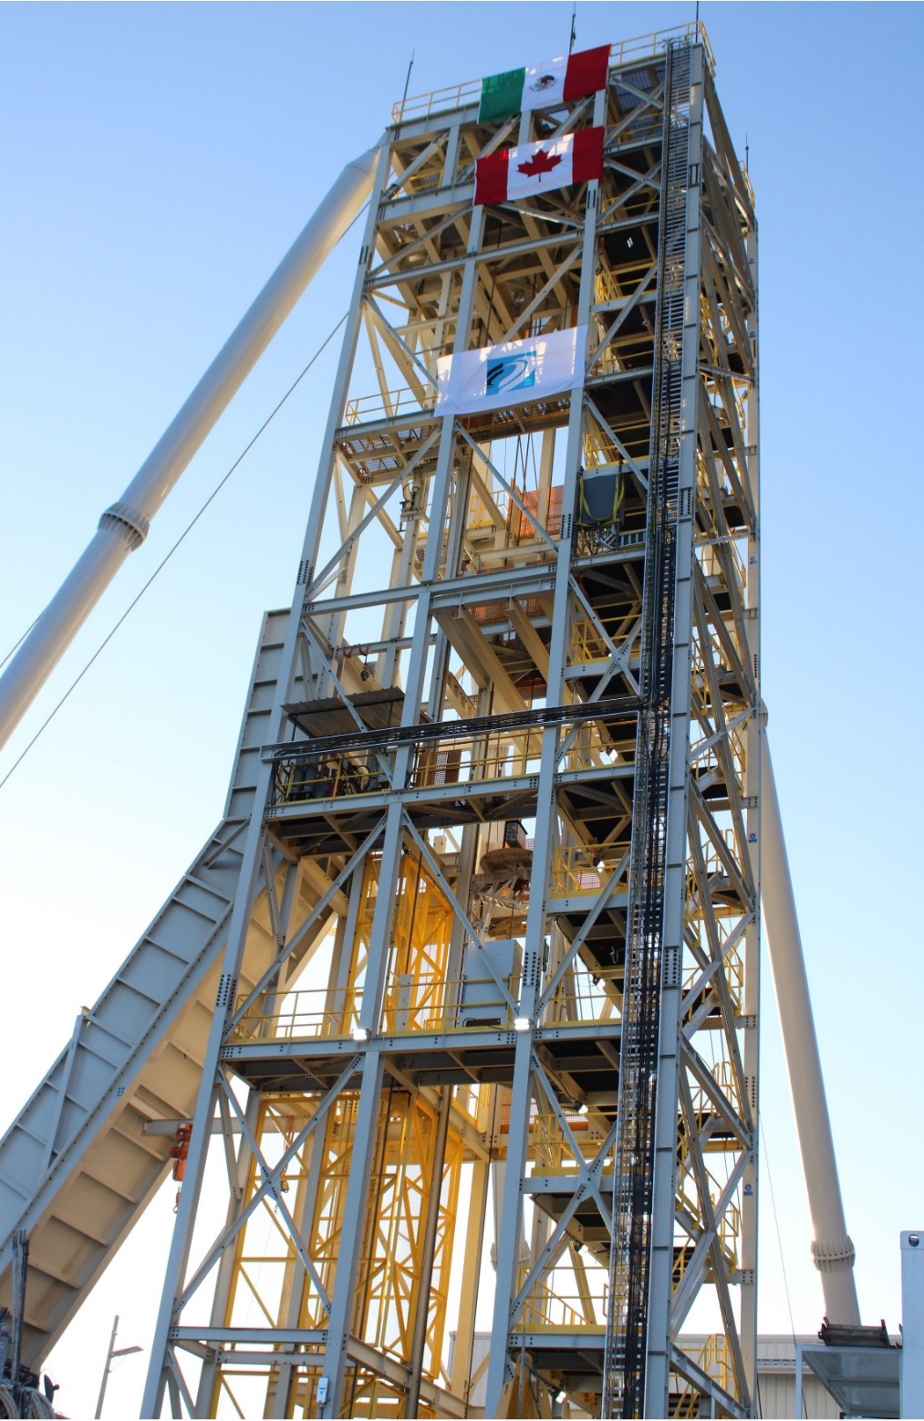
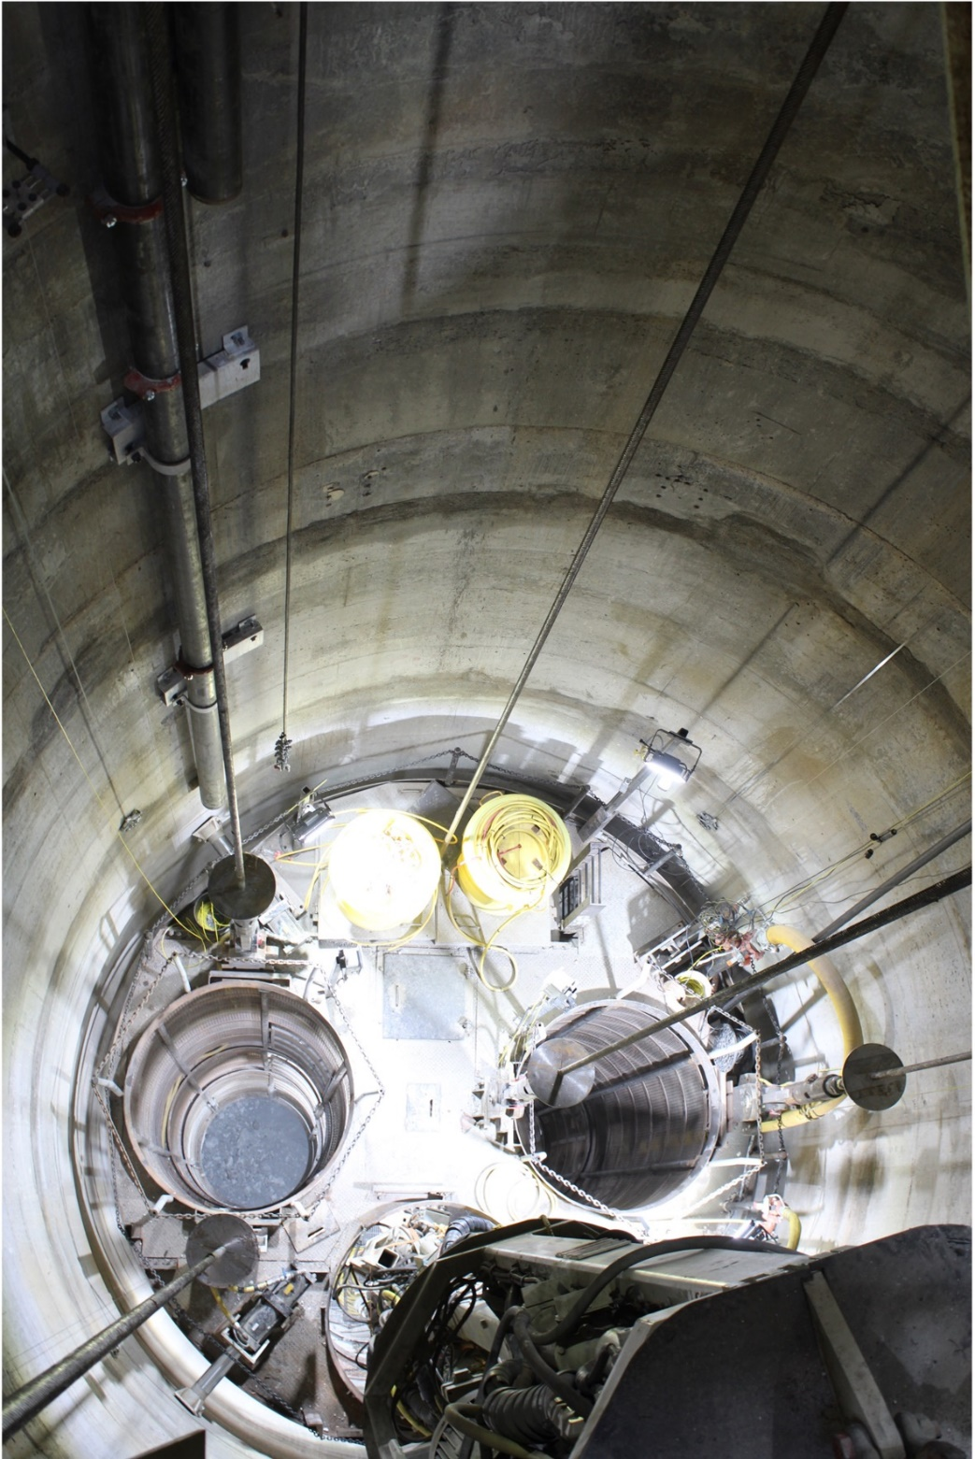
11
LA COLORADA
The fully concrete-lined 5.5-metre diameter ventilation shaft is expected to be completed in 2023 at a cost of
~$47 million.
The shaft is strategically located to exhaust hot, moist air directly from the source, diverting the high heat load being sent throughout the mine.
NEW VENTILATION SHAFT
Ventilation fans to be installed on shaft in 2024, reducing power requirements upon commissioning
Shaft sinking reached 495 metres of 590 metres total depth on September 13, 2023.

Slide 12
12
ZACATECAS, MEXICO
LA COLORADA SKARN – MINERAL RESOURCE ESTIMATE
Mining Method | Cut-off Value (US$/tonne) | Resource Classification | Tonnes (millions) | Zn (%) | Pb (%) | Ag (g/t) | Zn (Mt) | Pb (Mt) | Ag (Moz)
Sub-level Caving (SLC) | 45 | Indicated | 95.9 | 2.77 | 1.28 | 31 | 2.66 | 1.23 | 94.4
 |  | Inferred | 147.8 | 2.29 | 1.04 | 28 | 3.39 | 1.54 | 132.9
Notes:
Estimation and reporting of mineral resources were carried out in accordance with Canadian Institute of Mining, Metallurgy and Petroleum (CIM) guidelines.
Mineral resources have reasonable prospects for eventual economic extraction demonstrating sufficient spatial continuity of mineralisation constrained within a potentially mineable shape. No mineral reserves are reported at this time.
Prices used to report mineral resources were: US$22 per ounce of silver, US$2,800 per tonne of zinc and US$2,200 per tonne of lead.
An estimate of mineral value per tonne was calculated using metallurgical recoveries of 87.4% Ag, 88% Pb and 93% Zn with mineral concentrate qualities of 67% Pb in lead concentrate and 60% Zn in zinc concentrate, obtained from metallurgical testing. Estimates for transport, payability and refining/selling costs, based on experience and long-term views of the marketing, treatment and refining of these types of mineral concentrates, were included.
Reasonable prospects for eventual economic extraction were assessed by determining the total in-situ tonnes and grade constrained inside volumes that are based on a bulk style sub-level caving underground mining method. The tonnes and grades are inclusive of the must-take low grade material within the volume, as per CIM best practice guidelines. No other mining dilution or mineral losses have been accounted for. A US$45 per tonne operating cost has been assumed, which includes estimates of mining, processing and G&A operating costs.
This mineral resource estimate was prepared under the supervision of, or was reviewed by, Christopher Emerson, FAusIMM, Vice President Exploration and Geology, and Martin G. Wafforn, P.Eng., Senior Vice President Technical Services and Process Optimization, each of whom is a Qualified Person as that term is defined in National Instrument 43-101 ("NI 43-101").
The effective date of the mineral resources estimate is Sept. 13, 2022.

Slide 13
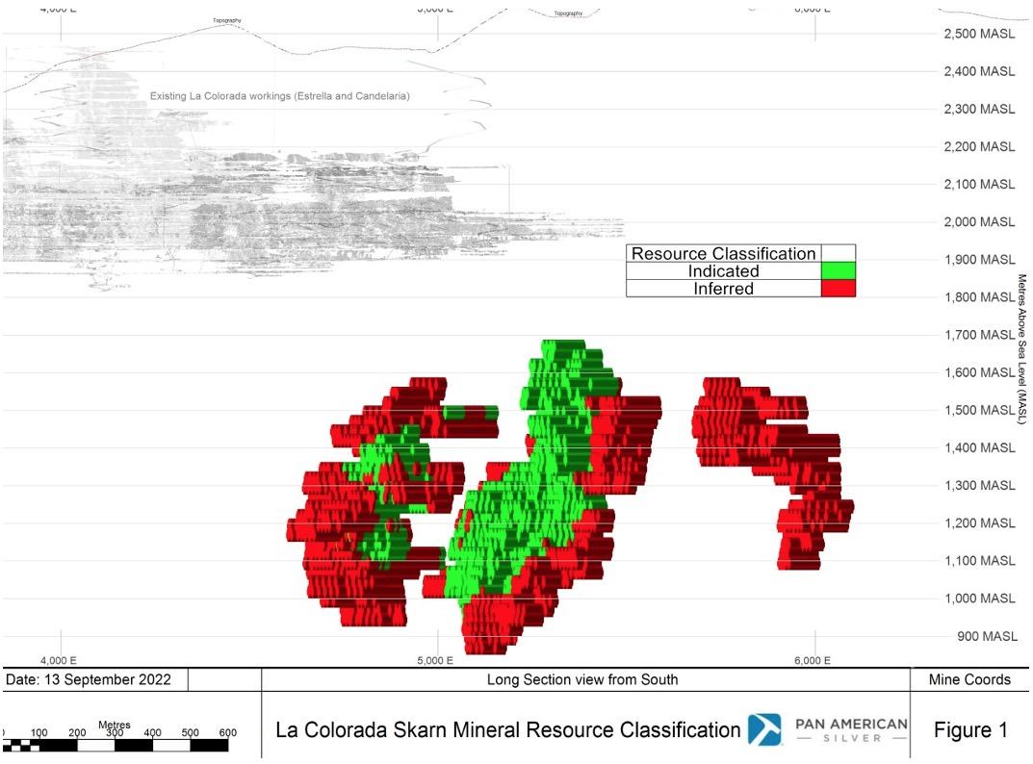
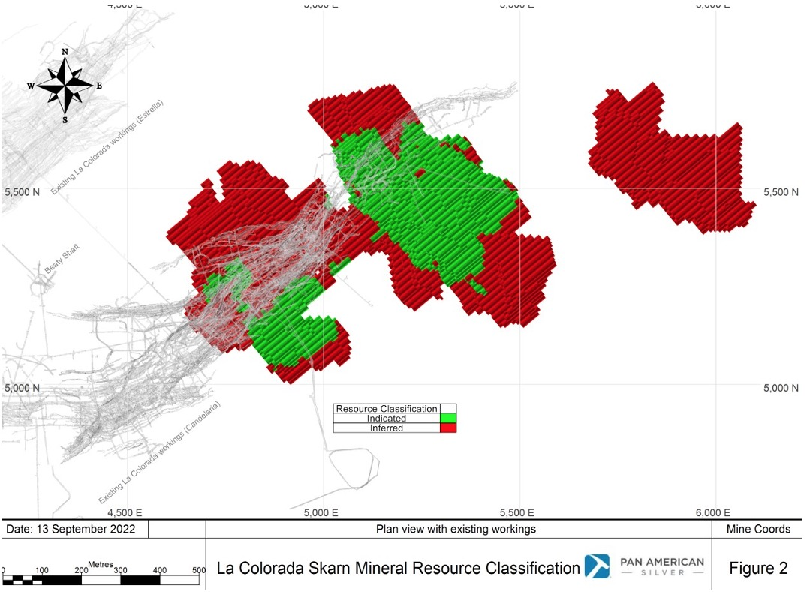
LA COLORADA SKARN VIEW
13
// polymetallic skarn mineralisation is concentrated in 3 zones, covering an area of 1,500 metres by 1,100 metres laterally, and a depth of between 600 metres and 1,900 metres below surface

Slide 14
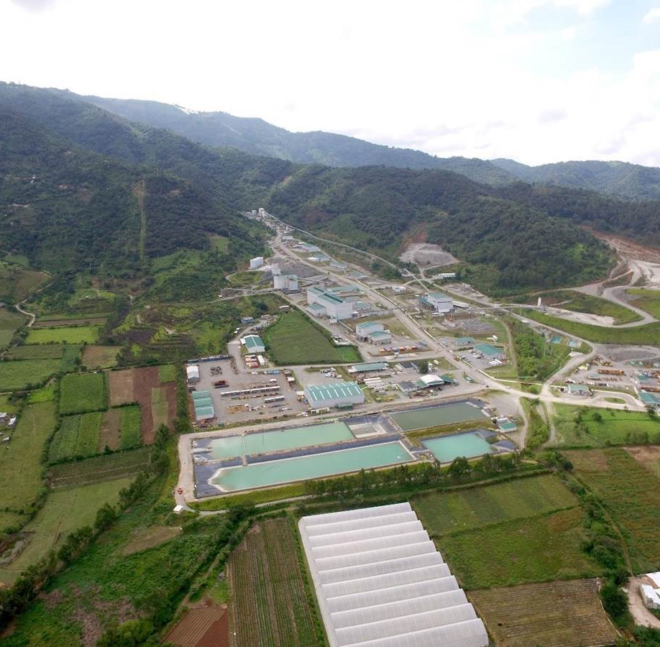
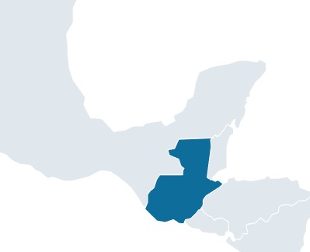
14
SANTA ROSA, GUATEMALA
ESCOBAL
MEXICO
GUATEMALA
// One of the world’s best silver mines
Escobal
High-quality, well-built operation with over US$500 million invested⁽¹⁾
One of the world’s largest primary silver deposits with reserves of 264 Moz
3 consecutive years of production at 20 Moz Ag/year at AISC consistently below US$10/oz Ag prior to 2017
Mine operations suspended pending completion of an ILO 169 consultation by the Guatemalan government
Based on development, expansion, and sustaining capital invested from 2011 to 2017.
Historical Silver Production & AISC
Mineral Reserves
& Resources
 |  | Grade |  |  |  | Contained Metal
 | Tonnes | Ag | Au | Pb | Zn | Ag | Au | Pb | Zn
 | (Mt) | (g/t) | (g/t) | (%) | (%) | (Moz) | (koz) | (kt) | (kt)
P&P Reserves | 24.7 | 334 | 0.35 | 0.79 | 1.30 | 264.5 | 278 | 196 | 320
M&I Resources | 16.5 | 208 | 0.21 | 0.37 | 0.65 | 110.1 | 110 | 61 | 106
Inferred Resources | 1.9 | 180 | 0.90 | 0.22 | 0.42 | 10.7 | 54 | 4 | 8
2014A
2015A
2016A
AISC is a non-GAAP measure; see the “Non-GAAP Measures” section of our Cautionary Note on page 2 of this presentation.
(as of June 30, 2023)
See presentation Appendix for more detailed information on the Company's reserves and resources and the metal price assumptions used for these estimates.
NYSE | TSX PAAS

Slide 15
15
ESCOBAL CONSULTATION PHASE UNDERWAY
For more information, please visit https://mem.gob.gt/derecho-minero-escobal/
// Escobal mining license suspended pending completion of an ILO 169 Consultation in Guatemala
PRE-PHASE 1
REVIEW
PHASE 1
PRE-CONSULTATION
PHASE 2
CONSULTATION
PHASE 3
SUPREME COURT VERIFICATION
PAS Guatemala shall work with 2011 Environmental Impact Study (EIS) consultant and experts at two Guatemalan Universities to review, define, and recommend area of influence (AOI) to Ministry of Environment and Natural Resources
Ministry of Energy and Mines (MEM) leads the process
Define and agree to the terms, timeline and mechanisms under which the consultation (Phase 2) will take place
MEM leads the process
Formal dialogue process to achieve agreements amongst the main participants in the process: Xinka indigenous communities, MEM and PAS Guatemala (Pan American’s subsidiary in Guatemala)
MEM to submit results of the consultation process to the Guatemalan Supreme Court (SC)
SC certifies with all three parties that the ILO 169 consultation process as outlined in the Constitutional Court’s resolution has been followed
MARN (Environmental Ministry) completed the area of influence analysis and submitted to the MEM in November 2018. On February 5, 2020, the Supreme Court ruled that the MARN process for the determination of the AOI was completed properly.
Pre-consultation completed in July 2022.
Underway.
Awaiting completion of Phase 2.

Slide 16
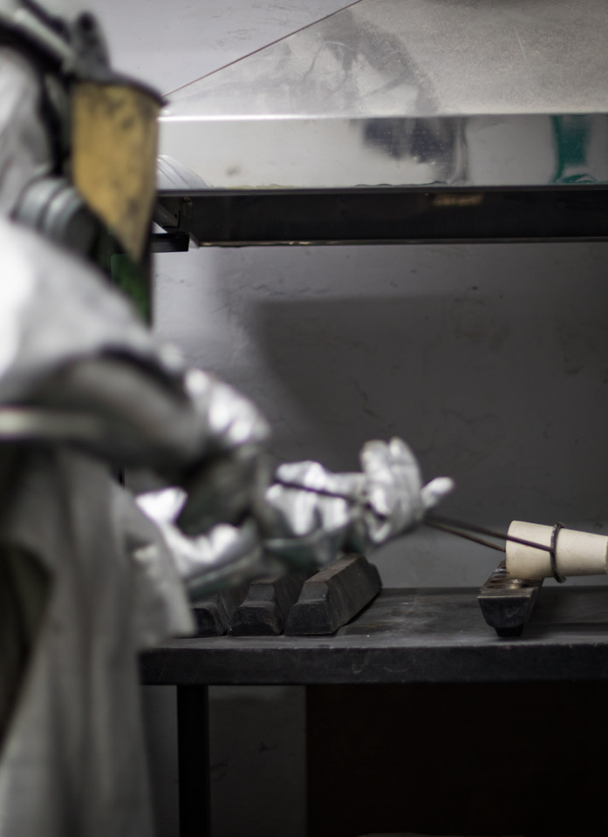
16
Large silver reserves⁽¹⁾
Proven and probable mineral reserves of 576.6 Mozs plus measured and indicated mineral resources of 959.1 Mozs, as of June 30, 2023
Escobal mine has potential to add ~20 Moz of silver production annually following restart of operations
The mine is currently on care and maintenance pending completion of an ILO 169 Consultation by the government of Guatemala
La Colorada Skarn estimated to contain 94.4 Moz of silver indicated mineral resource and 132.9 Moz inferred mineral resource⁽³⁾
Pan American advancing the project through continued infill and exploration drilling and preparation of a preliminary economic assessment for release in late 2023
THE WORLD’S PREMIER SILVER MINING COMPANY
Preferred investment for silver mining investors
Transaction created the world’s premier silver mining company with average daily trading liquidity of $74M⁽²⁾ and a market capitalization of $5.1B⁽⁴⁾
Pan American estimated mineral reserves and resources reported as of June 30, 2023. See presentation Appendix for more detailed information on the Company's reserves and resources.
Based on FactSet 90-day average trading volume as of October 6, 2023.
The effective date of the mineral resource estimate is September 13, 2022; See presentation Appendix for more detailed information on the Company's reserves and resources and the metal price assumptions used for these estimates.
Based on the post-transaction shares outstanding of 364.4 million multiplied by the October 6, 2023 closing price of the Pan American Shares of $13.87.
The “go-to” name for investing in silver

Slide 17
WORLD SILVER SUPPLY & DEMAND
17
// 2022 actual⁽¹⁾; in million ounces
Silver Supply 1,005
Silver Demand
1,242
Source: Silver Institute, April 2023.
Net physical investment in coins and bars.
~ 142 Moz supply shortfall estimated for 2023
By YE 2023, global silver inventories estimated to have decreased by 430.9M ozs Since 2020

Slide 18
18
PHOTOVOLTAIC DEMAND
// Silver demand for solar installations has grown, representing 140 Moz, or ~11% of total demand, in 2022 while thrifting has plateaued
Index is based on silver loadings per cell. Source: Metals Focus, April 2023

Slide 19
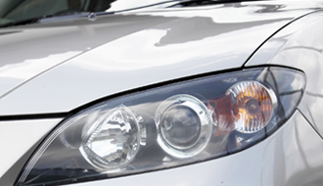

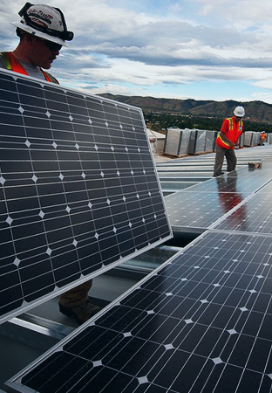

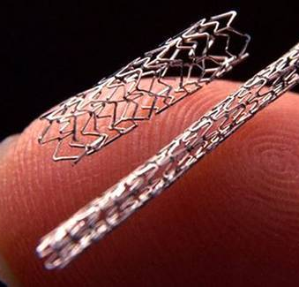

19
SILVER: METAL OF THE FUTURE
// Growing industrial demand from global transition
to decarbonization and electrification
Silver has the highest electrical and thermal conductivity of all metals, making it an important metal in the transition to a low carbon economy.
~11% of silver demand is for photovoltaics (solar panels).
~19% of silver demand is for electrical applications. Shift to a low carbon economy involves increase in electrical componentry, including electrical vehicles.
Silver is an important component in the buildout of 5G networks, the next major evolution in communication technology.
Silver has medical and sanitary applications because of its anti-bacterial properties.
Source: Silver Institute, World Silver Survey 2023

Slide 20
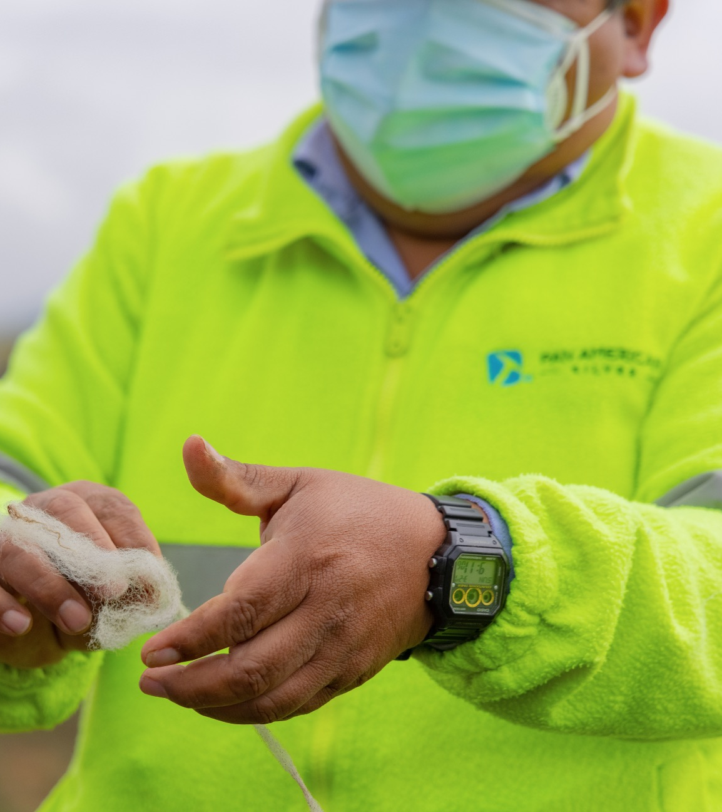

















ESG DISCLOSURE & PERFORMANCE
20
RATINGS & RANKINGS
REPORTING FRAMEWORKS & STANDARDS
68
Ranked top 7% in the Metals & Mining industry
BBB rating
Ranked in the top 45th percentile
  Scale: 0 (worst) to 100 (best).
  Scale: CCC (worst) to AAA (best).
MEMBERSHIPS & COMMITMENTS
27.9 (medium risk)
#8 out of 29 companies in Precious Metals Mining sector | Ranked top 25th percentile
C+ rating
Upgraded from ‘C’ to ‘C+’ in March 2022 | Ranked top 20%
  Scale: 100 (worst) to 0 (best).
  Scale: D- (worst) to A+ (best).
$750 MILLION REVOLVING CREDIT FACILITY LINKED TO
THIRD-PARTY ESG RATINGS (S&P GLOBAL AND MSCI)
PAAS to host ESG call on October 19th , 2023
Details provided at panamericansilver.com
(as of July 25, 2023)

Slide 21
21
A LEADING PRODUCER OF SILVER AND GOLD IN THE AMERICAS
// PAAS SNAPSHOT ¹
NYSE: PAAS
TSX: PAAS
$5.1B
MARKET CAP
364.4M
SHARES OUTSTANDING
$74M
AVERAGE DAILY TRADING VALUE⁽³⁾
$0.10
QUARTERLY DIVIDEND²
2.9%
DIVIDEND YIELD
9
SELL SIDE ANALYSTS
Long-life silver reserves
Medium and long-term growth projects
Committed to best-in-class ESG performance
Experienced management team
Strong balance sheet
MEMBER OF THE MSCI WORLD AND S&P/TSX COMPOSITE INDICES
FactSet market data as of October 6, 2023.
Dividend paid September 1, 2023.
Based on 90-day average daily trading volume and value per FactSet

Slide 22

APPENDIX
ARGENTINA BOLIVIA BRAZIL CANADA CHILE GUATEMALA MEXICO PERU ARGENTINA BOLIVIA BRAZIL CANADA CHILE GUATEMALA MEXICO PERU ARGENTINA BOLIVIA BRAZIL CANADA CHILE GUATEMALA MEXICO PERU ARGENTINA BOLIVIA BRAZIL CANADA CHILE GUATEMALA MEXICO PERU ARGENTINA BOLIVIA BRAZIL CANADA CHILE GUATEMALA MEXICO PERU ARGENTINA BOLIVIA BRAZIL CANADA CHILE GUATEMALA MEXICO PERU ARGENTINA BOLIVIA BRAZIL CANADA CHILE GUATEMALA MEXICO PERU ARGENTINA BOLIVIA BRAZIL CANADA CHILE GUATEMALA MEXICO PERU ARGENTINA BOLIVIA BRAZIL CANADA CHILE GUATEMALA MEXICO PERU ARGENTINA BOLIVIA BRAZIL CANADA CHILE GUATEMALA MEXICO PERU ARGENTINA BOLIVIA BRAZIL CANADA CHILE GUATEMALA MEXICO PERU ARGENTINA BOLIVIA BRAZIL CANADA CHILE GUATEMALA MEXICO ARGENTINA BOLIVIA BRAZIL CANADA CHILE GUATEMALA MEXICO ARGENTINA BOLIVIA BRAZIL CANADA CHILE GUATEMALA MEXICO PERU
Notes:
Less ink intensive.

Slide 23
23
INVESTMENT GRADE SENIOR NOTES
// Low-cost debt acquired as part of the Yamana transaction
$500 million
2.63% coupon
August 2031
S&P long-term issuer rating of BBB-
Moody’s rating of Baa3
Attractive coupon rates
Staggered maturity dates
Redeemable at Company’s option
$283 million
4.625% coupon
December 2027
NYSE | TSX PAAS

Slide 24
2023 OPERATING OUTLOOK (9 month contribution from Yamana acquired mines)
24
 | Silver Production (million ounces) | Gold Production (thousand ounces) | Cash Costs ($ per ounce)⁽¹⁾ | AISC ($ per ounce) ⁽¹⁾
Silver Segment:
La Colorada (Mexico) | 5.5 – 5.9 | 3 | 14.00 – 15.50 | 17.00 – 18.50
Cerro Moro (Argentina)⁽²⁾ | 3.6 – 3.9 | 77 – 85 | 5.50 – 8.80 | 11.00 – 14.50
Huaron (Peru) | 3.6 – 3.8 | – | 5.80 – 7.30 | 11.50 – 13.00
San Vicente (Bolivia)⁽³⁾ | 2.5 – 2.6 | – | 14.10 – 15.90 | 16.00 – 17.50
Manantial Espejo (Argentina)⁽⁴⁾ | 0.2 | 2 | 11.80 – 12.90 | 13.70 – 14.80
Silver Segment Consolidated | 15.4 – 16.4 | 82 – 90 | 10.00 – 12.00 | 14.00 – 16.00
Gold Segment:
Jacobina (Brazil)⁽²⁾ | – | 144 – 164 | 750 – 810 | 1,020 – 1,110
El Peñon (Chile)⁽²⁾ | 2.9 – 3.5 | 122 – 142 | 600 – 770 | 785 – 985
Timmins (Canada) | – | 130 – 141 | 1,340 – 1,480 | 1,650 – 1,800
Shahuindo (Peru) | 0.3 | 134 – 146 | 780 – 920 | 1,300 – 1,470
La Arena (Peru) | – | 98 – 106 | 1,200 – 1,270 | 1,600 – 1,690
Minera Florida (Chile)⁽²⁾ | 0.2 – 0.3 | 62 – 74 | 1,340 – 1,430 | 1,700 – 1,850
Dolores (Mexico) | 2.2 – 2.5 | 98 – 107 | 1,110 – 1,240 | 1,230 – 1,360
Gold Segment Consolidated | 5.6 – 6.6 | 788 – 880 | 975 – 1,100 | 1,275 – 1,425
12-months Pan American Silver Original Assets Production⁽⁵⁾ | 14.3 – 15.3 | 465 – 505
9-months Acquired Operations Production⁽⁶⁾ | 6.7 – 7.7 | 405 – 465
Total Consolidated Production | 21.0 – 23.0 | 870 – 970
In addition to consolidated silver and gold production, 2023 consolidated base metal production is forecast to be:
Zinc (kt) | 41 - 45
Lead (kt) | 18 – 21
Copper (kt) | 5
  Cash Costs and AISC are non-GAAP measures. Please refer to the section “Alternative Performance (Non-GAAP) Measures” of the MD&A for the period ended March 31, 2023 for a detailed description of these measures and where appropriate a reconciliation of the measure to the Q1 2023 Financial Statements. The AISC forecast assumes metal prices of $22.00/oz for silver, $1,850/oz for gold, $3,000/tonne ($1.36/lb) for zinc, $2,100/tonne ($0.95/lb) for lead, and $8,000/tonne ($3.63/lb) for copper; and average annual exchange rates relative to 1 USD of 18.75 for the Mexican peso ("MXN"), 3.75 for the Peruvian sol ("PEN"), 270.00 for the Argentine peso ("ARS"), 7.00 for the Bolivian boliviano ("BOB"), $1.33 for the Canadian dollar ("CAD"), $800.00 for the Chilean peso ("CLP") and $5.00 for the Brazilian real ("BRL").
  2023 production and AISC forecasts for Cerro Moro, Jacobina, El Peñon and Minera Florida reflects ownership for the nine- month period from March 31 to December 31, 2023.
  San Vicente data represents Pan American’s 95.0% interest in the mine's production.
  Mining activities have been completed at Manantial Espejo at the end of 2022, with residual processing completed in January 2023.
  Includes La Colorada, Huaron, San Vicente, Manantial Espejo, Timmins, Shahuindo, La Arena and Dolores mines.
  Reflects ownership of the Cerro Moro, Jacobina, El Peñon and Minera Florida mines for the nine-month period from March 31 to December 31, 2023.

Slide 25
2023 CAPITAL EXPENDITURE & OPERATING FORECAST
25
 | Expenditures ($ millions)
Sustaining Capital
La Colorada (Mexico) | 15.0 – 16.0
Cerro Moro (Argentina) | 20.0 – 21.0
Huaron (Peru) | 17.0 – 18.0
San Vicente (Bolivia)⁽¹⁾ | 3.5 – 4.5
Jacobina (Brazil) | 42.0 – 44.0
El Peñon (Chile) | 25.5 – 26.5
Timmins (Canada) | 41.0 – 43.0
Shahuindo (Peru) | 72.0 – 74.0
La Arena (Peru) | 38.0 – 40.0
Minera Florida (Chile) | 24.0 – 25.0
Dolores (Mexico) | 7.0 – 8.0
Sustaining Capital Sub-total | 305.0 – 320.0
Project Capital
La Colorada Projects (Mexico) | 36.0 – 38.0
Huaron Projects (Peru) | 22.0 – 25.0
Timmins Projects (Canada) | 11.0 – 13.0
Jacobina Projects (Brazil) | 26.0 – 29.0
Project Capital Sub-total | 95.0 – 105.0
Total Capital Expenditures | 400.0 – 425.0
Total Reclamation Expenditures | 18.0 – 20.0
General & Administration | 75.0 – 80.0
Care & Maintenance | 98.0 – 109.0
Exploration Expense⁽²⁾ | 14.0 – 16.0
Project capital invested to advance strategic goals:
Continued exploration and in-fill drilling on the La Colorada Skarn project where engineering work is being advanced towards a H2 2023 PEA and advancing construction of the concrete-lined ventilation shaft
Upgrading plant facility infrastructure at Jacobina
Huaron tailings pressure filtration plant / dry-stack tailings storage
Bell Creek paste fill plant
  Capital expenditures and reclamation expenditures at San Vicente are shown at a 100% ownership.
  Includes regional greenfield exploration expenditures. Expenditures relating to near-mine exploration are included in the sustaining and project capital amounts.

Slide 26
2023 QUARTERLY OPERATING OUTLOOK
26
 | Q1 Actual | Q2 Actual | Q2 Guidance | Q3 Guidance⁽¹⁾ | Q4 Guidance⁽¹⁾ | FY 2023 Guidance⁽¹⁾
Silver Production (million ounces) | 3.89 | 6.02 | 5.40 - 6.00 | 5.70 - 6.40 | 6.00 - 6.70 | 21.00 - 23.00
Gold Production (thousand ounces) | 122.7 | 248.2 | 225.0 - 255.0 | 248.0 - 283.0 | 274.0 - 309.0 | 870.0 - 970.0
Silver Segment Cash Costs ⁽²⁾ | 12.19 | 9.29 | 11.00 - 13.10 | 8.50 - 10.60 | 9.20 - 11.30 | 10.00 - 12.00
Silver Segment AISC ⁽²⁾ | 14.13 | 15.70 | 16.10 - 18.20 | 11.70 - 13.80 | 12.10 - 14.20 | 14.00 - 16.00
Gold Segment Cash Costs ⁽²⁾ | 1,120 | 1,045 | 1,070 - 1,200 | 975 - 1,110 | 860 - 975 | 975 - 1,100
Gold Segment AISC ⁽²⁾ | 1,196 | 1,342 | 1,430 - 1,580 | 1,290 - 1,440 | 1,070 - 1,200 | 1,275 - 1,425
The Q3, Q4 and FY 2023 Guidance are forward-looking; please see the “Cautionary Note Regarding Forward Looking Statements and Information” on slide 2 of this presentation.
Cash Costs and AISC are non-GAAP measures. Please refer to the section “Alternative Performance (Non-GAAP) Measures” of the MD&A for the period ended June 30, 2023, for further information on this measure. The AISC forecast assumes metal prices of $22.00/oz for silver, $1,850/oz for gold, $3,000/tonne ($1.36/lb) for zinc, $2,100/tonne ($0.95/lb) for lead, and $8,000/tonne ($3.63/lb) for copper; and average annual exchange rates relative to 1 USD of 18.75 for the Mexican peso ("MXN"), 3.75 for the Peruvian sol ("PEN"), 270.00 for the Argentine peso ("ARS"), 7.00 for the Bolivian boliviano ("BOB"), $1.33 for the Canadian dollar ("CAD"), $800.00 for the Chilean peso ("CLP") and $5.00 for the Brazilian real ("BRL").

Slide 27
SUSTAINABILITY GOVERNANCE AND MANAGEMENT
// Structure and Accountability
SAFETY, ENVIRONMENTAL
AND SOCIAL
35%
BOARD OF DIRECTORS
The Communities and Sustainable Development (CSD) Committee reviews the Company’s sustainability and ESG performance. The Health, Safety, and Environment (HSE) Committee provides policy direction and oversight of the performance on safety and technical matters relating to the environment. The Nominating and Governance Committee reviews and provides direction on the Company’s governance practices. The Human Resources and Compensation Committee assists the Board in fulfilling its responsibilities relating to human resources and compensation issues.
SAFETY¹
ENVIRONMENT²
Annual Incentive Plan
2022
I&D³
CORPORATE MANAGEMENT TEAM
Our CEO and senior leadership direct and oversee strategy, programs, initiatives, and performance related to communities, health and safety, environment and human resources. They also monitor sustainability indicator performance on a monthly basis. The ESG Management Committee supports the Company in fulfilling its ESG management responsibilities and enhancing its ESG performance.
TSM⁴
OPERATING
PERFORMANCE
COUNTRY MANAGERS
Oversee and manage sustainability in each of the countries where we operate.
GROWTH
  ¹ Lost time injury frequency (LTIF)
  and lost time injury severity (LTIS) targets.
  ² Significant Environmental Incidents (“SEIs”).
  ³ Inclusion & Diversity by percentage of women employees in the total
  workforce.
  ⁴ Level of performance of Mining Association of Canada’s TSM standard.
MINE MANAGERS
Implement sustainability programs and initiatives and supervise teams responsible for community relations, environment, safety, and human resources.

Slide 28
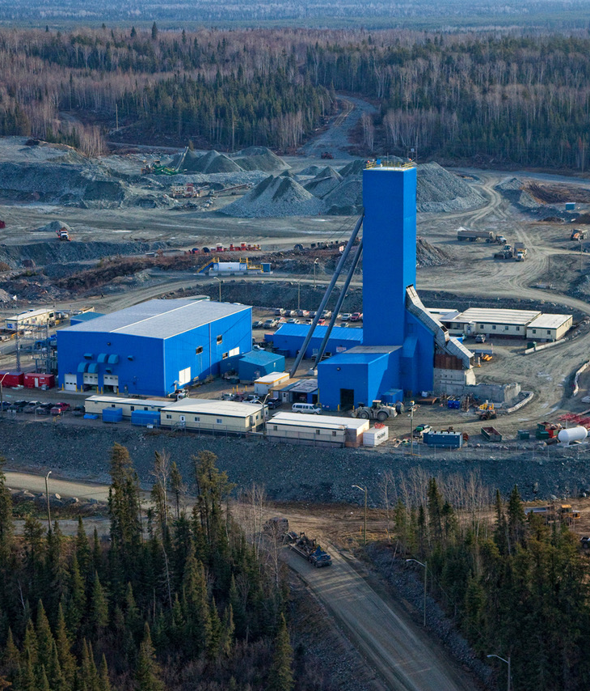
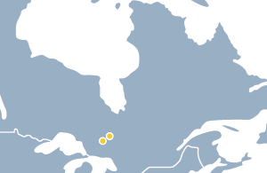
28
ONTARIO, CANADA
TIMMINS
Timmins West
Bell Creek
// Two producing mines in prolific Canadian mining camp
100% owned and operated
Comprises two underground gold mines, Timmins West and Bell Creek, which both feed the Bell Creek mill
Throughput capacity of ~6,000 tpd producing doré
Exploration success has extended mine life
Gold Production (Koz)
Mineral Reserves & Resources
 |  |  | Grade |  | Contained Metal
 | Tonnes |  | Au |  | Au
 | (Mt) |  | (g/t) |  | (koz)
P&P Reserves | 9.7 |  | 2.87 |  | 893
M&I Resources | 4.9 |  | 2.63 |  | 418
Inferred Resources | 3.8 |  | 3.11 |  | 384
2020
2021
2022
(as of June 30, 2023; see presentation Appendix for more detailed information on the Company's reserves and resources and the metal price assumptions used for these estimates.)

Slide 29
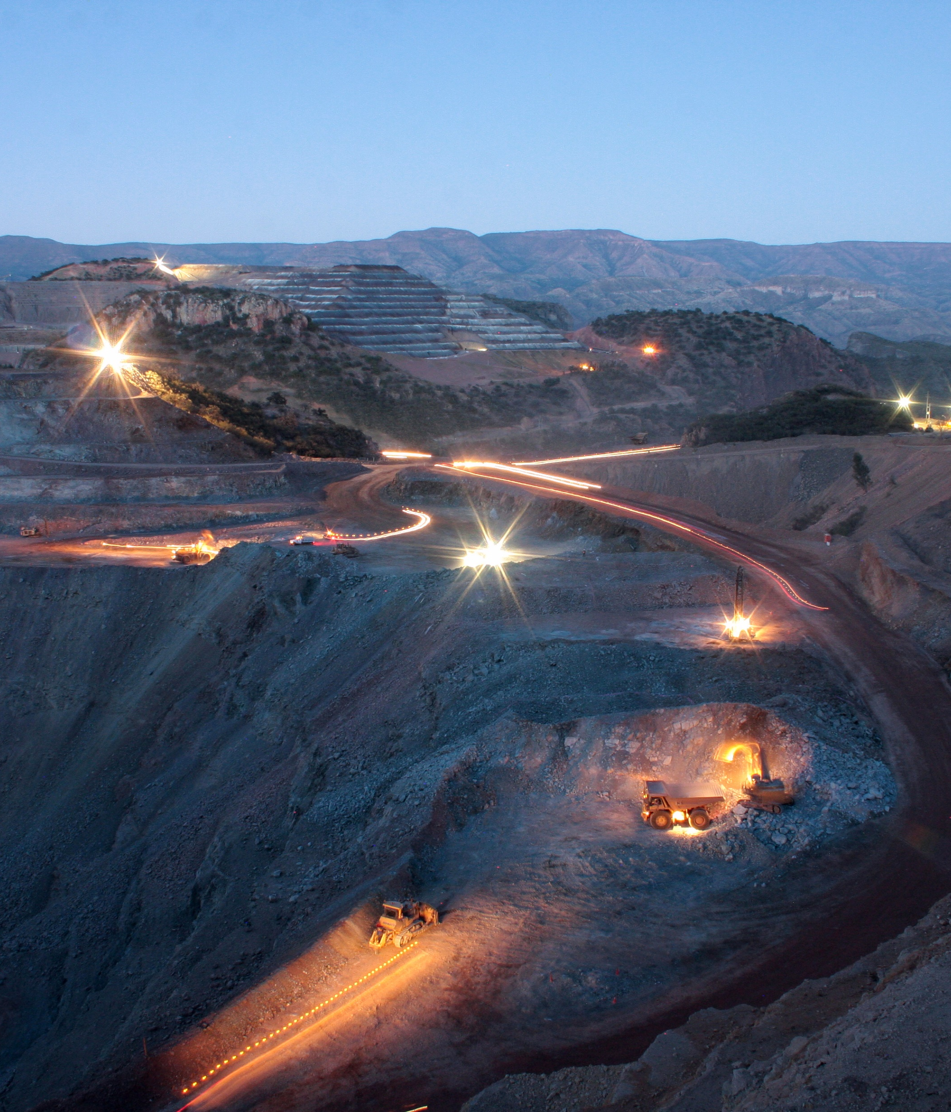
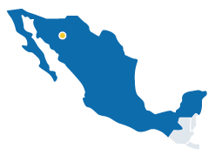
29
Dolores
CHIHUAHUA, MEXICO
DOLORES
// Large gold / silver Mine
100% owned and operated
Mining is by open pit and uses conventional cyanide heap leaching to produce gold and silver doré
Average throughput capacity of 20,000 tpd
Silver & Gold Production
Mineral Reserves & Resources
 |  | Grade |  | Contained Metal
 | Tonnes | Ag | Au | Ag | Au
 | (Mt) | (g/t) | (g/t) | (Moz) | (koz)
P&P Reserves | 7.6 | 18 | 0.53 | 4.4 | 131
M&I Resources | 6.2 | 28 | 0.44 | 5.5 | 86
Inferred Resources | 1.3 | 40 | 1.18 | 1.7 | 50
2020
2021
2022
(as of June 30, 2023; see presentation Appendix for more detailed information on the Company's reserves and resources and the metal price assumptions used for these estimates.)

Slide 30
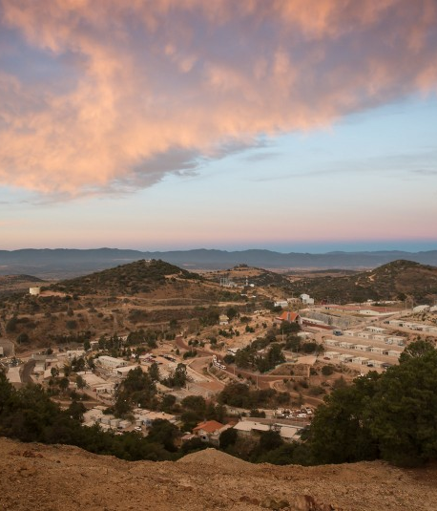
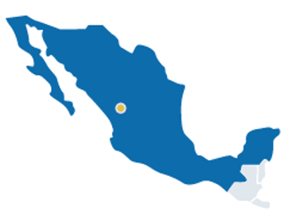
ZACATECAS, MEXICO
La Colorada
LA COLORADA
// Pan American’s largest silver producing mine
100% owned and operated underground mine
Expansion completed in 2017 – new mine shaft and sulphide processing plant
Currently producing silver-gold doré bars from a conventional cyanide leach plant for the oxide ore, and silver-rich lead and zinc concentrates from a flotation plant treating sulphide ore
Silver Production (Moz)
Mineral Reserves & Resources
 |  |  | Grade |  |  |  |  |  |  |  | Contained Metal
 | Tonnes |  | Ag |  | Au |  | Pb |  | Zn |  | Ag |  | Au |  | Pb |  | Zn
 | (Mt) |  | (g/t) |  | (g/t) |  | (%) |  | (%) |  | (Moz) |  | (koz) |  | (kt) |  | (kt)
P&P Reserves | 9.2 |  | 294 |  | 0.20 |  | 1.25 |  | 2.18 |  | 86.3 |  | 59 |  | 114 |  | 199
M&I Resources | 3.2 |  | 176 |  | 0.18 |  | 0.82 |  | 1.35 |  | 18.2 |  | 18 |  | 26 |  | 44
Inferred Resources | 14.7 |  | 174 |  | 0.20 |  | 0.94 |  | 1.67 |  | 82.2 |  | 93 |  | 138 |  | 245
2020
2021
2022
(as of June 30, 2023; see presentation Appendix for more detailed information on the Company's reserves and resources and the metal price assumptions used for these estimates.)

Slide 31
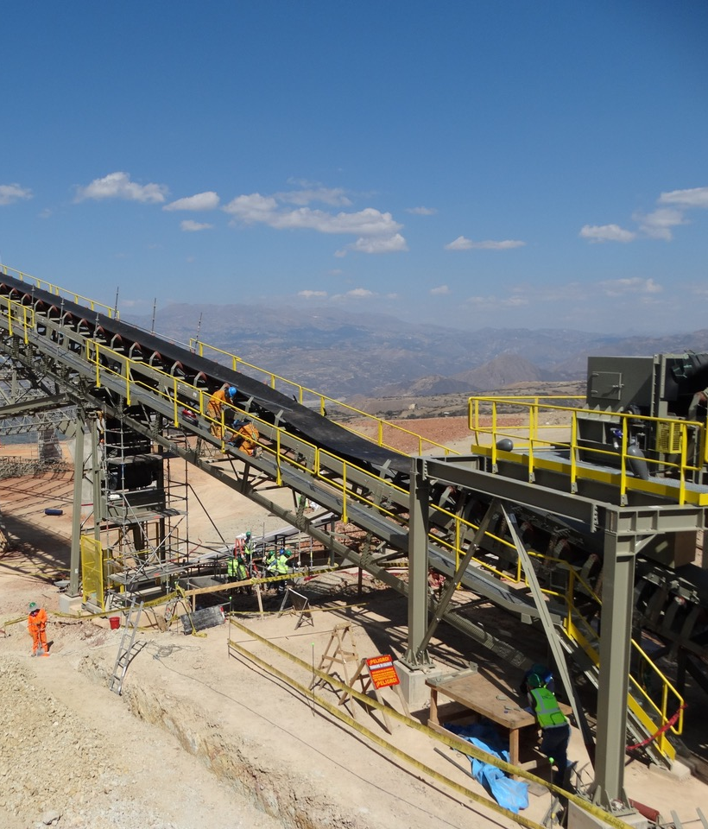
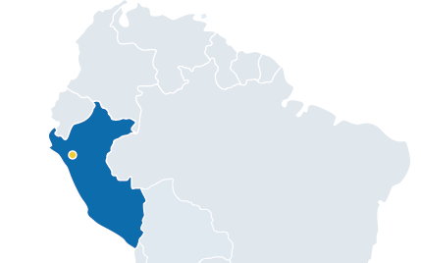
CAJAMARCA, PERU
Shahuindo
SHAHUINDO
// Large gold mine with significant growth potential
100% owned and operated open pit gold mine producing silver by-products from doré
Average throughput capacity of ~36,000 tpd with heap leach processing
Commercial production began in 2016, significant exploration potential and ability to extend mine life
Gold Production (koz)
Mineral Reserves & Resources
 |  |  | Grade |  |  |  | Contained Metal
 | Tonnes |  | Au |  | Ag |  | Au |  | Ag
 | (Mt) |  | (g/t) |  | (g/t) |  | (koz) |  | (Moz)
P&P Reserves | 92.4 |  | 0.47 |  | 7 |  | 1,405 |  | 21.9
M&I Resources | 12.5 |  | 0.32 |  | 5 |  | 129 |  | 2.3
Inferred Resources | 10.1 |  | 0.38 |  | 8 |  | 124 |  | 2.4
2020
2021
2022
(as of June 30, 2023; see presentation Appendix for more detailed information on the Company's reserves and resources and the metal price assumptions used for these estimates.)

Slide 32
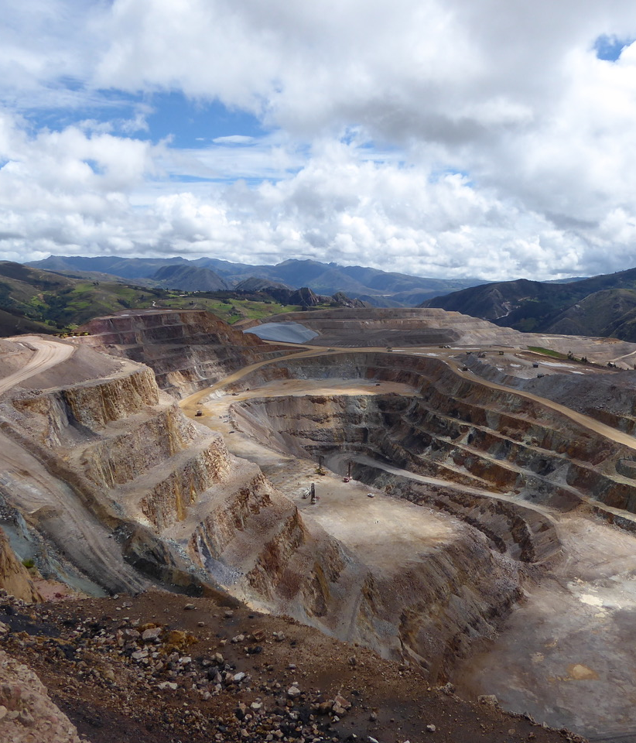
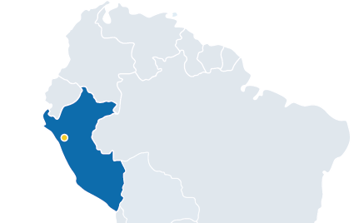
LA LIBERTAD, PERU
La Arena
LA ARENA
// Gold mine with sulphide expansion potential (La Arena II)
100% owned and operated open pit gold mine producing doré
Run-of-mine heap leach currently processing ~36,000 tpd
Exploration success has extended mine life
Gold Production (Koz)
Mineral Reserves & Resources
 |  |  | Grade |  | Contained Metal
 | Tonnes |  | Au |  | Au
 | (Mt) |  | (g/t) |  | (koz)
P&P Reserves | 32.6 |  | 0.33 |  | 343.1
M&I Resources | 3.3 |  | 0.19 |  | 20.6
Inferred Resources | 5.8 |  | 0.23 |  | 43.4
2020
2021
2022
(as of June 30, 2023; see presentation Appendix for more detailed information on the Company's reserves and resources and the metal price assumptions used for these estimates.)

Slide 33
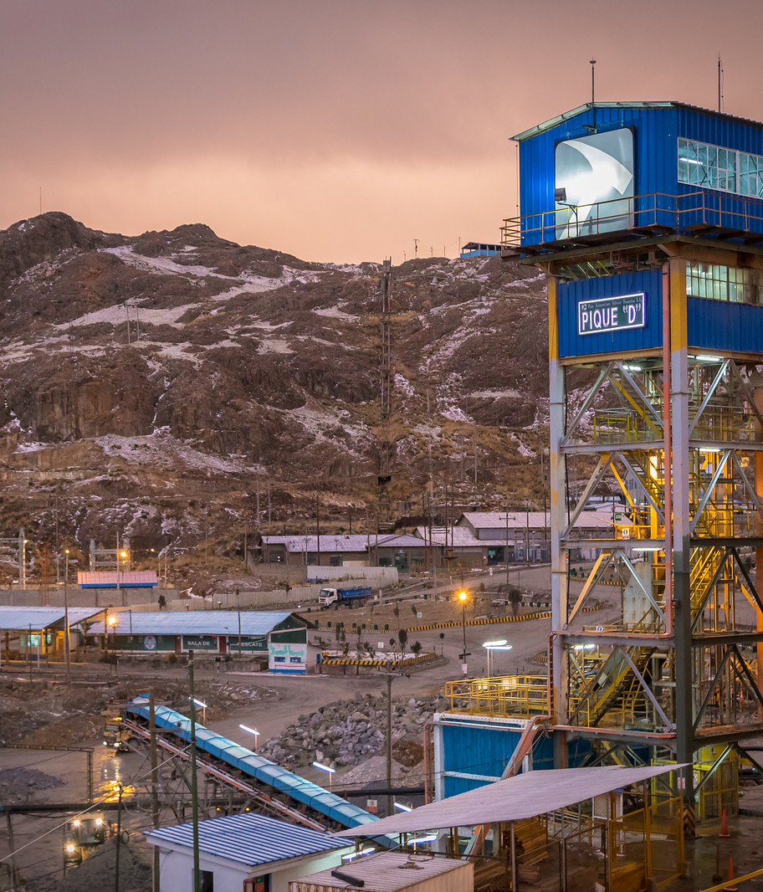
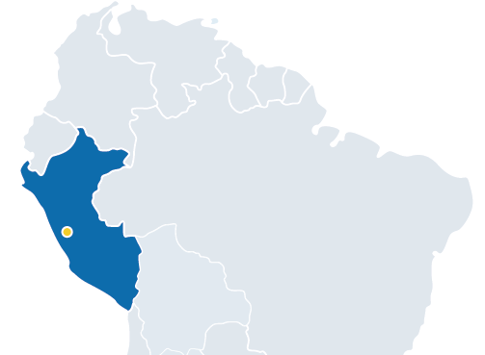
PASCO, PERU
Huaron
HUARON
// Polymetallic silver mine
100% owned and operated underground mine
Average throughput capacity of ~2,500 tpd using flotation technology to produce silver in copper, lead, and zinc concentrates
Silver Production (Moz)
Mineral Reserves & Resources
 |  |  | Grade |  |  |  |  |  |  |  | Contained Metal
 | Tonnes |  | Ag |  | Cu |  | Pb |  | Zn |  | Ag |  | Cu |  | Pb |  | Zn
 | (Mt) |  | (g/t) |  | (%) |  | (%) |  | (%) |  | (Moz) |  | (kt) |  | (kt) |  | (kt)
P&P Reserves | 9.3 |  | 171 |  | 0.56 |  | 1.60 |  | 3.07 |  | 50.9 |  | 51 |  | 148 |  | 285
M&I Resources | 3.2 |  | 176 |  | 0.30 |  | 1.90 |  | 3.09 |  | 18.4 |  | 10 |  | 62 |  | 100
Inferred Resources | 5.9 |  | 164 |  | 0.35 |  | 1.76 |  | 2.87 |  | 31.2 |  | 21 |  | 104 |  | 170
2020
2021
2022
(as of June 30, 2023; see presentation Appendix for more detailed information on the Company's reserves and resources and the metal price assumptions used for these estimates.)

Slide 34
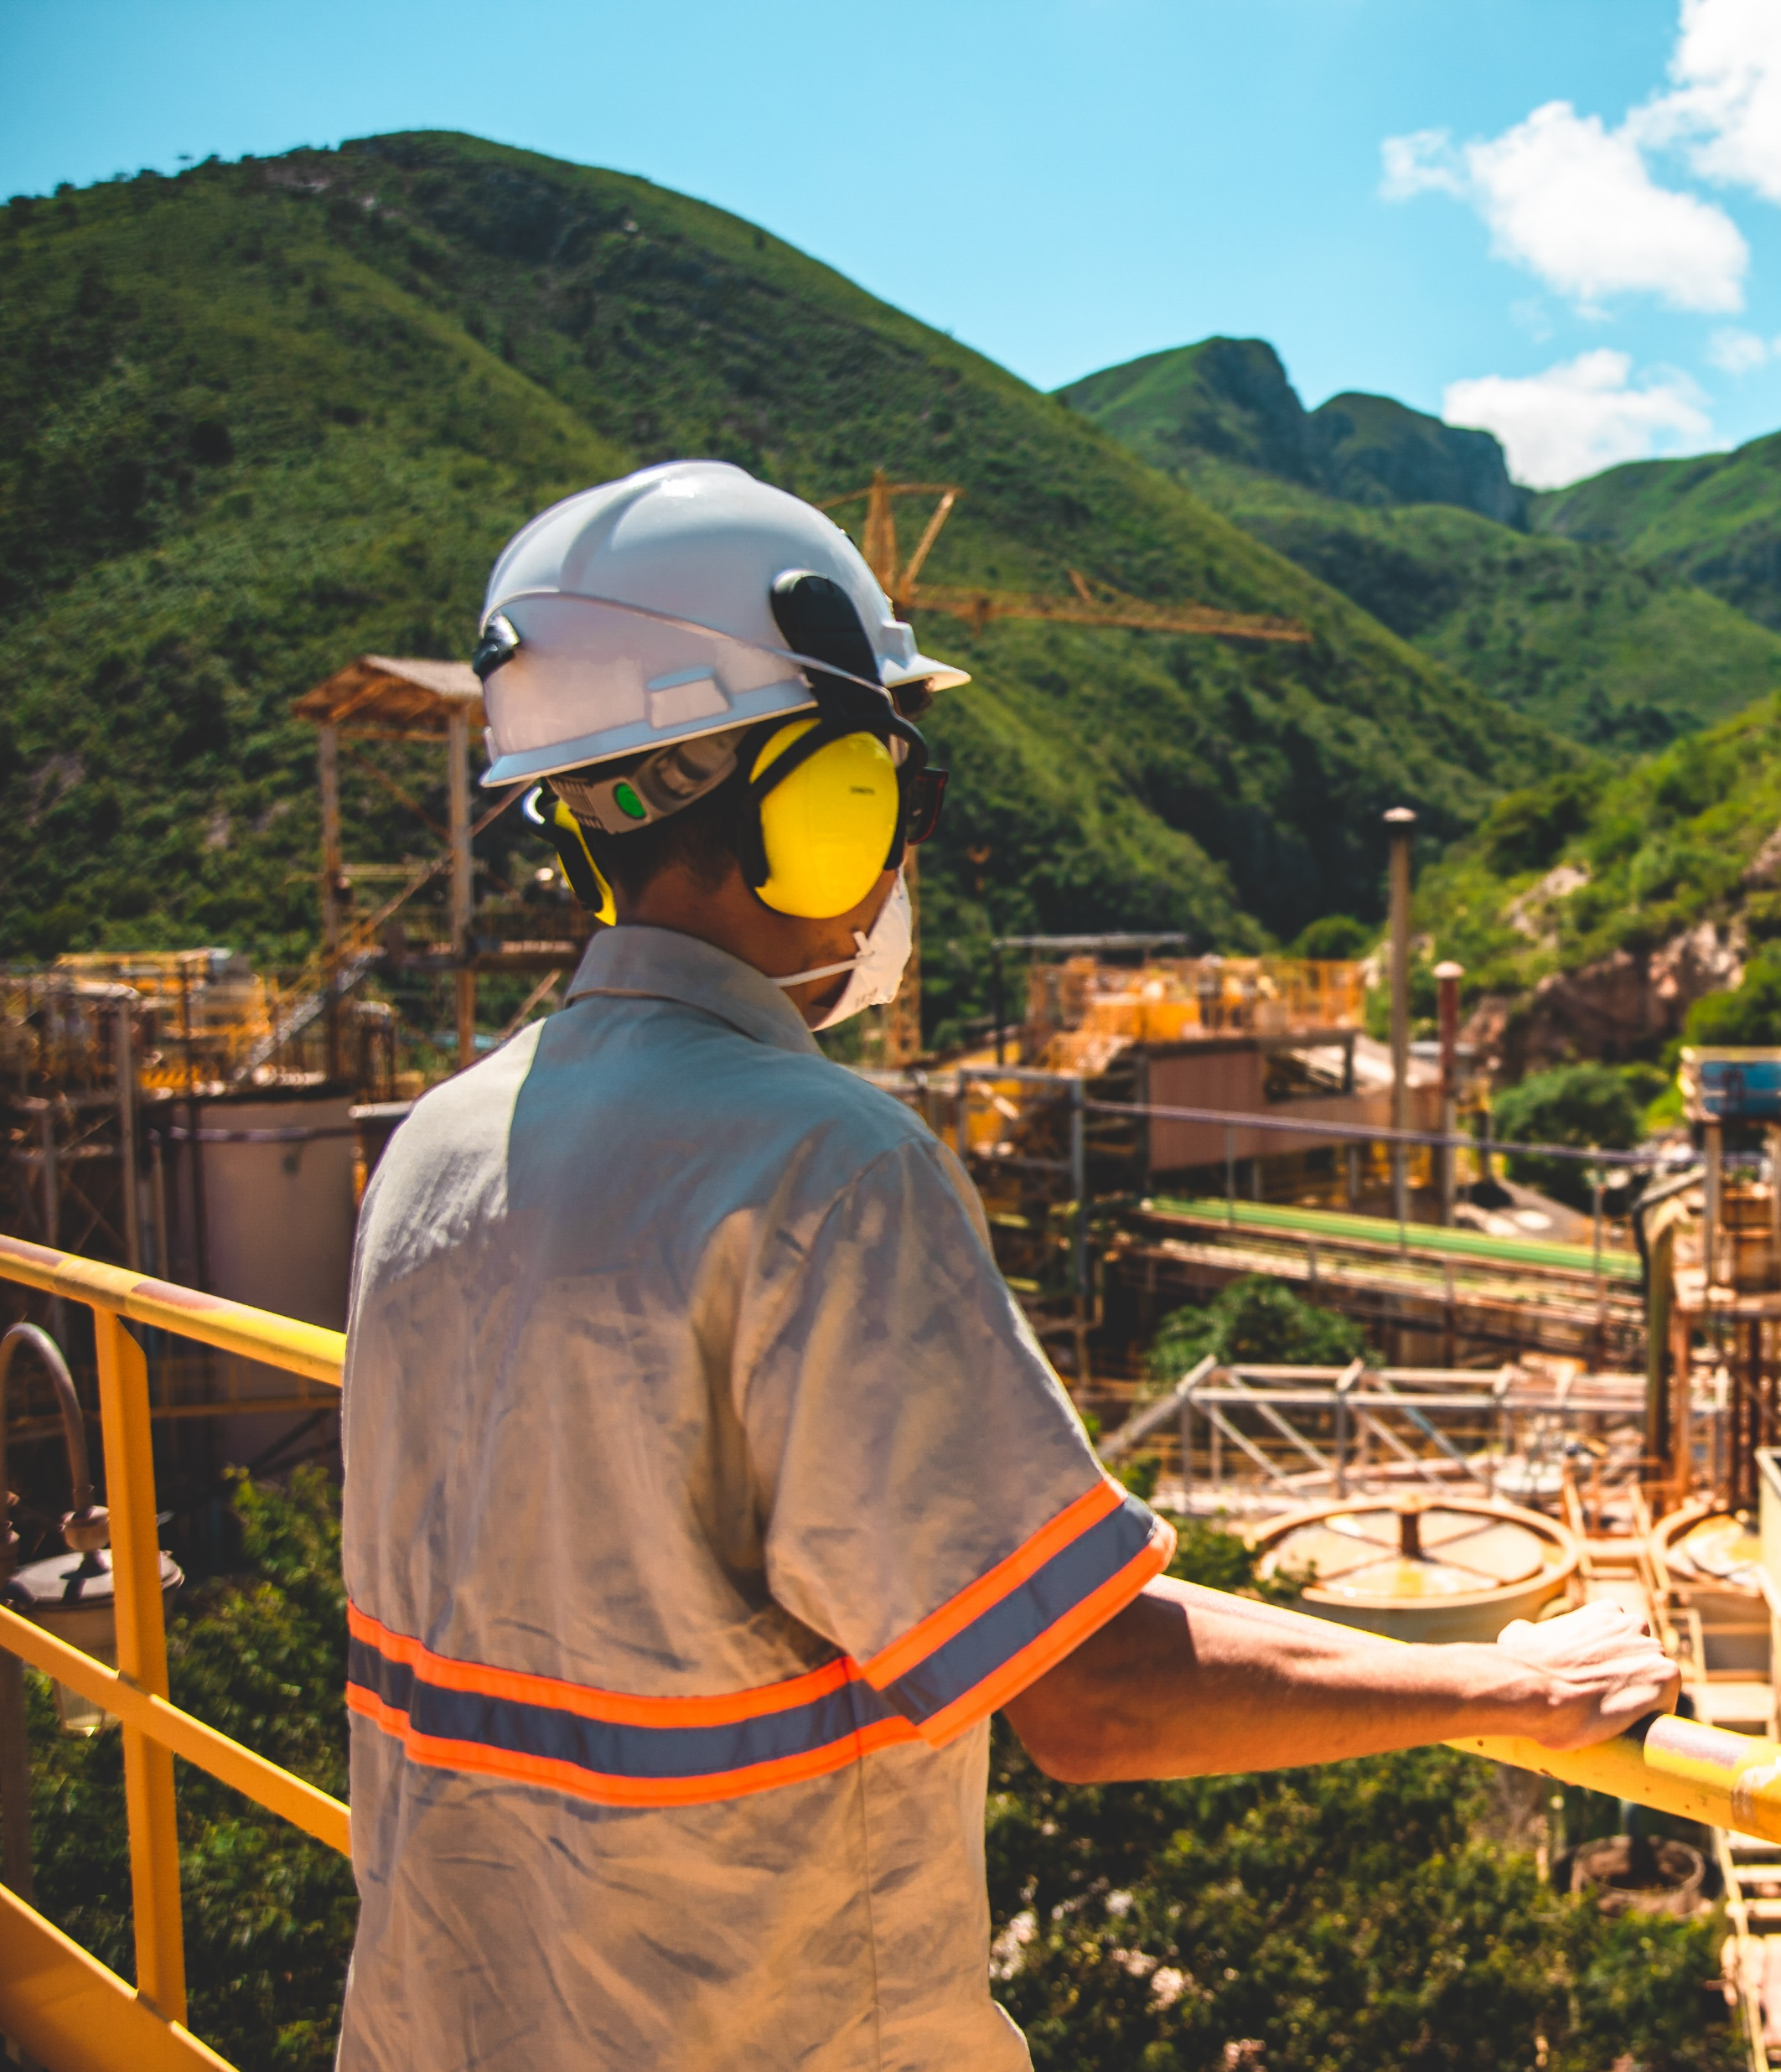
BAHIA, BRAZIL
Jacobina
JACOBINA
// Large gold mine with significant growth potential⁽¹⁾
100% owned and operated underground gold mine producing doré via a conventional leaching process
Average throughput of ~8,289 tpd during 2022 with the phased expansion to 8,500 tpd completed mid-2022
Gold Production (koz)⁽¹⁾
Mineral Reserves & Resources
 |  |  | Grade |  | Contained Metal
 | Tonnes |  | Au |  | Au
 | (Mt) |  | (g/t) |  | (koz)
P&P Reserves | 48.3 |  | 2.02 |  | 3,143
M&I Resources | 94.4 |  | 1.55 |  | 4,704
Inferred Resources | 40.1 |  | 1.56 |  | 2,015
2020
2021
2022
(as of June 30, 2023; see presentation Appendix for more detailed information on the Company's reserves and resources and the metal price assumptions used for these estimates.)
  Please see Yamana Gold’s SEDAR profile for further information.

Slide 35
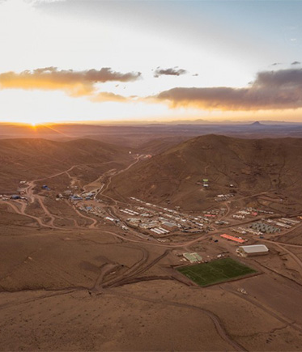
POTOSÍ, BOLIVIA
San Vicente
SAN VICENTE
// Polymetallic silver mine
95% owned and operated underground mine
Average throughput capacity of ~950 tpd utilizing a standard flotation process to produce silver-zinc and silver-lead concentrates
Mechanization efforts, enhanced mine dilution controls and improvements in site infrastructure underway to lower production costs
Silver Production (Moz)
Mineral Reserves & Resources
 |  |  | Grade |  |  |  |  |  |  |  | Contained Metal
 | Tonnes |  | Ag |  | Cu |  | Pb |  | Zn |  | Ag |  | Cu |  | Pb |  | Zn
 | (Mt) |  | (g/t) |  | (%) |  | (%) |  | (%) |  | (Moz) |  | (kt) |  | (kt) |  | (kt)
P&P Reserves | 1.4 |  | 310 |  | 0.31 |  | 0.28 |  | 3.49 |  | 14.6 |  | 4 |  | 4 |  | 51
M&I Resources | 1.1 |  | 204 |  | 0.19 |  | 0.23 |  | 2.62 |  | 7.0 |  | 2 |  | 3 |  | 28
Inferred Resources | 1.5 |  | 188 |  | 0.22 |  | 0.27 |  | 2.63 |  | 9.2 |  | 3 |  | 4 |  | 40
2020
2021
2022
(as of June 30, 2023; see presentation Appendix for more detailed information on the Company's reserves and resources and the metal price assumptions used for these estimates.)

Slide 36
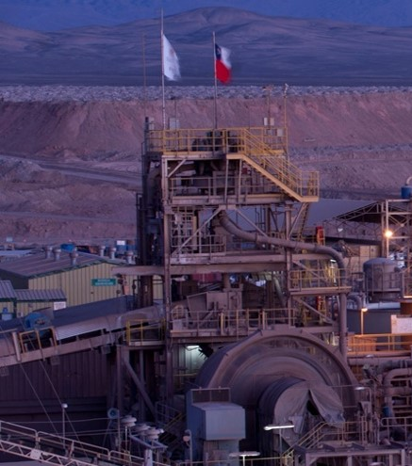
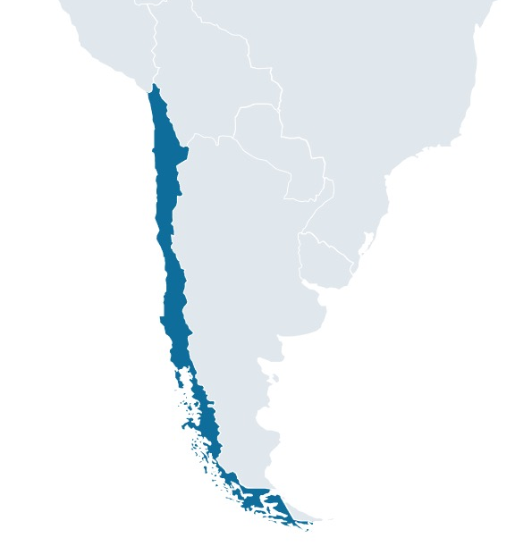
ANTOFAGASTA, CHILE
El Peñon
El Peñon
// Large gold / silver Mine
100% owned and operated underground gold and silver mine producing gold and silver doré
The mine has been in operation since 1999 and has consistently replaced ounces mined
Average throughput of ~3,714 tpd in 2022
Silver & Gold Production⁽¹⁾
Mineral Reserves & Resources
 |  |  | Grade |  |  |  | Contained Metal
 | Tonnes |  | Au |  | Ag |  | Au |  | Ag
 | (Mt) |  | (g/t) |  | (g/t) |  | (koz) |  | (Moz)
P&P Reserves | 6.1 |  | 4.38 |  | 158 |  | 855 |  | 30.8
M&I Resources | 7.8 |  | 3.19 |  | 106 |  | 795 |  | 26.5
Inferred Resources | 18.5 |  | 1.36 |  | 51 |  | 805 |  | 30.0
2020
2021
2022
(as of June 30, 2023; see presentation Appendix for more detailed information on the Company's reserves and resources and the metal price assumptions used for these estimates.)
  Please see Yamana Gold’s SEDAR profile for further information.

Slide 37
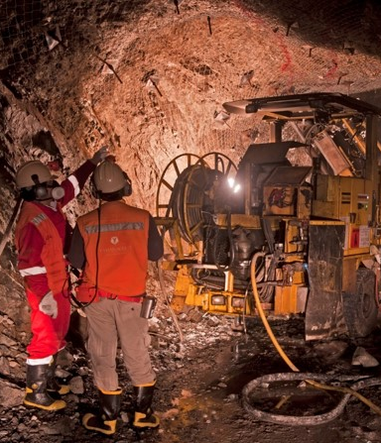
METROPOLITAN REGION, CHILE
MINERA FLORIDA
Minera Florida
// Polymetallic gold mine
100% owned and operated underground mine producing gold and silver doré bars and zinc concentrate
Average throughput of ~2,649 tpd during 2022
Gold Production (koz)⁽¹⁾
Mineral Reserves & Resources
 |  |  | Grade |  |  |  |  |  | Contained Metal
 | Tonnes |  | Au |  | Ag |  | Zn |  | Au |  | Ag |  | Zn
 | (Mt) |  | (g/t) |  | (g/t) |  | (%) |  | (koz) |  | (Moz) |  | (kt)
P&P Reserves | 2.9 |  | 3.27 |  | 22 |  | 1.00 |  | 300 |  | 2.0 |  | 28
M&I Resources | 6.2 |  | 3.30 |  | 18 |  | 1.08 |  | 654 |  | 3.6 |  | 67
Inferred Resources | 4.9 |  | 2.93 |  | 15 |  | 0.83 |  | 461 |  | 2.4 |  | 41
2020
2021
2022
(as of June 30, 2023; see presentation Appendix for more detailed information on the Company's reserves and resources and the metal price assumptions used for these estimates.)
  Please see Yamana Gold’s SEDAR profile for further information.

Slide 38
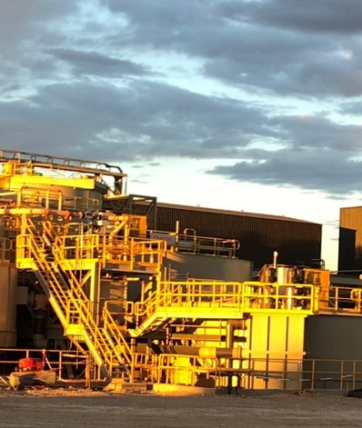
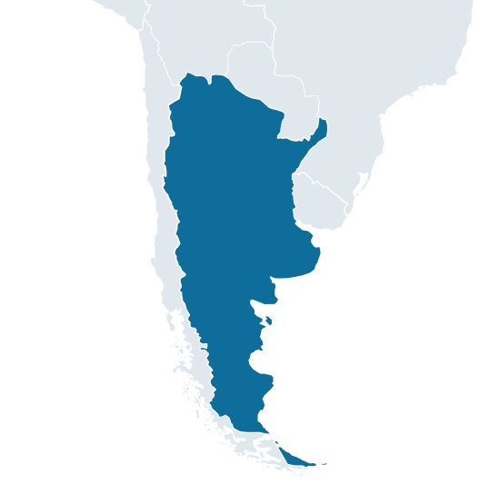
SANTA CRUZ, ARGENTINA
Cerro moro
// Integrated gold & silver mining complex
Cerro Moro
100% owned and operated open pit and underground gold and silver complex feeding a single processing plant producing gold and silver doré
Average throughput of ~1,074 tpd in 2022
Silver & Gold Production⁽¹⁾
Mineral Reserves & Resources
 |  |  | Grade |  |  |  | Contained Metal
 | Tonnes |  | Ag |  | Au |  | Ag |  | Au
 | (Mt) |  | (g/t) |  | (g/t) |  | (Moz) |  | (koz)
P&P Reserves | 1.2 |  | 276 |  | 7.41 |  | 11.3 |  | 302
M&I Resources | 0.7 |  | 340 |  | 4.93 |  | 8.2 |  | 120
Inferred Resources | 0.7 |  | 220 |  | 8.66 |  | 4.9 |  | 192
2020
2021
2022
(as of June 30, 2023; see presentation Appendix for more detailed information on the Company's reserves and resources and the metal price assumptions used for these estimates.)
  Please see Yamana Gold’s SEDAR profile for further information.

Slide 39
LA LIBERTAD, PERU
La Arena II
LA ARENA II
// 100% owned, undeveloped copper porphyry
Mineral Resources²
(as of June 30, 2023)
 |  | Grade |  | Contained Metal
 | Tonnes | Au | Cu | Au | Cu
 | (Mt) | (g/t) | (%) | (koz) | (kt)
M&I Resources | 708.7 | 0.23 | 0.37 | 5,300 | 2,633
Inferred Resources | 68.2 | 0.21 | 0.29 | 455 | 159
Model Highlights & Key Assumptions
LT Gold Price | 1,300 US$/oz | Ave. Au Sulphide Grade | 0.24 g/t
LT Copper Price | 3.30 US$/lb | LOM Average Cu Mill Recovery Sulphide | 87%
LOM Average Milled | 28.8 Mtpa | LOM Average Au Mill Recovery Sulphide | 60%
Initial Capital | 1,346 US$M | LOM Metal Production – Copper Concentrate | 4,465 Mlbs
Sustaining Capital | 1,093 US$M | LOM Metal Production – Gold in Copper Concentrate | 2,790 Koz
Avg. Annual Operating Costs | 395 US$M | LOM Gold Doré Production | 575 Koz
Ave. Cost Per Tonne Processed | 12.87 US$/mt | NPV At 8% | 823.8 US$M
Sulphide Milled | 616.4 Mt | IRR | 14.7%
Ave. Cu Sulphide Grade | 0.38% | Ave. Annual After Tax Cash Flow | 273 US$M
Based on Tahoe PEA February 2018¹
Mine Type | PEA study projects large Open Pit
Processing | Flotation Processing Plant to be constructed
Products | Copper Concentrate (Doré from smaller oxide resource)
Capacity | Projected to be 80,000 tpd
Modeled Mine Life | 21 Year Production Life
Deposit Type | Porphyry
Reference is made to the Technical Report on the La Arena Project, Peru dated February 20, 2018 prepared for Tahoe Resources Inc., a copy of which is filed under the company profile of Tahoe Resources Inc. on SEDAR at www.sedar.com. This technical report contains a preliminary economic assessment of the La Arena II copper-gold porphyry project. Preliminary economic assessment is preliminary in nature, and includes inferred mineral resources that are considered too speculative geologically to have the economic considerations applied to them that would enable them to be categorized as mineral reserves. There is no certainty that the preliminary economic assessment will be realized. As of the date of this presentation, the Qualified Persons named in this presentation are not aware that there is any new material scientific or technical information that would make this disclosure relating to the preliminary economic assessment to be inaccurate or misleading.
The expansion of the current La Arena pit has resulted in the removal of a small portion of the La Arena II resources from those reported in the Tahoe 2018 PEA.

Slide 40
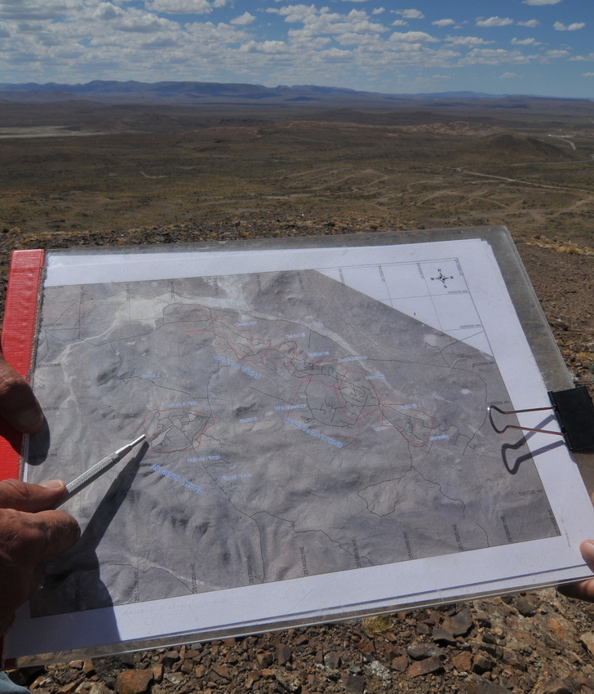
40
CHUBUT, ARGENTINA
NAVIDAD
// One of the largest undeveloped primary silver deposits
Navidad
100% owned silver project
Project comprises 8 individual mineral deposits in
3 separate mineralized trends
Scalable production profile with high-grade mineralization at surface
Development contingent on provincial mining law change
Mineral Resources
 |  |  | Grade |  |  |  |  |  | Contained Metal
 | Tonnes |  | Ag |  | Cu |  | Pb |  | Ag |  | Cu |  | Pb
 | (Mt) |  | (g/t) |  | (%) |  | (%) |  | (Moz) |  | (kt) |  | (kt)
M&I Resources | 155.2 |  | 127 |  | 0.06 |  | 0.86 |  | 632.4 |  | 71 |  | 1,326
Inferred Resources | 45.9 |  | 81 |  | 0.02 |  | 0.57 |  | 119.4 |  | 9 |  | 262
(as of June 30, 2023; see presentation Appendix for more detailed information on the Company's reserves and resources and the metal price assumptions used for these estimates.)

Slide 41
ZACATECAS, MEXICO
ZACATECAS, MEXICO
LA COLORADA SKARN PROJECT
// Mineral Resource Estimate at Different Cut-off Values and Mining Methods
Mining Method | Cut-off Value (US$/tonne) | Classification | Tonnes (millions) | Zn (%) | Pb (%) | Ag (g/t) | Zn (Mt) | Pb (Mt) | Ag (Moz)
Sub-level Caving (SLC) | 45 | Indicated | 95.9 | 2.77 | 1.28 | 31 | 2.66 | 1.23 | 94.4
 |  | Inferred | 147.8 | 2.29 | 1.04 | 28 | 3.39 | 1.54 | 132.9
Sub-level Shrinkage (SLS) | 45 | Indicated | 101.5 | 2.66 | 1.22 | 30 | 2.70 | 1.24 | 96.3
 |  | Inferred | 153.2 | 2.03 | 0.88 | 25 | 3.12 | 1.34 | 125.1
 | 65 | Indicated | 67.3 | 3.08 | 1.46 | 33 | 2.07 | 0.98 | 72.1
 |  | Inferred | 60.8 | 2.59 | 1.13 | 30 | 1.60 | 0.68 | 59.8
Long-hole Open Stoping (LHOS) | 60 | Indicated | 65.4 | 3.39 | 1.62 | 36 | 2.22 | 1.06 | 75.6
 |  | Inferred | 113.8 | 2.91 | 1.32 | 34 | 3.31 | 1.50 | 124.6
 | 70 | Indicated | 56.3 | 3.62 | 1.76 | 38 | 2.03 | 0.99 | 68.0
 |  | Inferred | 88.5 | 3.17 | 1.46 | 37 | 2.80 | 1.29 | 104.5
Prices used to report mineral resources were: US$22 per ounce of silver, US$2,800 per tonne of zinc and US$2,200 per tonne of lead.
An estimate of mineral value per tonne was calculated using metallurgical recoveries of 87.4% Ag, 88% Pb and 93% Zn with mineral concentrate qualities of 67% Pb in lead concentrate and 60% Zn in zinc concentrate, obtained from metallurgical testing. Estimates for transport, payability and refining/selling costs, based on experience and long-term views of the marketing, treating and refining of these types of mineral concentrates, were included.
This table has been included to reflect the sensitivity of the mineral resource to mining method, potential mineable shapes and costs rather than applying variable cut-off values within a non-selective mining shape.
The inventories in the table are for sensitivity comparisons to the SLC mineral resource estimate stated above; they do not represent mineral resource estimates in themselves.
All inventories are in-situ tonnes and metal contents.
The effective date of the mineral resources estimate is Sept.13, 2022. See our news release dated Sept. 14, 2022 for further information.

Slide 42
PAN AMERICAN SILVER MINERAL RESERVES As of June 30, 2023 ⁽¹⁾
Property | Location | Classification | Tonnes (Mt) | Ag (g/t) | Contained Ag (Moz) | Au (g/t) | Contained Au (Koz) | Cu (%) | Contained Cu (Kt) | Pb (%) | Contained Pb (Kt) | Zn (%) | Contained Zn (Kt)
Silver Segment
Huaron | Peru | Proven | 6.0 | 174 | 33.4 | - | - | 0.62 | 36.7 | 1.53 | 91.3 | 3.06 | 182.5
 |  | Probable | 3.3 | 166 | 17.5 | - | - | 0.45 | 14.7 | 1.74 | 57.1 | 3.11 | 102.1
La Colorada | Mexico | Proven | 5.0 | 296 | 47.2 | 0.21 | 33.8 | - | - | 1.25 | 61.9 | 2.15 | 106.6
 |  | Probable | 4.2 | 292 | 39.1 | 0.19 | 25.3 | - | - | 1.26 | 52.5 | 2.22 | 92.7
Morococha (92.3%)^{(2,3)} | Mexico | Proven | 3.3 | 156 | 16.6 | - | - | 0.44 | 14.7 | 1.31 | 43.3 | 3.95 | 130.7
 |  | Probable | 3.3 | 158 | 16.6 | - | - | 0.32 | 10.6 | 1.43 | 46.5 | 3.78 | 123.1
San Vicente (95%)⁽²⁾ | Bolivia | Proven | 0.7 | 341 | 8.2 | - | - | 0.34 | 2.5 | 0.35 | 2.6 | 3.67 | 27.5
 |  | Probable | 0.7 | 278 | 6.4 | - | - | 0.27 | 1.9 | 0.21 | 1.5 | 3.30 | 23.6
Escobal | Guatemala | Proven | 2.5 | 486 | 39.5 | 0.42 | 34.2 | - | - | 1.02 | 25.7 | 1.75 | 44.4
 |  | Probable | 22.1 | 316 | 225.0 | 0.34 | 243.8 | - | - | 0.77 | 169.9 | 1.25 | 275.7
Cerro Moro |  | Proven | 0.5 | 330 | 5.7 | 6.33 | 109.7 | - | - | - | - | - | -
 |  | Probable | 0.7 | 237 | 5.6 | 8.18 | 192.2 | - | - | - | - | - | -
Total Silver Segment⁽³⁾ |  |  | 52.3 | 274 | 460.8 | 0.57 | 639.1 | 0.47 | 81.0 | 1.08 | 552.4 | 2.17 | 1,108.8
Gold Segment
La Arena | Peru | Proven | 15.1 | - | - | 0.38 | 183.4 | - | - | - | - | - | -
 |  | Probable | 17.5 | - | - | 0.28 | 159.7 | - | - | - | - | - | -
Dolores | Mexico | Proven | 6.3 | 17 | 3.4 | 0.53 | 108.6 | - | - | - | - | - | -
 |  | Probable | 1.3 | 24 | 1.0 | 0.53 | 22.1 | - | - | - | - | - | -
Shahuindo | Peru | Proven | 58.8 | 8 | 15.1 | 0.51 | 967.8 | - | - | - | - | - | -
 |  | Probable | 33.6 | 6 | 6.8 | 0.40 | 436.8 | - | - | - | - | - | -
Timmins | Canada | Proven | 5.0 | - | - | 2.93 | 473.5 | - | - | - | - | - | -
 |  | Probable | 4.7 | - | - | 2.80 | 419.4 | - | - | - | - | - | -
Jacobina | Brazil | Proven | 27.0 | - | - | 2.00 | 1,737.8 | - | - | - | - | - | -
 |  | Probable | 21.3 | - | - | 2.06 | 1,404.8 | - | - | - | - | - | -
El Peñon | Chile | Proven | 0.9 | 213 | 6.2 | 5.35 | 155.6 | - | - | - | - | - | -
 |  | Probable | 5.2 | 148 | 24.6 | 4.21 | 699.5 | - | - | - | - | - | -
Minera Florida | Chile | Proven | 0.9 | 26 | 0.7 | 3.25 | 89.6 | - | - | - | - | 1.15 | 9.8
 |  | Probable | 2.0 | 20 | 1.3 | 3.28 | 210.6 | - | - | - | - | 0.93 | 18.6
MARA (56.25%)⁽³⁾ | Argentina | Proven | 330.3 | 3 | 32.1 | 0.25 | 2,654.8 | 0.57 | 1,882.7 | - | - | - | -
 |  | Probable | 291.2 | 3 | 24.6 | 0.16 | 1,497.7 | 0.39 | 1,135.5 | - | - | - | -
Jeronimo (57%)⁽³⁾ | Argentina | Proven | 6.4 | - | - | 3.91 | 798.3 | - | - | - | - | - | -
 |  | Probable | 2.3 | - | - | 3.79 | 284.1 | - | - | - | - | - | -
Total Gold Segment⁽⁴⁾ |  |  | 829.6 | 5 | 115.8 | 0.46 | 12,304.2 | 0.49 | 3,018.2 | - | - | 0.99 | 28.4
Total Gold and Silver Segments ⁽⁴⁾ |  | Proven + Probable | 881.9 | 23 | 576.6 | 0.47 | 12,943.3 | 0.49 | 3,099.2 | 1.08 | 552.4 | 2.11 | 1,137.2
  (1) See table below entitled "Metal price assumptions used to estimate mineral reserves and mineral resources as at June 30, 2023".
  (2) This information represents the portion of mineral reserves attributable to Pan American based on its ownership interest in the operating entity as indicated.
  (3) Pan American announced on July 31 that it had agreed to divest Morococha, MARA and Jeronimo. The sale of MARA was completed on September 20, 2023 and the sale of Morococha was completed on September 22, 2023. The corresponding mineral reserves and mineral resources do not yet reflect the completion of those transactions.
  (4) Totals may not add up due to rounding. Total average grades of each metal are with respect to those mines that produce the metal.

Slide 43

Property | Location | Classification | Tonnes (Mt) | Ag (g/t) | Contained Ag (Moz) | Au (g/t) | Contained Au (Koz) | Cu (%) | Pb (%) | Zn (%)
Silver Segment
Huaron | Peru | Measured | 1.4 | 180 | 8.2 | - | - | 0.30 | 1.95 | 3.15
 |  | Indicated | 1.8 | 173 | 10.2 | - | - | 0.30 | 1.86 | 3.06
La Colorada | Mexico | Measured | 0.7 | 153 | 3.6 | 0.13 | 3.0 | - | 0.64 | 1.18
 |  | Indicated | 2.5 | 182 | 14.6 | 0.19 | 15.0 | - | 0.87 | 1.41
Morococha (92.3%)^{(3,4)} | Peru | Measured | 0.6 | 130 | 2.7 | - | - | 0.64 | 0.79 | 2.59
 |  | Indicated | 0.7 | 124 | 3.0 | - | - | 0.61 | 0.74 | 2.37
La Colorada Skarn | Mexico | Indicated | 95.9 | 31 | 94.4 | - | - | - | 1.28 | 2.77
Manantial Espejo | Argentina | Measured | 0.3 | 164 | 1.7 | 2.40 | 24.7 | - | - | -
 |  | Indicated | 1.0 | 149 | 4.9 | 2.79 | 91.5 | - | - | -
Joaquin | Argentina | Measured | 0.1 | 360 | 1.5 | 0.28 | 1.2 | - | - | -
 |  | Indicated | 0.4 | 351 | 4.2 | 0.28 | 3.4 | - | - | -
San Vicente (95%)^{(3,4)} | Bolivia | Measured | 0.8 | 200 | 5.1 | - | - | 0.19 | 0.23 | 2.57
 |  | Indicated | 0.3 | 213 | 1.9 | - | - | 0.20 | 0.24 | 2.78
Navidad | Argentina | Measured | 15.4 | 137 | 67.8 | - | - | 0.10 | 1.44 | -
 |  | Indicated | 139.8 | 126 | 564.5 | - | - | 0.04 | 0.79 | -
Escobal | Guatemala | Measured | 2.3 | 251 | 18.6 | 0.23 | 16.7 | - | 0.31 | 0.59
 |  | Indicated | 14.2 | 201 | 91.6 | 0.20 | 93.0 | - | 0.38 | 0.66
Cerro Moro | Argentina | Measured | 0.1 | 287 | 1.1 | 7.09 | 26.5 | - | - | -
 |  | Indicated | 0.6 | 349 | 7.1 | 4.57 | 93.0 | - | - | -
Total Silver Segment⁽⁵⁾ |  |  | 279.1 | 101 | 906.6 | 0.51 | 368.0 | 0.06 | 0.98 | 2.45
Gold Segment
Dolores | Mexico | Measured | 5.5 | 23 | 4.0 | 0.33 | 57.7 | - | - | -
 |  | Indicated | 0.7 | 70 | 1.5 | 1.35 | 28.7 | - | - | -
La Bolsa | Mexico | Measured | 10.8 | 10 | 3.5 | 0.70 | 242.8 | - | - | -
 |  | Indicated | 10.6 | 8 | 2.7 | 0.54 | 184.3 | - | - | -
Pico Machay | Peru | Measured | 4.7 | - | - | 0.91 | 137.5 | - | - | -
 |  | Indicated | 5.9 | - | - | 0.67 | 127.1 | - | - | -
La Arena | Peru | Measured | 1.2 | - | - | 0.25 | 9.5 | - | - | -
 |  | Indicated | 2.1 | - | - | 0.16 | 11.1 | - | - | -
Shahuindo | Peru | Measured | 5.4 | 6 | 1.1 | 0.31 | 53.6 | - | - | -
 |  | Indicated | 7.1 | 5 | 1.2 | 0.33 | 75.8 | - | - | -
Timmins | Canada | Measured | 2.6 | - | - | 2.77 | 233.0 | - | - | -
 |  | Indicated | 2.3 | - | - | 2.48 | 185.4 | - | - | -
Jacobina | Brazil | Measured | 49.1 | - | - | 1.61 | 2541.3 | - | - | -
 |  | Indicated | 45.3 | - | - | 1.48 | 2162.4 | - | - | -
El Peñon | Chile | Measured | 1.1 | 146 | 5.2 | 4.10 | 145.2 | - | - | -
 |  | Indicated | 6.7 | 99 | 21.3 | 3.04 | 650.2 | - | - | -
Minera Florida | Chile | Measured | 1.7 | 18 | 1.0 | 3.21 | 172.6 | - | - | 1.23
 |  | Indicated | 4.5 | 18 | 2.6 | 3.32 | 481.3 | - | - | 1.03
La Arena II | Peru | Measured | 154.1 | - | - | 0.25 | 1255.4 | 0.38 | - | -
 |  | Indicated | 554.6 | - | - | 0.23 | 4044.9 | 0.37 | - | -
MARA (56.25%)-Agua Rica⁽⁴⁾ | Argentina | Measured | 30.2 | 1.6 | 1.5 | 0.13 | 126.0 | 0.22 | - | -
 |  | Indicated | 116.0 | 1.9 | 6.9 | 0.11 | 410.4 | 0.30 | - | -
MARA (56.25%)-Alumbrera⁽⁴⁾ | Argentina | Measured | 65.3 | - | - | 0.31 | 650.8 | 0.31 | - | -
 |  | Indicated | 5.2 | - | - | 0.29 | 48.1 | 0.21 | - | -
Jeronimo (57%)⁽⁴⁾ | Chile | Measured | 0.8 | - | - | 3.77 | 93.6 | - | - | -
 |  | Indicated | 0.4 | - | - | 3.69 | 45.7 | - | - | -
La Pepa (80%) | Chile | Measured | 47.1 | - | - | 0.61 | 922.8 | - | - | -
 |  | Indicated | 52.3 | - | - | 0.49 | 824.3 | - | - | -
Lavra Velha | Brazil | Indicated | 4.5 | - | - | 1.96 | 282.1 | - | - | -
Whitney(82.8%)⁽³⁾ | Canada | Measured | 0.8 | - | - | 7.02 | 180.7 | - | - | -
 |  | Indicated | 1.9 | - | - | 6.77 | 406.3 | - | - | -
Gold River | Canada | Indicated | 0.7 | - | - | 5.29 | 117.4 | - | - | -
Marlhill | Canada | Indicated | 0.4 | - | - | 4.52 | 57.4 | - | - | -
Vogel | Canada | Indicated | 2.2 | - | - | 1.75 | 125.0 | - | - | -
Total Gold Segment⁽⁵⁾ |  |  | 1203.6 | 8 | 52.6 | 0.44 | 17090.1 | 0.35 | - | 1.09
Total Gold and Silver Segments⁽⁵⁾ |  | Measured + Indicated | 1482.7 | 62 | 959.1 | 0.44 | 17458.1 | 0.31 | 0.98 | 2.39
PAN AMERICAN SILVER MEASURED +INDICATED RESOURCES
as of June 30, 2023 ^{(1,2)}
(1) See table below entitled "Metal price assumptions used to estimate mineral reserves and mineral resources as at June 30, 2023".
(2) Mineral resources are reported exclusive of mineral reserves.
(3) This information represents the portion of mineral resources attributable to Pan American based on its ownership interest in the operating entity as indicated.
  (4) Pan American announced on July 31 that it had agreed to divest Morococha, MARA and Jeronimo. The sale of MARA was completed on September 20, 2023 and the sale of Morococha was completed on September 22, 2023. The corresponding mineral reserves and mineral resources do not yet reflect the completion of those transactions.
(5) Totals may not add up due to rounding. Total average grades of each metal are with respect to those mines that produce the metal.
NYSE | TSX PAAS

Slide 44
PAN AMERICAN SILVER INFERRED MINERAL RESOURCES as of June 30, 2023 ^{(1,2)}
Property | Location | Classification | Tonnes (Mt) | Ag (g/t) | Contained Ag (Moz) | Au (g/t) | Contained Au (koz) | Cu (%) | Pb (%) | Zn (%)
Silver Segment
Huaron | Peru | Inferred | 5.9 | 164 | 31.2 | - | - | 0.35 | 1.76 | 2.87
La Colorada | Mexico | Inferred | 14.7 | 174 | 82.2 | 0.20 | 93.0 |  | 0.94 | 1.67
Morococha (92.3%)^{(3,4)} | Mexico | Inferred | 5.2 | 143 | 24.0 | - | - | 0.35 | 1.28 | 3.74
La Colorada Skarn | Mexico | Inferred | 147.8 | 28 | 132.9 | - | - | - | 1.04 | 2.29
Manantial Espejo | Argentina | Inferred | 0.5 | 106 | 1.8 | 1.49 | 25.2 | - | - | -
San Vicente (95%) ⁽³⁾ | Bolivia | Inferred | 1.5 | 188 | 9.2 | - | - | 0.22 | 0.27 | 2.63
Cerro Moro | Argentina | Inferred | 0.7 | 220 | 4.9 | 8.66 | 191.6 | - | - | -
Navidad | Argentina | Inferred | 45.9 | 81 | 119.4 | - | - | 0.02 | 0.57 | -
Joaquin | Argentina | Inferred | 0.2 | 280 | 1.4 | 0.25 | 1.2 | - | - | -
Escobal | Guatemala | Inferred | 1.9 | 180 | 10.7 | 0.90 | 53.7 | - | 0.22 | 0.42
Total Silver Segment⁽⁵⁾ |  |  | 224.3 | 58 | 417.7 | 0.63 | 364.8 | 0.09 | 0.95 | 2.29
Gold Segment
Dolores | Mexico | Inferred | 1.3 | 40 | 1.7 | 1.18 | 50.3 | - | - | -
La Bolsa | Mexico | Inferred | 13.7 | 8 | 3.3 | 0.51 | 224.6 | - | - | -
Pico Machay | Peru | Inferred | 23.9 | - | - | 0.58 | 445.7 | - | - | -
La Arena | Peru | Inferred | 5.8 | - | - | 0.23 | 43.4 | - | - | -
Shahuindo | Peru | Inferred | 10.1 | 8 | 2.4 | 0.38 | 124.4 | - | - | -
Timmins | Canada | Inferred | 3.8 | - | - | 3.11 | 383.5 | - | - | -
Jacobina | Brazil | Inferred | 40.1 | - | - | 1.56 | 2,014.7 | - | - | -
El Peñon | Chile | Inferred | 18.5 | 51 | 30.0 | 1.36 | 804.5 | - | - | -
Minera Florida | Chile | Inferred | 4.9 | 15 | 2.4 | 2.93 | 461.1 | - | - | 0.83
La Arena II | Peru | Inferred | 68.2 | - | - | 0.21 | 454.6 | 0.24 | - | -
Whitney (82.8%)⁽³⁾ | Canada | Inferred | 0.8 | - | - | 5.34 | 141.4 |  | - | -
MARA (56.25%)-Agua Rica⁽⁴⁾ | Argentina | Inferred | 417.9 | 2 | 21.8 | 0.09 | 1,209.2 | 0.23 | - | -
MARA (56.25%)-Alumbrera⁽⁴⁾ | Argentina | Inferred | 1.7 | - | - | 0.23 | 12.6 | 0.17 | - | -
Jeronimo(57%)⁽⁴⁾ | Chile | Inferred | 1.1 | - | - | 4.49 | 161.4 | - | - | -
Arco Sul | Brazil | Inferred | 6.2 | - | - | 3.08 | 614.2 | - | - | -
(1) See table below entitled "Metal price assumptions used to estimate mineral reserves and mineral resources as at June 30, 2023".
(2) Mineral resources are reported exclusive of mineral reserves.
(3) This information represents the portion of mineral resources attributable to Pan American based on its ownership interest in the operating entity as indicated.
(4) Pan American announced on July 31 that it had agreed to divest Morococha, MARA and Jeronimo. The sale of MARA was completed on September 20, 2023 and the sale of Morococha was completed on September 22, 2023. The corresponding mineral reserves and mineral resources do not yet reflect the completion of those transactions.
(5) Totals may not add up due to rounding. Total average grades of each metal are with respect to those mines that produce the metal.
La Pepa (80%) | Chile | Inferred | 20.0 | - | - | 0.46 | 296.1 | - | - | -
Lavra Velha | Brazil | Inferred | 4.7 | - | - | 1.56 | 238.0 | - | - | -
Gold River | Canada | Inferred | 5.3 | - | - | 6.06 | 1,027.4 | - | - | -
Vogel | Canada | Inferred | 1.5 | - | - | 3.60 | 168.8 | - | - | -
Dolores | Mexico | Inferred | 1.3 | 40 | 1.7 | 1.18 | 50.3 | - | - | -
Total Gold Segment⁽⁵⁾ |  |  | 649.6 | 4 | 61.6 | 0.42 | 8,875.9 | 0.23 |  | 0.83
Total Gold + Silver Segments ⁽⁵⁾ |  | Inferred | 873.9 | 22 | 479.4 | 0.43 | 9,240.7 | 0.22 | 0.95 | 2.25

Slide 45
METAL PRICE ASSUMPTIONS USED TO ESTIMATE MINERAL RESERVES AND RESOURCES as of June 30, 2023
Mine | Category | Ag US$/oz | Au US$/oz | Cu US$/t | Pb US$/t | Zn US$/t
Huaron | All categories | 19.00 | 1,300 | 7,000 | 2,000 | 2,600
Morococha | All categories | 19.00 | 1,300 | 7,000 | 2,000 | 2,600
La Colorada | All categories | 19.00 | 1,300 | 7,000 | 2,000 | 2,600
La Colorada Skarn | Resource | 22.00 |  |  | 2,200 | 2,800
Dolores | Reserves | 19.00 | 1,600
 | Resources | 22.00 | 1,700
La Bolsa | All categories | 14.00 | 825
Manantial Espejo | Resources | 22.00 | 1,700
San Vicente | All categories | 19.00 | 1,300 | 7,000 | 2,000 | 2,600
Navidad | All categories | 12.52 |  |  | 1,100
Pico Machay | All categories |  | 700
Joaquin | Resources | 22.00 | 1,700
Escobal | All categories | 20.00 | 1,300 |  | 2,204 | 2,424
Shahuindo | Reserves | 19.00 | 1,500
 | Resources | 22.00 | 1,700
La Arena | Reserves | 19.00 | 1,500
 | Resources | 22.00 | 1,700
La Arena II | All categories |  | 1,500 | 8,816
Bell Creek | All categories | 19.00 | 1,500
Timmins | All categories | 19.00 | 1,500
Whitney | Resources |  | 1,200
Gold River | Resources |  | 1,200
Marlhill | Resources |  | 1,125
Vogel | Inside pit |  | 1,150
 | Below pit |  | 1,150
Jacobina | Reserves |  | 1,500
 | Resources |  | 1,700
Cerro Moro | Reserves | 19.00 | 1,600
 | Resources | 22.00 | 1,700
El Peñon | Reserves | 18.00 | 1,250
 | Resources | 18.00 | 1,250
Minera Florida | Reserves | 19.00 | 1,500 |  |  | 2,600
 | Resources | 22.00 | 1,700 |  |  | 2,800
Jeronimo | Reserves |  | 900
 | Resources |  | 900
MARA Agua Rica | Reserves | 18.00 | 1,250 | 6,613
 | Resources | 24.00 | 1600 | 8,818
MARA Alumbrera | Resources |  | 1,300 | 6,239
Arco Sul | Resources |  | 1,250
La Pepa | Resources |  | 1,650
Lavra Velha | Resources |  | 1,650

Slide 46
GENERAL NOTES APPLICABLE TO THE FOREGOING TABLES:
All mineral reserves and mineral resources have been estimated in accordance with the standards of the Canadian Institute of Mining, Metallurgy and Petroleum and National Instrument 43-101. Mineral resources are reported exclusives of mineral reserves.
Pan American does not expect these mineral reserve and mineral resource estimates to be materially affected by metallurgical, environmental, permitting, legal, taxation, socio-economic, political, and marketing or other relevant issues.
The Company has undertaken a verification process with respect to the data disclosed in this presentation. The mineral resource and mineral reserves databases comprising drilling and, in some cases, surface and underground sampling, have been compiled at each of the Pan American mine sites by the qualified staff. All the assay data used in the resource evaluation provided by each of the mines has been subjected to the industry standard quality assurance and quality control ("QA/QC") program including the submission of certified standards, blanks, and duplicate samples. The results are reviewed monthly by management. The results of the QA/QC samples submitted for the resource databases demonstrate acceptable accuracy and precision. The Qualified Person is of the opinion that the sample preparation, analytical, and security procedures followed for the samples are sufficient and reliable for the purpose of this mineral resource and mineral reserve estimates. Pan American is not aware of any drilling, sampling, recovery or other factors that could materially affect the accuracy or reliability of the data reported herein.
For additional information regarding Pan American's material mineral properties prior to the completion of the acquisition of Yamana, including detailed information concerning associated QA/QC and data verification matters, the key assumptions, parameters and methods used by Pan American to estimate mineral reserves and mineral resources, and for a detailed description of known legal, political, environmental, and other risks that could materially affect the Pan American’s business and the potential development of the Pan American’s mineral reserves and mineral resources, please refer to Pan American’s Annual Information Form dated February 22, 2023, filed at www.sedarplus.ca, or Pan American's most recent Form 40-F filed with the United States Securities and Exchange Commission (the "SEC").
For further information about the material mineral projects acquired pursuant to the acquisition of Yamana, please refer to Yamana’s Annual Information Form dated March 29, 2023, filed at www.sedarplus.ca or Yamana’s most recent Form 40-F filed with the SEC.
Quantities and grades of contained metal are shown before metallurgical recoveries.
Technical information contained in this presentation with respect to Pan American has been reviewed and approved by Sébastien Bernier P. Geo., Senior Director, Reserves and Resources, Christopher Emerson, FAusIMM., Vice President of Exploration and Geology, and Martin Wafforn, P.Eng., Senior Vice President Technical Services and Process Optimization, who are each Qualified Persons for the purposes of National Instrument 43-101 - Standards of Disclosure for Mineral Projects ("NI 43-101").
Pan American Silver Corp. is authorized by The Association of Professional Engineers and Geoscientists of the Province of British Columbia to engage in Reserved Practice under Permit to Practice number 1001470.
Please refer to the cautionary information on mineral reserves and mineral resources on page 3 of this presentation.

Slide 47

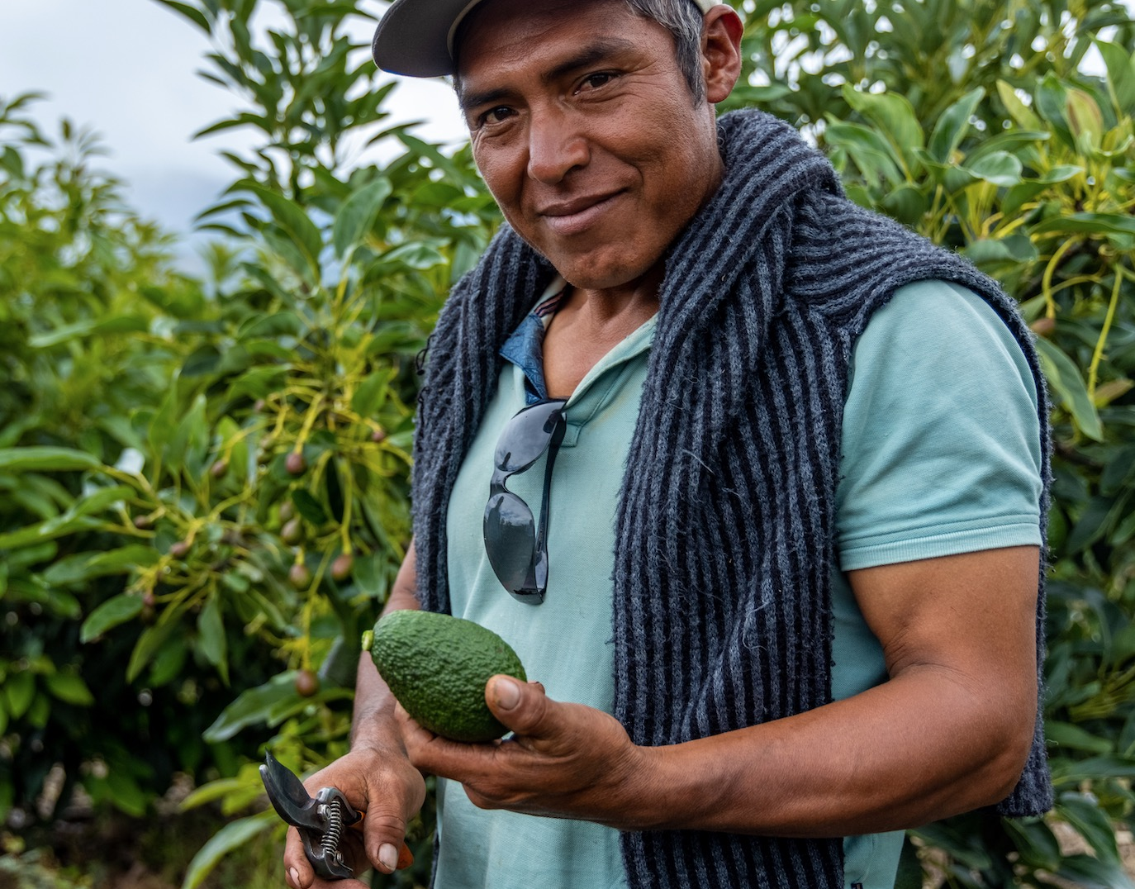
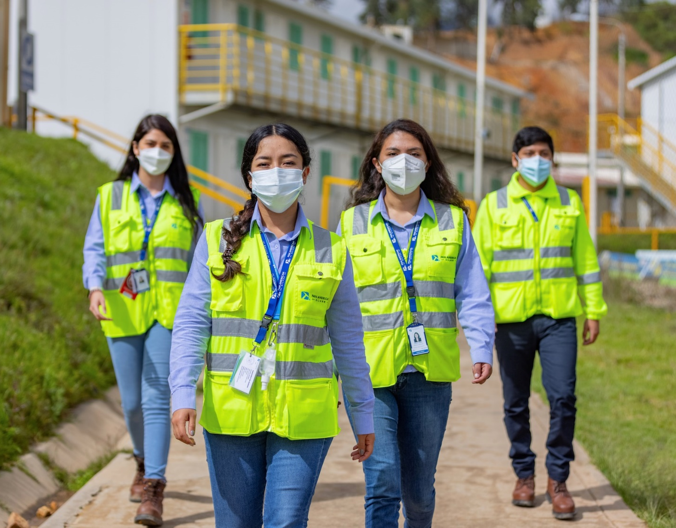
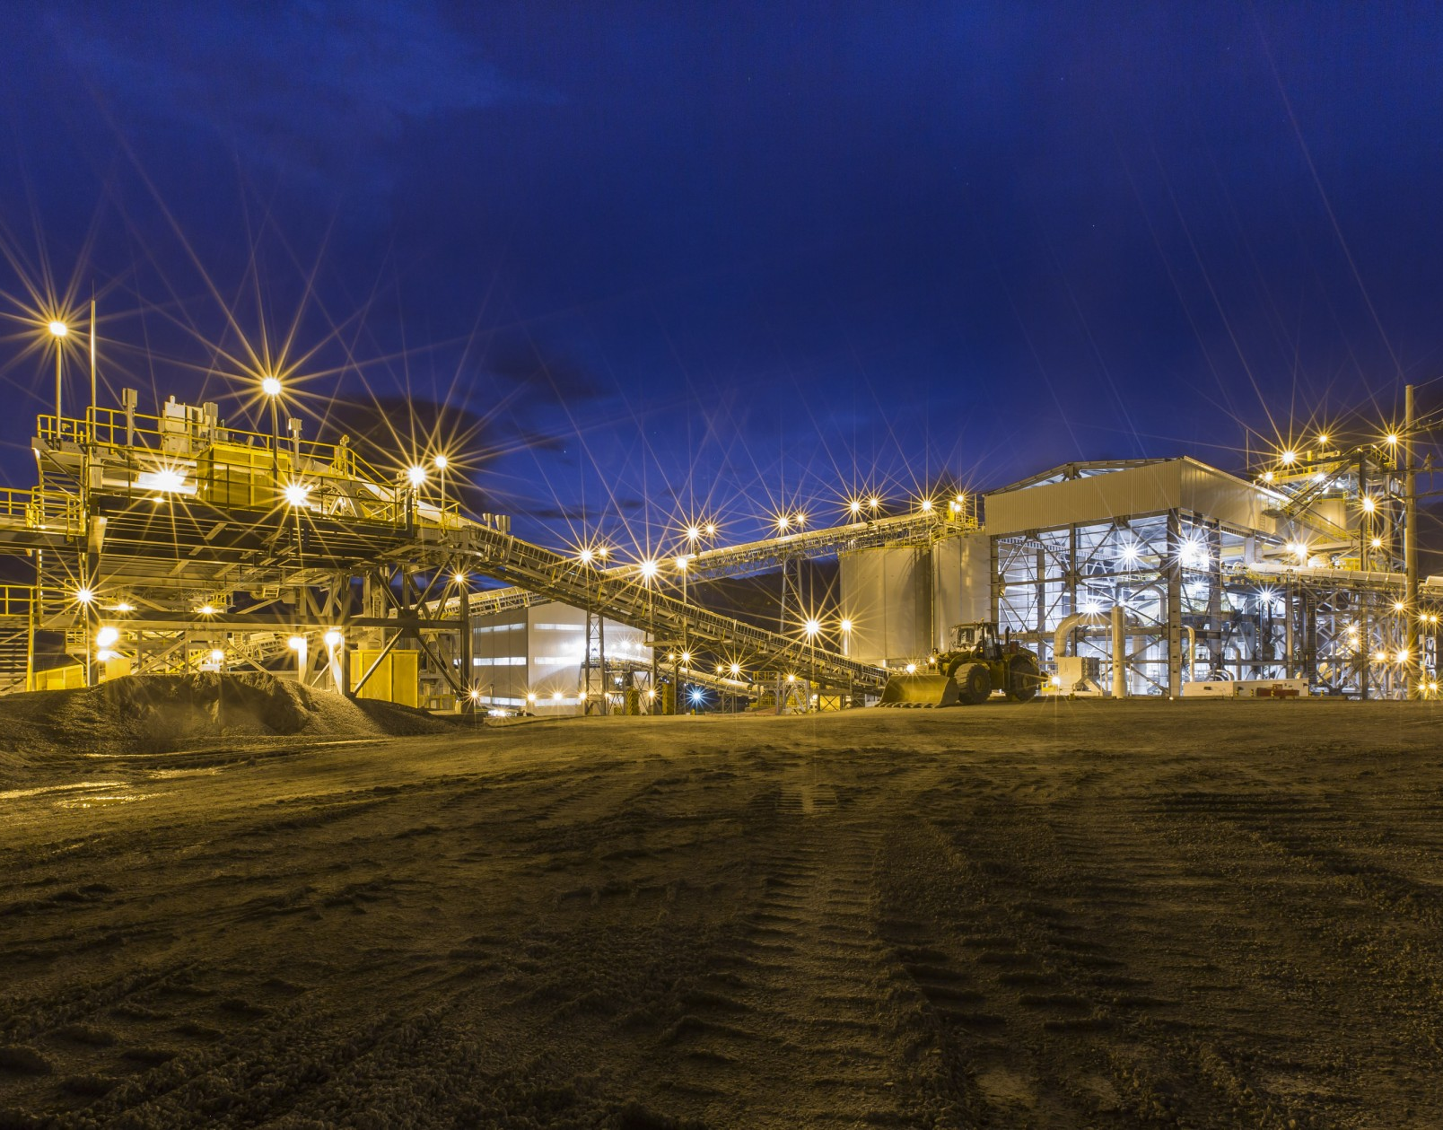
Siren Fisekci
VP, INVESTOR RELATIONS & CORPORATE COMMUNICATIONS
+1.604.806.3191 | ir@panamericansilver.com
panamericansilver.com
Suite 1440, 625 Howe Street
Vancouver, BC, V6C 2T6

