Slide 1
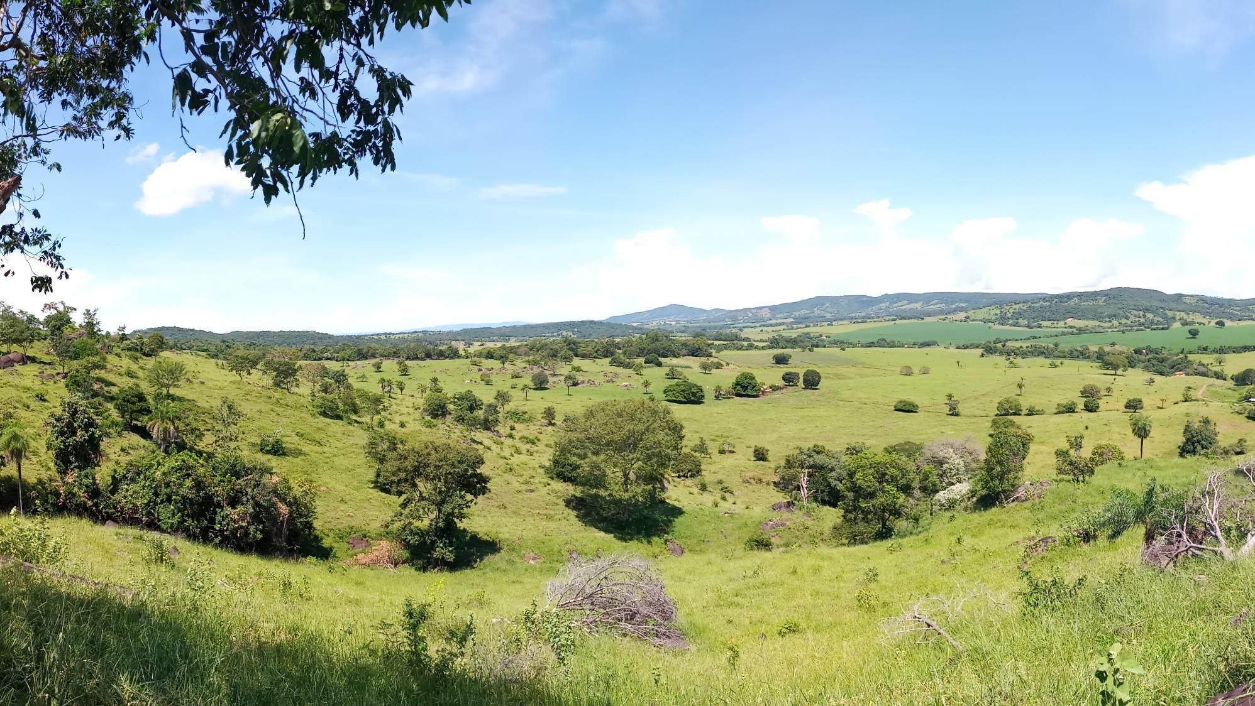

CRITICAL RARE EARTHS & URANIUM EXPLORATION IN THE AMERICAS
CSE: API | OTCQX: APAAF | FWB: A0I0 | MUN: A0I0 | BER: A0I0
May 2024

Slide 2
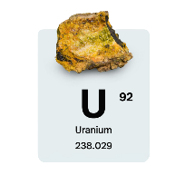
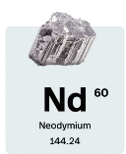
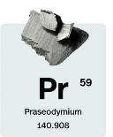
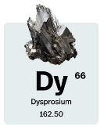
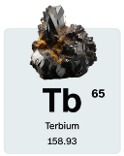

Forward Looking Statement
This presentation contains forward-looking statements which may include but are not limited to statements with respect to the future financial or operating performance of Appia and its projects, the future price of uranium, capital operating and exploration expenditures, success of exploration activities, permitting timelines, government regulation and environmental risks and costs. Appia has tried to identify these statements by using words such as "plans", "proposes", "expects" or "does not expect", "is expected", "estimates", "intends", "anticipates" or "does not anticipate", or "believes", or variations of such words and phrases or statements that certain actions, events or results "may", "could", "would", "might" or "will" be taken, occur or be achieved.
Forward-looking statements are not based on historical facts and involve known and unknown risks, uncertainties and other factors which may cause the actual results, performance or achievements of the Company, or events, to be materially different from any future results, performance, achievements or events express or implied by the forward-looking statements. These forward-looking statements reflect current expectations of management regarding future events and performance. Such forward-looking statements are based on a number of assumptions which management believes to be reasonable but may prove to be incorrect and involve significant risks, including but not limited to: the general risks associated with the mining industry, lack of operating history, dependence on key personnel, conflicts of interest, the need to raise additional capital, title to properties, competition, speculative nature of the business, acquiring additional properties, uninsured risks, external market factors, government regulation, environmental regulations, exploration risk, calculation of resources, insufficient resources, barriers to commercial production, maintaining property interests, commodity prices, exchange rates, lack of dividends, lack of public trading market, currency risk and controlling shareholder.
Although Appia has attempted to identify important factors that could cause actual results to differ materially from those contained in forward-looking statements, there may be other factors that cause results not to be as anticipated, estimated or intended. Anyone reviewing this Site should not place undue reliance on forward-looking statements. While the Company anticipates that subsequent events and developments may cause its views to change, Appia specifically disclaims any obligation to update these forward-looking statements, except as required by law. The factors identified above are not intended to represent a complete list of the factors that could affect the Company.
The technical information in this Presentation has been prepared in accordance with the Canadian regulatory requirements set out in National Instrument 43-101 Standards of Disclosure for Mineral Projects (“NI 43-101”). The information was reviewed and approved by Dr. Irvine R. Annesley, P.Geo, Consulting Geologist, and Mr. Andre Costa, VP of Exploration, Brazil and Qualified Persons as defined by National Instrument 43-101.
CSE: API | OTCQX: APAAF | FWB: A0I0 | MUN: A0I0 | BER: A0I0
www.appiareu.com

Slide 3

Company Overview
Appia is a publicly traded mineral exploration company that aims to strategically position and capitalize on the increasing demand for critical minerals, such as rare earth elements (REE) and uranium. These resources are essential for meeting the high demand for electric vehicles, wind turbines, advanced renewable electronics, and driving the transition towards a greener environment. Appia is committed to advancing multiple rare earths and uranium projects in mining-friendly regions, including Goiás State, Brazil, the Athabasca Basin area in Saskatchewan, Canada and Elliot Lake, Ontario, Canada.
Ionic Clay Rare Earths
Monazite Rare Earths
Uranium, Ontario
Uranium, Saskatchewan
PCH, GOIAS, BRAZIL
Critical REE (containing MREE & HREE) hosted in ionic clays
Rare Earths in ionic clays are generally more easily extractable with lower Opex & Capex costs
MRE & NI 43-101 Technical Report completed with SGS
Initial desorption testing proves IAC characteristics
Ongoing exploration & well-developed infrastructure
ALCES LAKE, SASK, CANADA
High-grade monazite prospect on surface and near-surface of up to 80% coarse-grained monazite
World-class critical REE with grades up to 50% TREO plus gallium
Most Attractive Mining Jurisdiction in Canada with access to SRC monazite processing facility
ELLIOT LAKE, ON, CANADA
Holds an extensive Indicated & Inferred Mineral Resource Estimate (MRE) of over 55 million pounds Uranium
Well-developed infrastructure & 58 Km from Cameco’s uranium refining facility near Blind River, ON
Spanning 13,008 hectares (32,143 acres)
Uranium Projects, SASK, CANADA
4 exploration projects in the Athabasca Basin
Loranger, Eastside, Otherside and North Wollaston projects
Plans for exploration in Summer of 2024 include drilling at Loranger, and further ground prospecting and exploration on the other 3 projects
www.appiareu.com

Slide 4
Why Appia?
Appia offers a unique opportunity to tap into the growing demand for rare earth elements and uranium, which are pivotal in powering various industries. As the world transitions to cleaner energy sources and advanced technologies, the demand for rare earth elements and uranium is on the rise. Appia’s strategic positioning in these markets, coupled with its commitment to environmentally conscious exploration practices, makes it a compelling choice for investors looking to align their portfolios with the future of clean energy, high-tech innovation, and responsible resource development.
Strategic Outlook
Capital Structure
  Working towards becoming a major supplier of a secure source of critical minerals, including Uranium and Rare Earths, to supply North American and European markets.
  Increasing the NI 43-101 resource, and further exploration, at the PCH project. And will work towards identifying potential partners for off-take and/or strategic investment at the PCH project in Brazil. Moving towards the development of a Preliminary Economic Assessment (PEA).
  Monetizing the Elliot Lake project through sale or Joint-Venture partnership or off-take agreement.
  Continue exploration at the Alces Lake project to identify further high grade targets along the +20 KM structural corridor
  Drilling and ground exploration at Appia’s 4 uranium projects in Saskatchewan.
(at April 16th, 2024)
Issued:
136.4M shares
(Insiders approx. 27 %)
Fully Diluted:
145M shares
Cash on Hand: Approx. CAD $1.5 M
Debt: None
www.appiareu.com

Slide 5
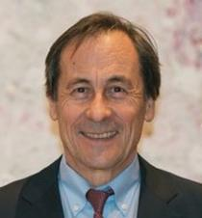
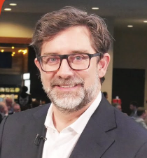

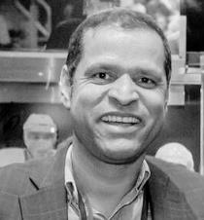
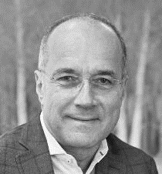

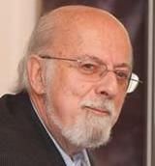

Executive Leadership & Advisors
Appia’s Management and Board has over 300 years combined industry experience
Anastasios (Tom) Drivas
CEO & DIRECTOR
Business entrepreneur with over 30 years of experience in various industries, including over 20 years in the mineral resource industry.
Stephen Burega
PRESIDENT
Brings 15 years of management and operations experience in the international mining and natural resources sectors, plus 15 years of experience in finance & communications.
Andre Costa M.Sc., FAIG
VP EXPLORATION
30 years´ Experience in Canada and Brazil managing exploration projects for Diamond, Potash, Uranium, Gold, Lithium, REE and copper.
Antonio Vitor
COUNTRY MANAGER
Track record as a portfolio manager and valued board member. Since 2015 exclusive dedication to mining industry – Graphite, REE and Silica sands.
Constantine Karayannopoulos
SR. TECHNICAL ADVISOR
30 years of expertise and leadership at NEO Performance Materials as COO, CEO, Chairman of the Board and CEO again from 2020-2023.
Don Hains, P. Geo
SR. TECHNICAL ADVISOR
40+ years’ experience as a consulting geologist and QP, with highly advanced Industrial Minerals and Ionic Adsorption Clay expertise.
Jack Lifton
SR. TECHNICAL ADVISOR
Consultant, author, and lecturer on the market fundamentals of technology metals.
CSE: API | OTCQX: APAAF | FWB: A0I0 | MUN: A0I0 | BER: A0I0
www.appiareu.com

Slide 6
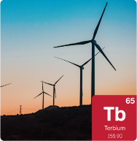

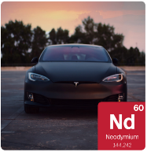
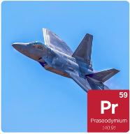
Critical Minerals: Rare Earths and Uranium
Transition to Clean Energy
Global transition to clean energy is underway
US, Europe, Canada and Australia have listed rare earths and uranium as critical materials due to their strategic economic importance for the transition to clean energy
Uranium is primarily used in the generation of clean energy, medicine, and scientific research
Rare Earth Elements
The highest REE demand is for Heavy (Dysprosium and Terbium) and Light (Neodymium and Praseodymium)
These heavy and light REEs are used primarily for permanent magnets, in EV drivetrains, wind turbines, technological, and military applications
The global rare earth metals market grew from $6.58 billion in 2022 to $7.29 billion in 2023, with a 10.8% CAGR. Projections indicate further growth, potentially reaching $9.6 billion by 2027 at a CAGR of 7.1%.
Global REEs Supply
China controls up to 90% of the supply of REEs and the market for permanent magnets
Western world is desperately working to build a supply of critical materials (including REEs) outside of China
International REEs demand will exceed supply and therefore pricing for REEs is forecast to dramatically increase over the coming years
CSE: API | OTCQX: APAAF | FWB: A0I0 | MUN: A0I0 | BER: A0I0
www.appiareu.com

Slide 7

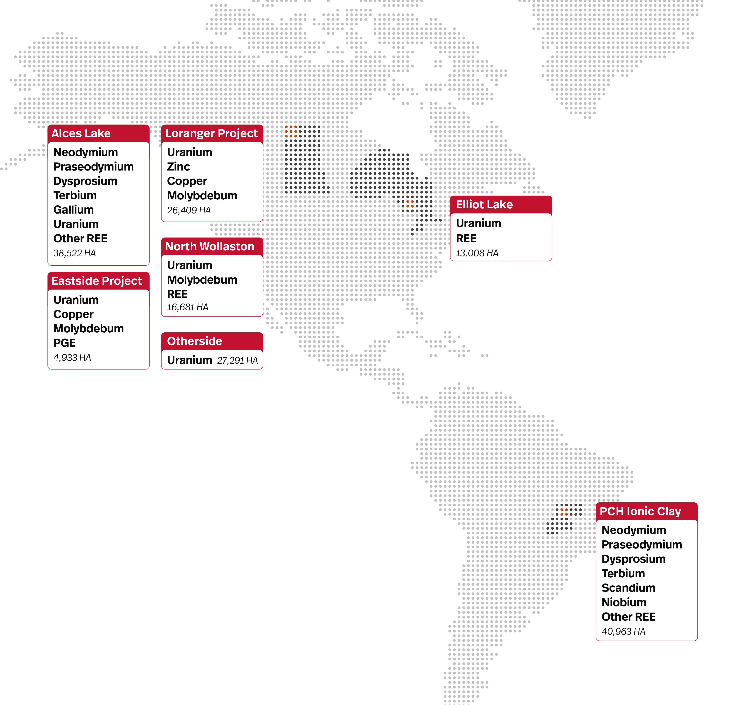
Our Projects
Appia is strategically positioned with mining projects in two of the world’s most mining-friendly jurisdictions, Canada and Brazil.
Canada
Renowned for political stability and robust legal framework
Beacon of security for mining investments
Rich endowment of mineral resources
Well-established mining industry
Secure environment safeguarding investor interests
Geological diversity for vast resource exploration
Experienced mining workforce for efficient project execution
Developed infrastructure supporting mining operations
Company's Projects in Canada
Alces Lake REE project is a high-grade Monazite project
Large uranium ground position in Elliot Lake
Four highly prospective uranium exploration projects in Athabasca Basin area: Loranger, North Wollaston, Eastside, Otherside
Company’s Project in Brazil
PCH Project is a large REE Ionic Adsorption Clay project
Canada
USA
Brazil
Abundance in mineral wealth
Welcoming atmosphere for mining endeavors
Regulatory improvements for increased investment
Legal certainty for mining operations
Geological accessibility
Well-established infrastructure with extensive transportation network
Diverse range of mineral resources
Skilled workforce
Brazil
www.appiareu.com
Notes:
Bullets

Slide 8
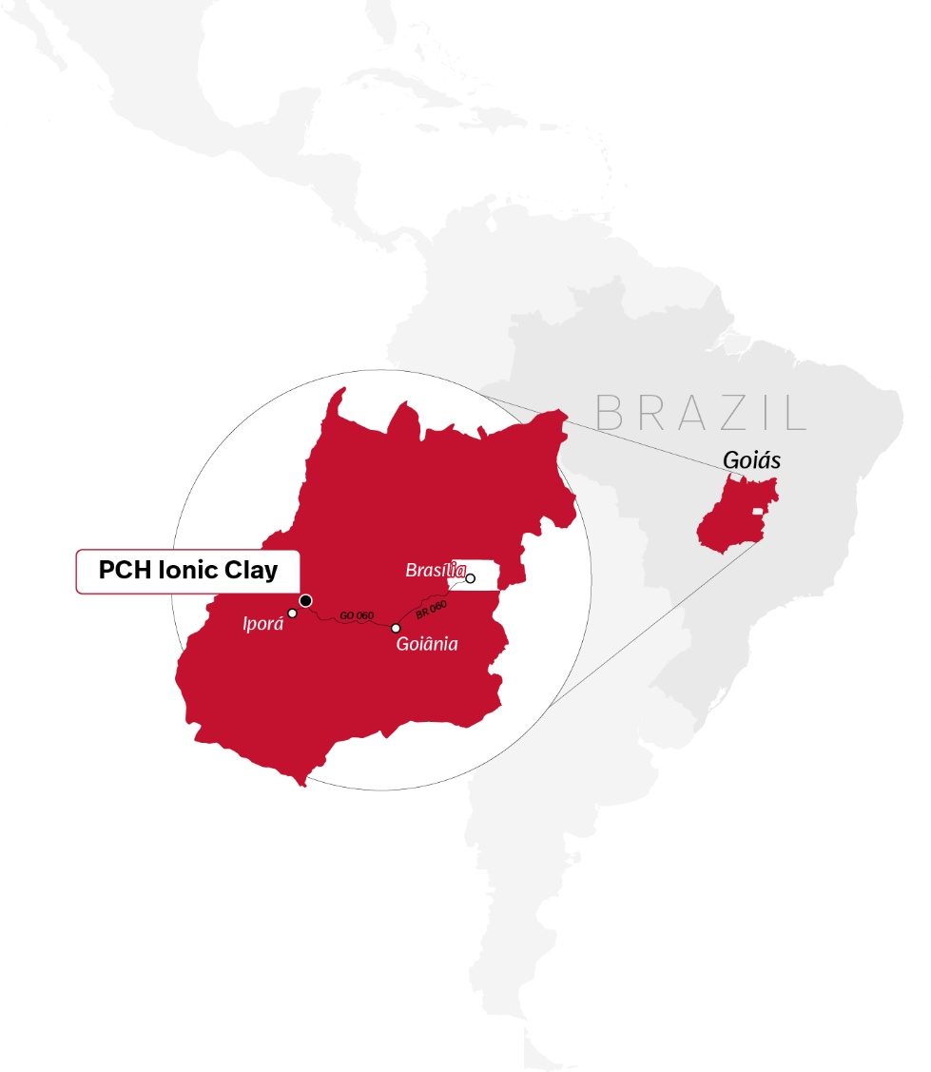
PCH Project, Goiás, Brazil
Highlights:
40,963 hectares in Tocantins Structural Province, Brasília Fold Belt, Goiás, Brazil.
Characterized by IAC REE mineralization associated with the weathered Ipora Granite.
High-grade REE mineralization associated with Carbonatitic dykes with unprecedented TREO assay results.
Mining-friendly jurisdiction with well-developed infrastructure and substantial government support and initiatives.
Supported by surrounding landowners and community.

Slide 9
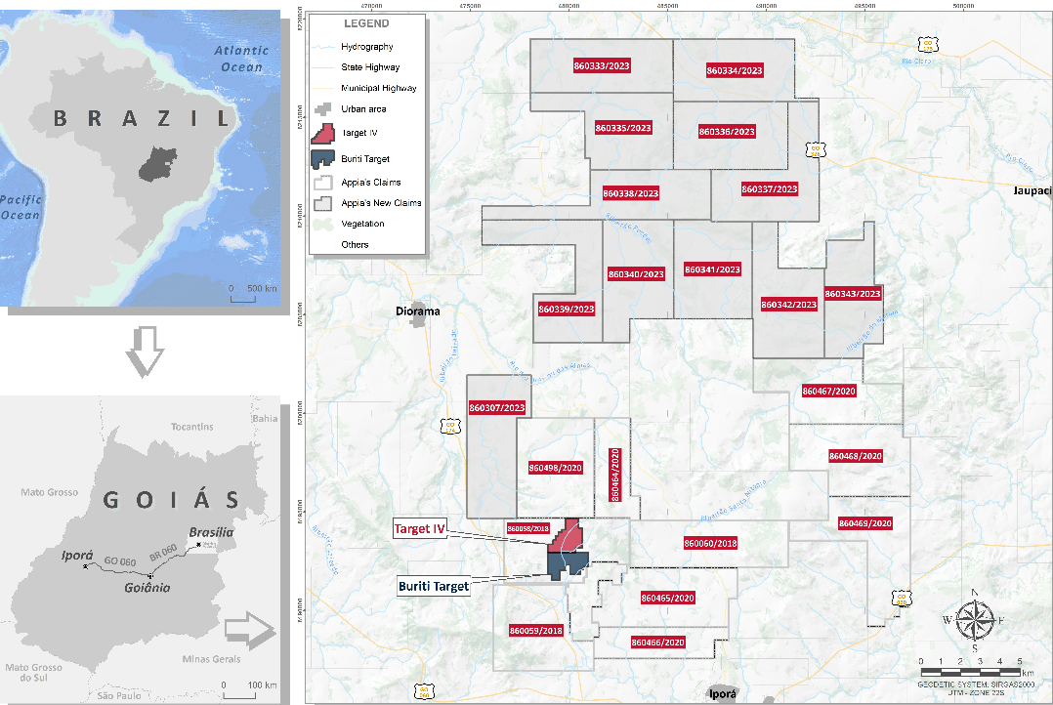
PCH REE Ionic Adsorption Clay (IAC) Project: Brazil
The PCH Ionic Clay Project
Located in the Goiás state of Brazil in the Brasilia fold belt, 216 km from Goiânia & 410 km from Brasília.
30 km from Iporá, ensuring access to skilled labour.
Infrastructure includes power and water, & is easily accessible via well-developed regional roads
The property hosts rare earths including Tb, Dy, Nd and Pr, also scandium, and cobalt
Experienced Brazilian team.
70% Earn in agreement to be completed by 2028
_____________________
2024 Mineral Resource Estimate on Target IV & Buriti
2024 NI 43-101 on PCH REE project.
_____________________
South of producing Serra Verde project (with an expected 900 million tonnes reserves at 1200 ppm TREO)
The 22-claim PCH Project spans a total of 40,963 hectares
Notes:
Text does not mention Tb, Dy, Nd or Pr and the elements are not shown for Sc, Co, and Nb

Slide 10
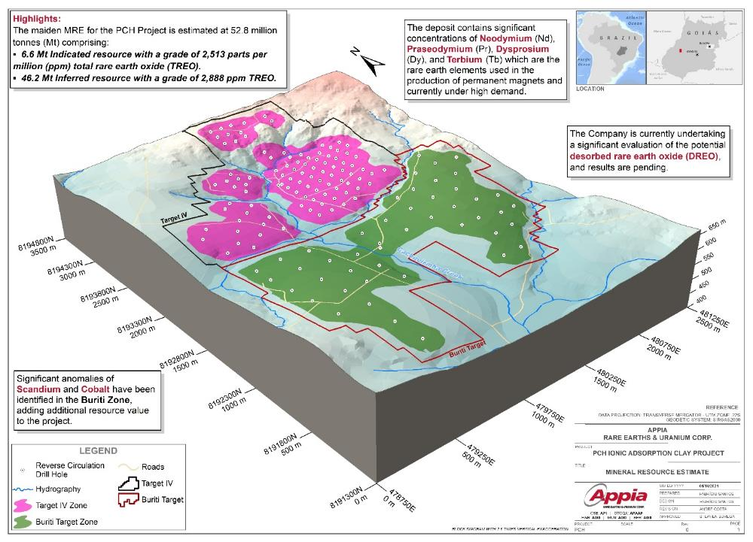
Target IV and Buriti Zone: MRE Highlights
The maiden MRE for the PCH Project is estimated at 52.8 million tonnes (Mt) comprising:
  6.6 Mt Indicated resource with a grade of 2,513 ppm TREO.
  46.2 Mt Inferred resource with a grade of 2,888 ppm TREO.
The deposit contains significant concentrations of Neodymium (Nd), Praseodymium (Pr), Dysprosium (Dy), and Terbium (Tb) which are the rare earth elements used in the production of permanent magnets and currently under high demand.

Slide 11
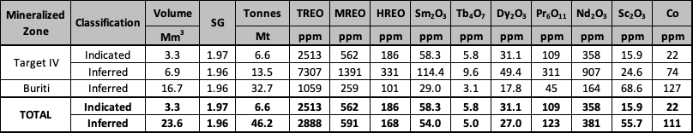
PCH Maiden Mineral Resource Estimate (MRE) Project:
The MRE has an effective date of the 1st of February 2024.
The Qualified Person for the MRE is Mr. Yann Camus, P.Eng., an employee of SGS.
The MRE provided in this table were estimated using current Canadian Institute of Mining, Metallurgy and Petroleum (“CIM”) Standards on Mineral Resources and Reserves, Definitions and Guidelines.
Mineral Resources that are not Mineral Reserves have not demonstrated economic viability. Additional drilling will be required to convert Inferred and Indicated Mineral Resources to Measured Mineral Resources. There is no certainty that any part of a Mineral Resource will ever be converted into Reserves.
All analyses used for the MRE were performed by SGS GEOSOL by ICM40B: Multi Acid Digestion / ICP OES – ICP MS and by IMS95R: Lithium Metaborate Fusion / ICP-MS.
MRE are stated at a cut-off total NSR value of 10 US$/t. The full price list and recovery used to estimate the NSR is in Table 2. The estimated basket price of TREO is US$26.98.
GEOVIA’s WhittleTM software was used to provide an optimized pit envelope to demonstrate reasonable prospection for economic extraction. Preliminary pit optimization parameters included overall pit slope of 30 degrees, in-pit mining costs of $2.10, processing and G/A costs of $9/t, and overall mining loss and dilution of 5%. Full details of the preliminary pit-optimization parameters can be found in Table 2. The basket price and oxides price list in Table 2 are based on forward-looking pricing. These future prices are predicted based on market trends, economic forecasts, and other relevant factors. The actual prices may vary depending on changes in these factors.
Figures are rounded to reflect the relative accuracy of the estimate and numbers may not add due to rounding.
Resources are presented undiluted and in situ, constrained within a 3D model, and are considered to have reasonable prospects for eventual economic extraction.
Bulk density values were determined based on physical test work and assumed porosities for each type of material.
Total Rare Earth Oxides: TREO = Y2O3 + Eu2O3 + Gd2O3 + Tb2O3 + Dy2O3 + Ho2O3 + Er2O3 + Tm2O3 + Yb2O3 + Lu2O3 + La2O3 + Ce2O3 + Pr2O3 + Nd2O3 + Sm2O3
Magnetic Rare Earth Oxides: MREO = Sm2O3 + Tb4O7 + Dy2O3 + Pr6O11 + Nd2O3
Heavy Rare Earth Oxides: HREO = Sm2O3 + Eu2O3 + Gd2O3 + Tb4O7 + Dy2O3 + Ho2O3 + Er2O3 + Tm2O3 + Yb2O3 + Lu2O3
The MRE may be materially affected by environmental, permitting, legal, title, taxation, socio-political, marketing, or other relevant issues.
Notes:
Text does not mention Tb, Dy, Nd or Pr and the elements are not shown for Sc, Co, and Nb

Slide 12
Preliminary Desorption Results From Target IV PCH
Desorbable values from RC holes located in the weathered portion of the Ipora Granite show representative preliminary desorption results with Nd2O3 and Pr2O3 ranging from 39.7 ppm to 451.2 ppm, from 1.6% to 48.2% recovery, and Tb4O7 and Dy2O3 ranging from 5.7 ppm to 70.2 ppm, from 12.0 to 86.7% recovery.

Slide 13
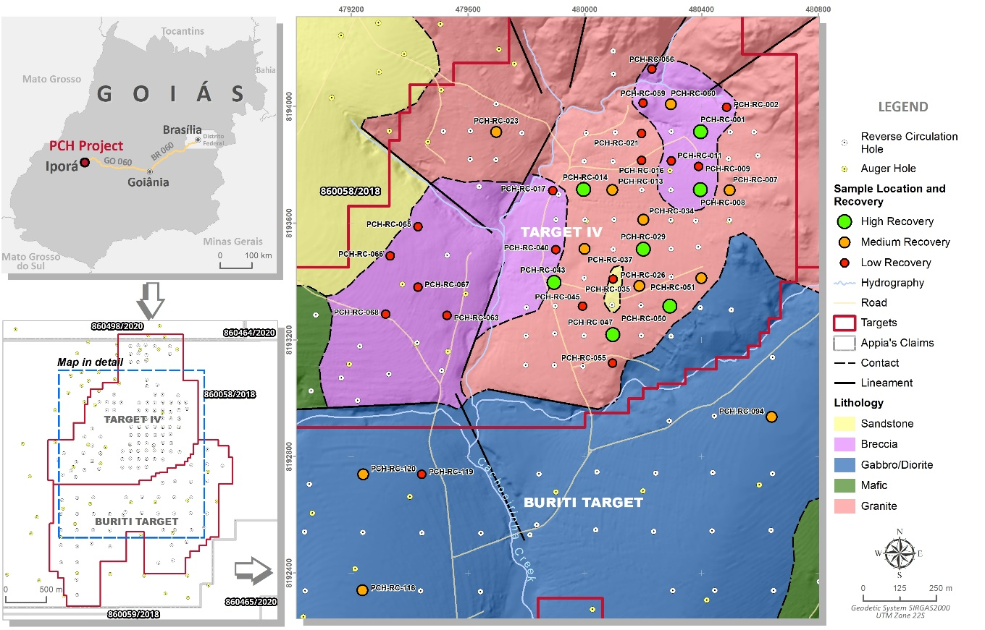
Preliminary Desorption Results

Slide 14
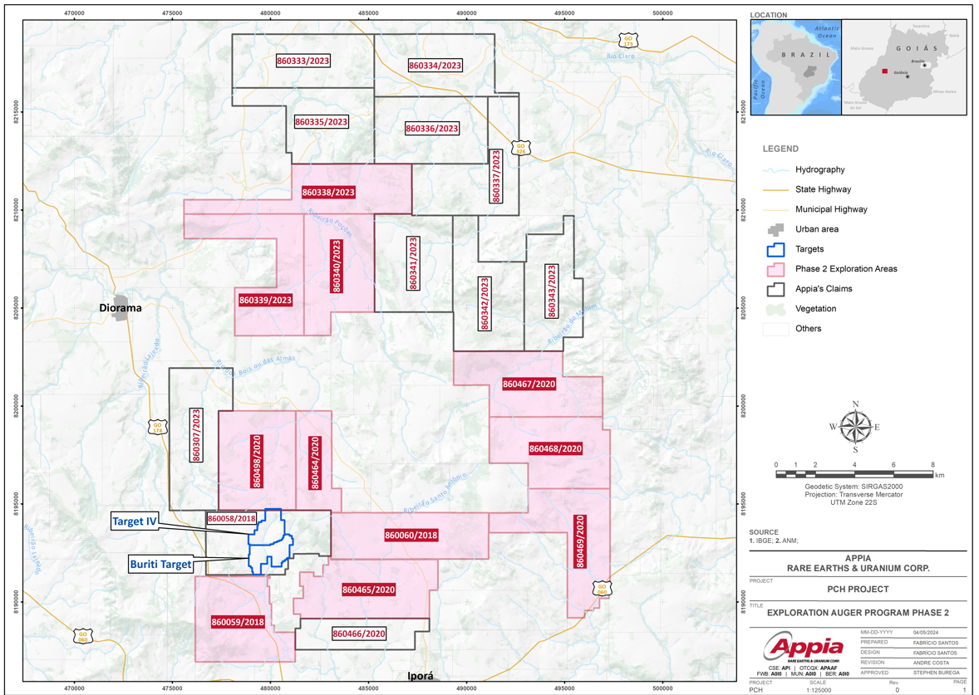
Phase II Exploration: Auger Drilling New Targets
The IAC style of mineralization is related to the Ipora Granite and the next phase exploratory auger drilling has started across 11 claim blocks.
  A similar geological formation;
  Similar weathering profile development with well-developed transition zone between Pedolith and Saprolite where the Ionic Adsorption Clays occur; and
  Positive showing of the related gammaspectometric geophysical response.

Slide 15
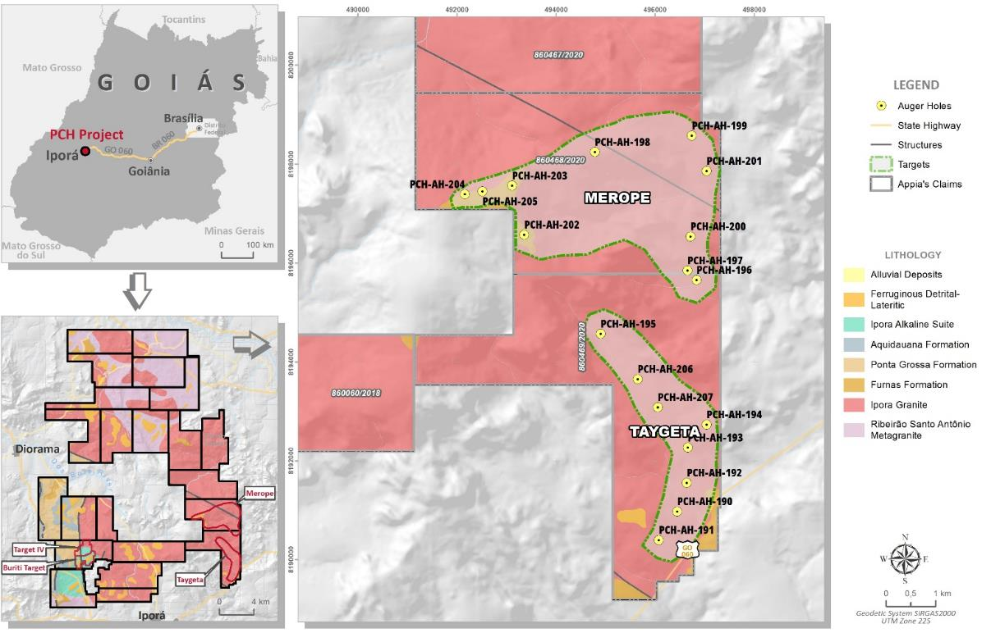
Phase II Exploration Targets : Merope and Taygeta
The Taygeta and Merope targets cover an area of 546 and 1,134 hectares respectively.
The grade distribution signature found at depth in the auger drill holes is compatible with the pattern commonly found on IAC REE deposits.

Slide 16
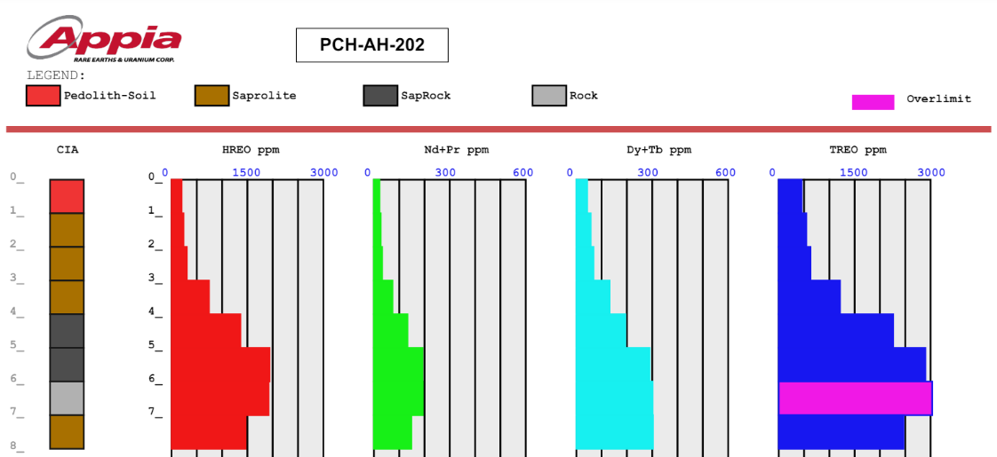
Phase II Exploration Targets : Merope and Taygeta
Assay results showed high concentrations of Neodymium + Praseodymium and Dysprosium + Terbium associated with the boundary of Pedolith and saprolite. This is the main characteristic of an IAC REE mineralization.

Slide 17
PCH REE IAC Project: Milestone And Next Steps
Exploration Milestones
Total drilling completed with 1 year – Approximately 400 Auger and RC holes
Approximately $1 million USD budget
Target IV and Buriti zones: maiden Mineral Resource Estimate (MRE) completed with 52.8 million tonnes (Mt) comprising:
  6.6 Mt Indicated resource with a grade of 2,513 ppm TREO.
  46.2 Mt Inferred resource with a grade of 2,888 ppm TREO.
Desorption results confirmed the IAC REE mineralization associated with the Ipora Granite.
Distinction of two REE mineralization styles:
  IAC REE.
  High-grade REE associated with Carbonitite Dike-Sill.
Discovery of new IAC REE targets Taygeta and Merope.
Indications point to the PCH project’s potential to develop into a premier resource in terms of tonnage and grade within an IAC.
International focus to secure critical materials
Advantage of the IAC
  Low radioactivity
  Desorbable
  Low capex/opex relative to hardrock mining
  Most environmentally friendly processing – use of small quantities of re-agents
  Highly enriched in heavy and magnet REE
Next Steps
Complete further REE desorption assays for the remainder of Target IV intervals including an update to the maiden MRE and NI-43101 report.
RC drilling on new target discoveries (Taygeta and Merope) to delineate the extent of mineralization and to develop an initial resource estimate including desorption testing.
Exploring the remaining tenements through initial auger drilling of new exploration targets.
Initiate the development of a Preliminary Economic Assessment report

Slide 18
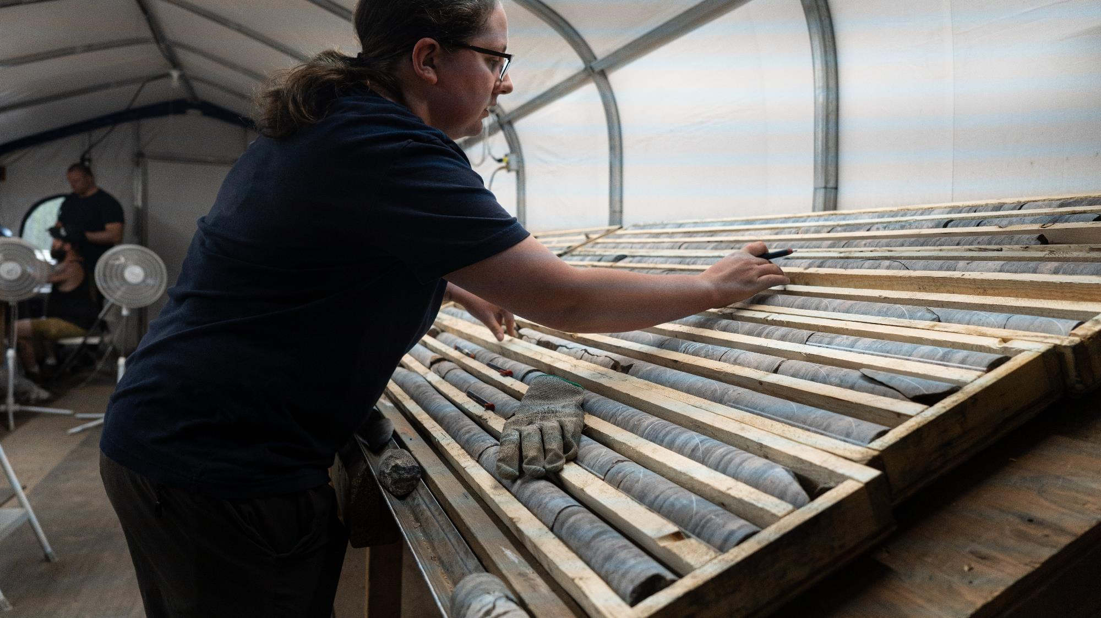
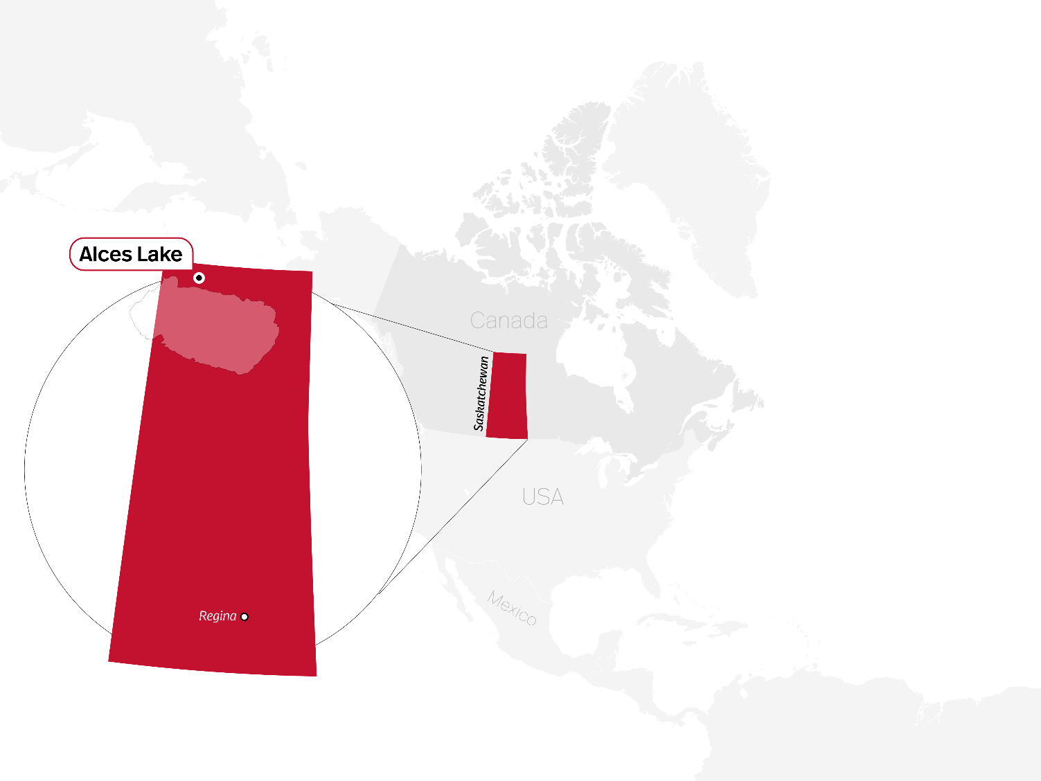

Alces Lake Project, Saskatchewan, Canada
Geology: Pegmatites
Pegmatites are a type of intrusive igneous rock characterized by exceptionally coarse grain size, often containing minerals such as quartz, K-feldspar, plagioclase, biotite, muscovite, and monazite.
While not specifically classified as carbonatites or alkaline rocks, pegmatites can contain rare earth elements (REE) and other valuable elements/metals.
Pegmatites are known for their enriched compositions, which can include economically significant concentrations of rare elements/metals.
These rocks often form in the final stages of magma crystallization and can be found intruding into other rocks or as dikes and veins within the Earth's crust.

Slide 19
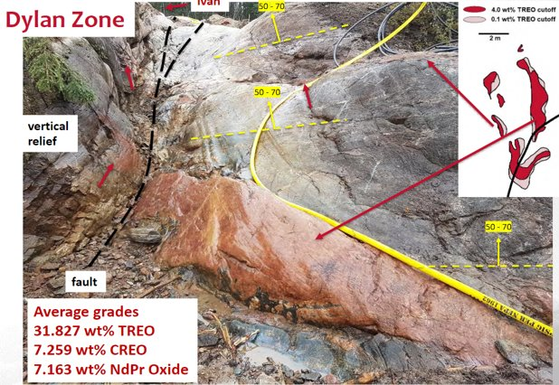
Alces Lake REE Project: Current Exploration
Resource Characteristics:
  World-class critical REE with grades up to 50% Total Rare Earths Oxide (TREO) plus gallium.
  Extensive high-grade monazite mineralization.
  Surface and near-surface showings/prospects of up to 80% coarse-grained monazite.
  Simple mineralogy - metallurgical testing confirms processing potential similar to other producing mines.
Exploration and Discoveries:
  Multiple zones of REE discoveries along geological strike, on sub-parallel trends, and with sub-surface zones open in all directions.
  Awaiting results from the summer 2023 exploration program – 40 diamond drill holes.
Geographical and Regulatory Context:
  Located in Saskatchewan’s prolific Athabasca Basin: the “Most Attractive Mining Jurisdiction in Canada.”
  Access to new REE processing facility at Saskatchewan Research Council facility in Saskatoon, Sask.
High-grade monazite outcrop WRCB zone, Alces Lake Saskatchewan

Slide 20
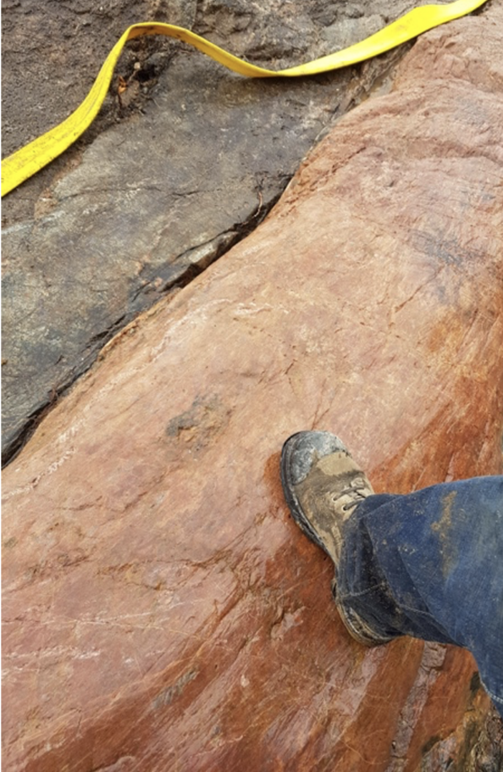
Alces Lake REE Project: Overview
High-grade monazite outcrop WRCB zone, Alces Lake Saskatchewan
High-grade monazite outcrop WRCB zone range from 4.209 to 32.17 wt.% total rare earth oxide (TREO)
2023 - Diamond drill results: 11 drill holes spanning 1,223 Metres completed in southern extension of Magnet Ridge. Five drill holes showcased substantial mineralization intersections, with widths up to 19 Metres, indicating a potential increase in grade and thickness.
2022 - Diamond drill results: 17,481 Metres of diamond drilling reported 8.98m @ 9.46 wt.% TREO including 0.87 m @ 17.1 wt.% TREO in hole 22-WRC-024 at Wilson Zone & 12.13 m @ 0.33 wt.% TREO including 5.7 m @ 0.55 wt.% TREO from hole 22-WRC-016 at AMP Zone in a structural corridor.
2021 - Diamond Drill results: 21-WRC-015 hole at Wilson North intersected 9.38 metres of 17.53 wt% TREO from 15.22 m- 24.60 m, including 2.14 Metres of 32.17 wt% TREO with assays up to 37.92 wt% TREO
Exploration strategy covers priority zones, extending approximately 20 kilometres in length and 5 to 7 km in width.
Bench-scale monazite processing and metallurgical testing results comparable to other producing rare earth projects. Preliminary work done at the Saskatchewan Research Council (SRC) achieved flotation concentrate TREO of 48% with 73% TREO recovery. Improvements are expected from future testing.
Permanent 35-person camp with year-around accessibility and promoting Work, Resources, and Employment Expansion for the Local First Nations Community of Fond-du-Lac

Slide 21
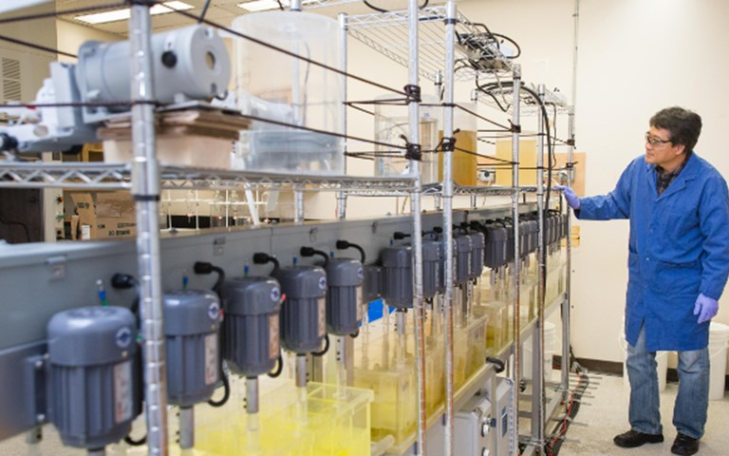
SRC REE Processing Facility: Saskatoon, Saskatchewan, Canada
Landmark Initiative
In August 2020, the Saskatchewan Research Council (SRC), a Provincial Crown Corporation, and the Government of Saskatchewan unveiled ground-breaking plans to finance and establish a unique Rare Earths Processing Facility in Saskatoon, Canada. This strategic move represents a pioneering effort to enhance rare earths processing capabilities and foster regional economic growth.
SRC: A Research Powerhouse
As Canada's second-largest research and technology organization, SRC boasts a global footprint, serving 1,600 clients across 22 countries. This extensive reach positions SRC as a leading force in driving innovation and research in various sectors.
Monazite Processing Expertise
Leveraging existing pilot facilities, SRC has already achieved significant milestones in rare earths processing. By optimizing a monazite processing flow sheet, SRC's facilities have successfully processed monazite sourced from Appia's Alces Lake project. This achievement underscores the practical application of research outcomes in advancing rare earths processing technologies.
SRC Rare Earth Element Extraction Lab
The processing facility is expected to be operational in 2024

Slide 22
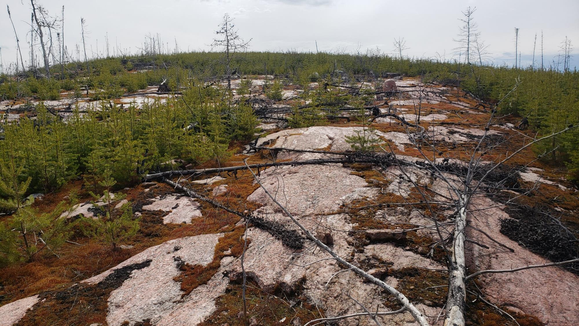
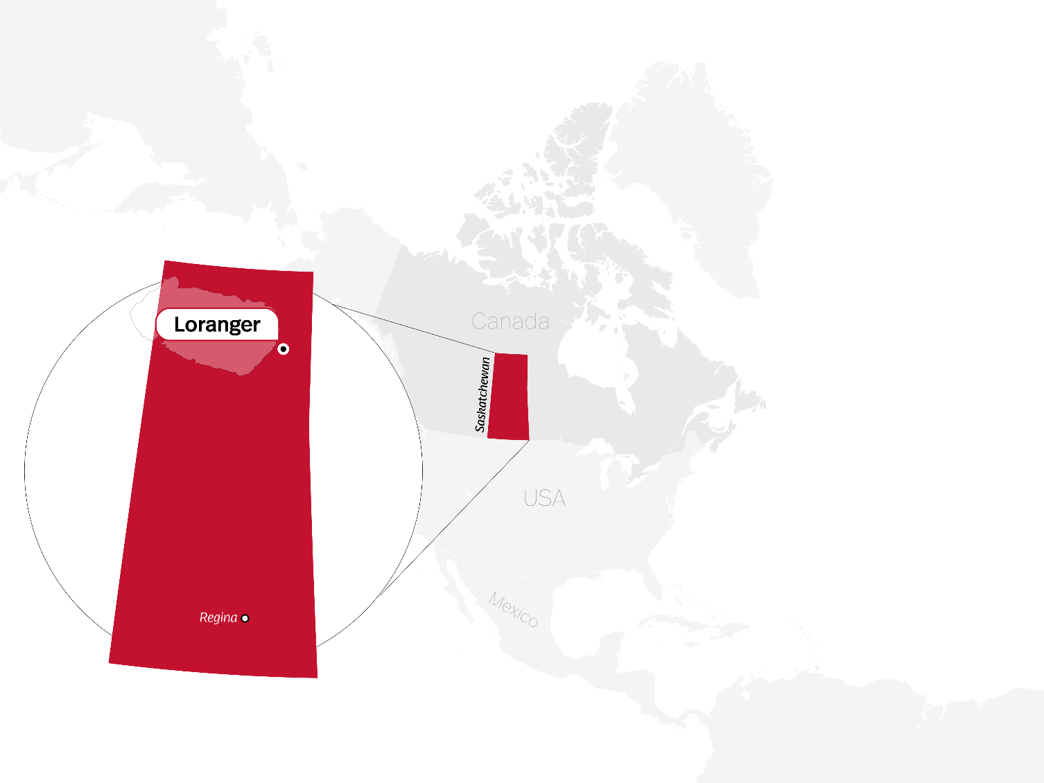

Loranger Project, Saskatchewan, Canada

Slide 23
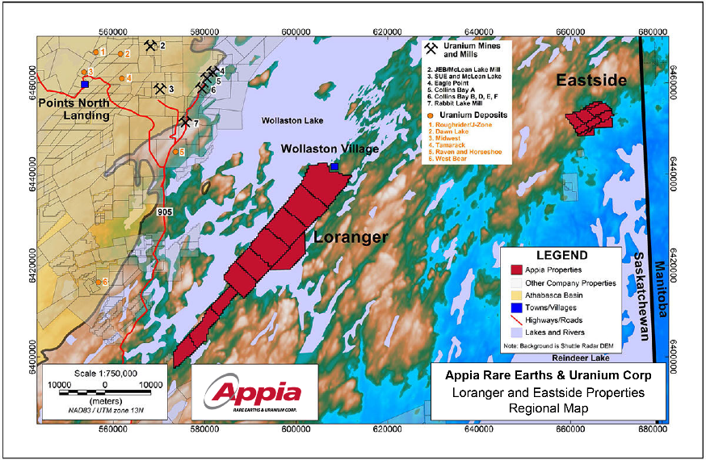
Loranger Uranium Project: Athabasca Basin Area, Saskatchewan, Canada
Project Highlights:
Upcoming diamond drilling program is anticipated to include 1,000 to 1,200 metres across 8 to 10 drill holes, aiming to uncover new uranium discoveries following up on 2017 and 2019 exploration.
Previous drilling campaigns covered 4,630.8 metres across 34 drill holes
Up to 0.34 wt% U3O8 has been uncovered through previous exploration in the core drill-zone.
Uranium exploration at Loranger boasts surface rights of approximately 26,408.8 hectares, measuring 57 km by 9 Km.
Exploration in the Nuhenéné region will progress through a collaborative partnership with the Ya’thi Néné First Nations and local Wollaston residents.
Appia’s Athabasca Basin area properties are located near Cameco’s Rabbit Lake uranium mill and Eagle Point mine operations.
The property is situated within the Eastern Wollaston Domain, next to the Western Wollaston Domain & Wollaston-Mudjatik Transition Zone (WMTZ), which is renowned for hosting over 1 billion pounds of high-grade U₃O₈.
CSE: API | OTCQX: APAAF | FWB: A0I0 | MUN: A0I0 | BER: A0I0
www.appiareu.com

Slide 24
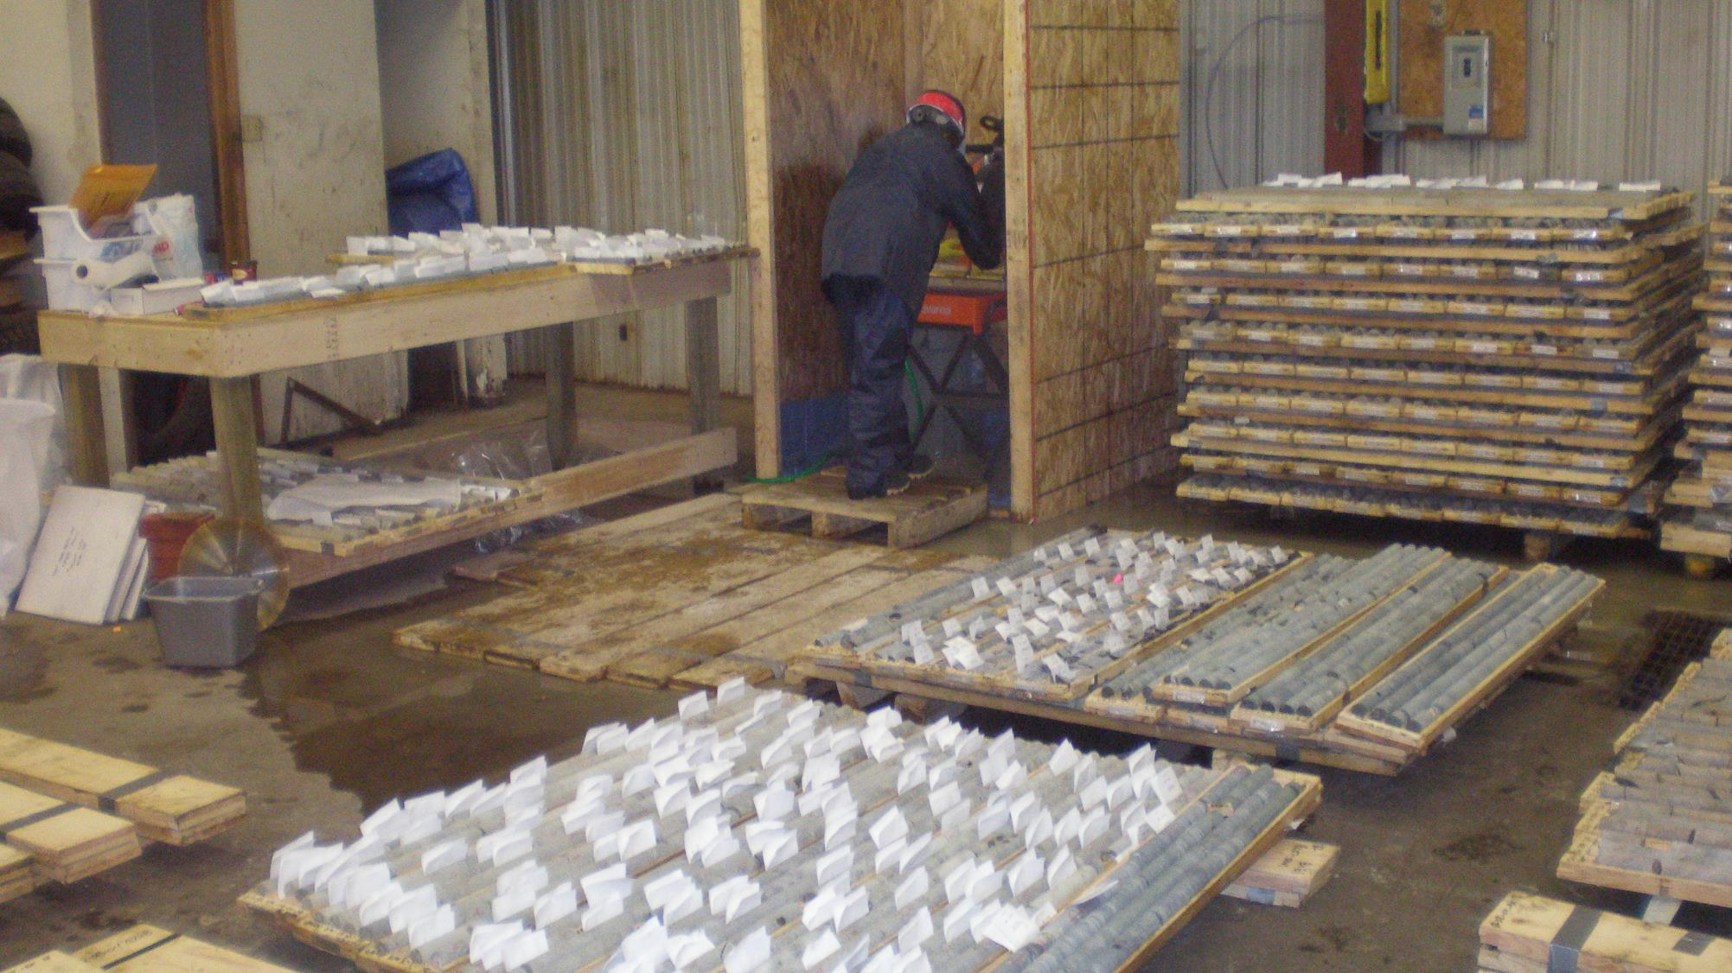
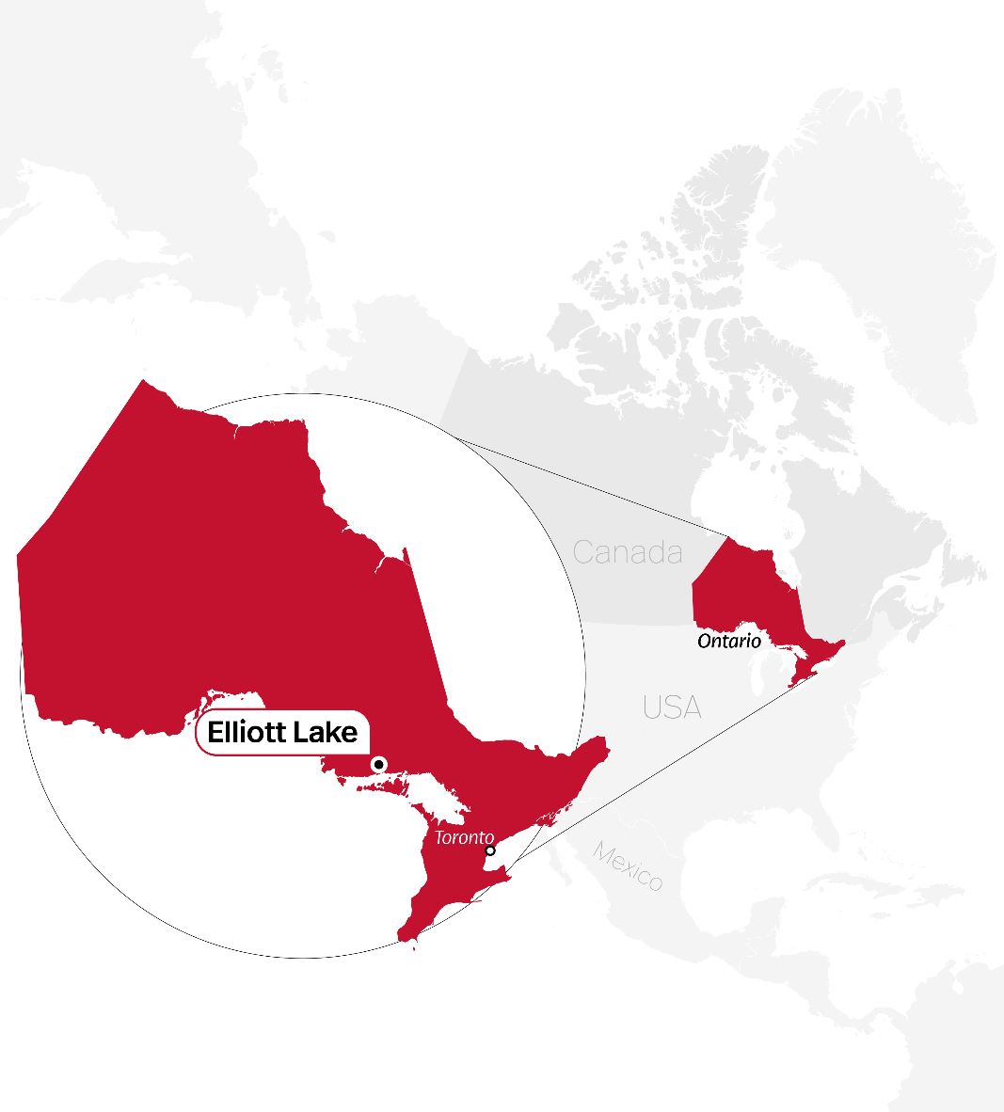
Elliot Lake, Ontario, Canada
Elliot Lake

Slide 25
Elliot Lake Uranium & REE Project: Ontario, Canada
Ownership and Size:
  Appia holds a 100% interest in the Elliot Lake property.
  The property spans approximately 13,008 hectares (32,143 acres).
Strategic Location:
  Adjacent to Denison Mines Corp. and Rio Algom Limited past-producing uranium and REE mines.
Historical Significance:
  The Elliot Lake camp has a rich history, having produced over 300 million lbs. of U3O8.
  Unique distinction as the only Canadian mining camp with significant historical commercial rare earth element production (yttrium).
Exploration Potential:
  Current resources show substantial potential for expansion.
  Resources are largely open along strike and at depth based on historical drilling data.
Metallurgical Testing:
  Various process methods employed in metallurgical testing.
  Indications of a high recovery rate, approximately 90% for uranium and most REE falling in the 80% to 90% range.
Geological Features:
  Uranium and REE metals are hosted within quartz-pebble conglomerate beds.
  These beds are situated in the Matinenda Formation, the basal unit of the Elliot Lake Group.
  The uranium and REE-bearing horizon is characterized as a clean, well-sorted, coarse-pebble conglomerate.

Slide 26
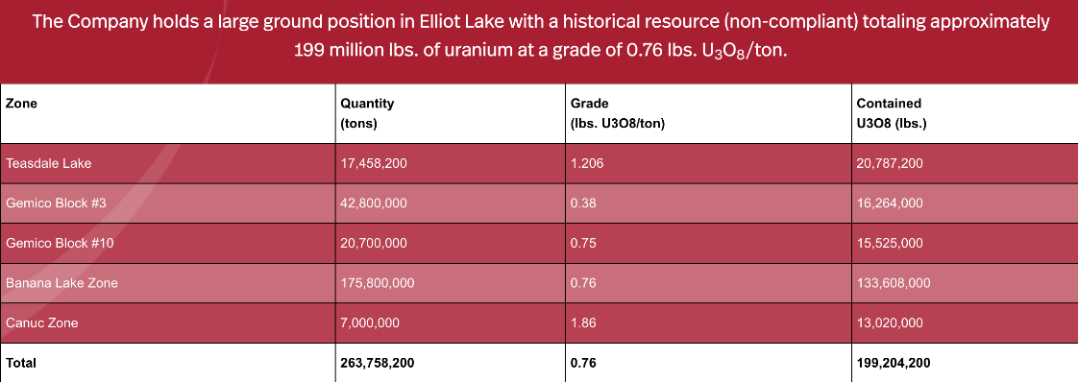
Elliot Lake Uranium & REE Project: Historical Mineral Resource Estimate (Non-Compliant
Notes
The historical resource was not estimated in accordance with definitions and practices established for the estimation of Mineral Resources and Mineral Reserves by the Canadian Institute of Mining and Metallurgy (“CIM”), is not compliant with Canada’s security rule National Instrument 43-101 (“NI 43-101”), and unreliable for investment decisions.
Neither Appia nor its Qualified Persons have done sufficient work to classify the historical resource as a current mineral resource under current mineral resource terminology and are not treating the historical resources as current mineral resources
Most of the historical resources were estimated by mining companies active in the Elliot Lake camp using assumptions, methods and practices that were accepted at the time, and based on corroborative mining experience.

Slide 27
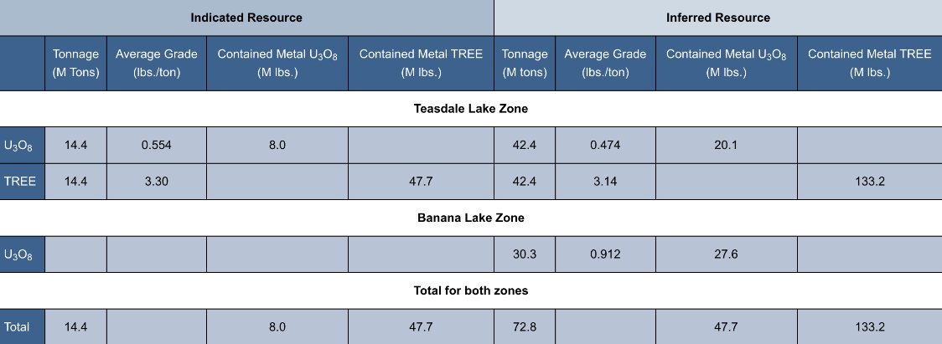
Elliot Lake Uranium & REE Project: NI 43-101 Mineral Resource Estimate
2013 NI 43-101 Mineral Resource Estimate
The NI 43-101 Indicated Mineral Resource for the Teasdale Lake Zone stands at 14,435,000 tons with a grade of 0.554 lbs U₃O₈/ton and 3.30 lbs TREE/ton, resulting in a total of 7,995,000 lbs U₃O₈ and 47,689,000 lbs TREE. In the Inferred Mineral Resource category, the Teasdale Lake Zone comprises 42,447,000 tons, grading 0.474 lbs U3O8/ton and 3.14 lbs TREE/ton, totaling 20,115,000 lbs U₃O₈ and 133,175,000 lbs TREE. Additionally, the Inferred Mineral Resource for the Banana Lake Zone is 30,315,000 tons, with a grade of 0.912 lbs U3O8/ton, resulting in a total of 27,638,000 lbs U₃O₈. The resources are largely unconstrained along strike and down dip. *Refer to the NI 43-101 Mineral Resource Estimate page for qualifying notes regarding the Mineral Resource estimates, and individual element grades supporting the reported TREE results.

Slide 28
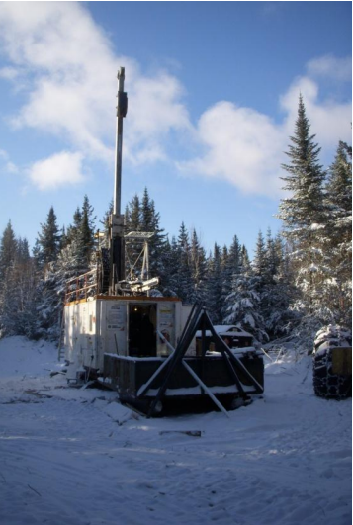
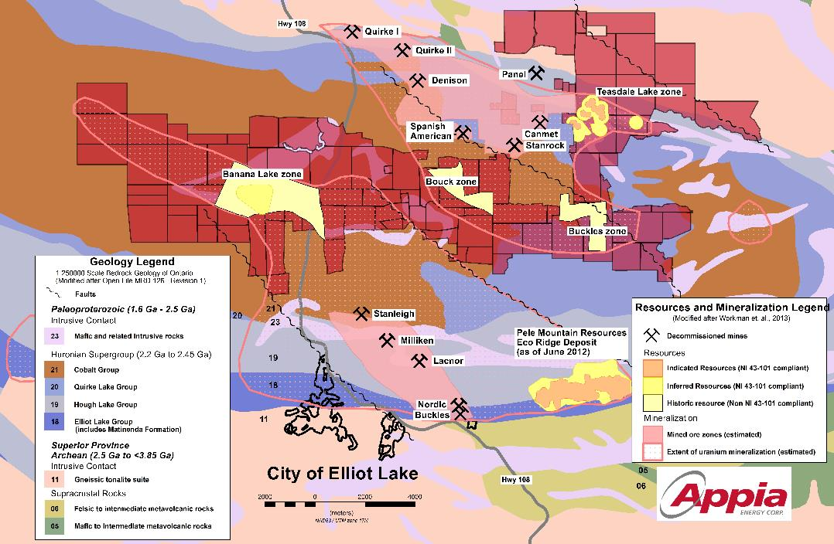
Elliot Lake Uranium & REE Projects
Located in the historic mining camp of Elliott Lake, Ontario, Canada
The Elliot Lake uranium-REE property comprises a group of 101 staked mineral claims, approximately 3 km north of the town of Elliot Lake.
Strong potential to increase the size of the current resources as they are largely unconstrained along strike and down dip.
2013 drilling program at Elliot Lake
Appia Energy Corp. changed its name to Appia Rare Earths & Uranium Corp. in October, 2021

Slide 29
CONTACT:
Suite 500 - 2 Toronto St.
Toronto, ON, Canada
M5C 2B6
Tom Drivas, CEO
Email: tdrivas@appiareu.com
Cell: +1 (416) 876-3957
Stephen Burega, President
Email: sburega@appiareu.com
Cell: +1 (647) 515-3734
CSE: API | OTCQX: APAAF | FWB: A0I0 | MUN: A0I0 | BER: A0I0
May 2024

Slide 30
Appendix A
Alces Lake TREO Summary Chart (2017-2020 results)
Zone | Slide # | La₂O₃ wt% | CeO₂ wt% | Pr₆O₁₁ wt% | Nd₂O₃ wt% | Sm₂O₃ wt% | Eu₂O₃ wt% | Gd₂O₃ wt% | Tb₄O₇ wt% | Dy₂O₃ wt% | Ho₂O₃ wt% | Er₂O₃ wt% | Yb₂O₃ wt% | Lu₂O₃ wt% | Y₂O₃ wt% | ThO₂ wt% | U₃O₈ wt% | TREO wt%* | CREO wt%**
Alces Lake Average | 5,8 | 3.873 | 8.203 | 0.896 | 2.896 | 0.390 | 0.005 | 0.214 | 0.012 | 0.037 | 0.004 | 0.010 | 0.001 | 0.000 | 0.102 | 2.069 | 0.057 | 16.645 | 3.847
Bell | 22 | 2.394 | 5.156 | 0.538 | 1.647 | 0.232 | 0.003 | 0.137 | 0.008 | 0.027 | 0.003 | 0.009 | 0.001 | 0.000 | 0.083 | 1.309 | 0.038 | 10.239 | 2.223
Charles | 22 | 2.250 | 4.640 | 0.517 | 1.601 | 0.216 | 0.003 | 0.125 | 0.007 | 0.022 | 0.003 | 0.007 | 0.001 | 0.000 | 0.066 | 1.164 | 0.036 | 9.458 | 2.150
Dante | 22 | 3.794 | 8.310 | 0.868 | 2.999 | 0.414 | 0.005 | 0.215 | 0.014 | 0.036 | 0.004 | 0.008 | 0.001 | 0.000 | 0.096 | 2.209 | 0.056 | 16.763 | 3.922
Dylan | 22 | 7.407 | 15.841 | 1.719 | 5.444 | 0.708 | 0.010 | 0.407 | 0.020 | 0.066 | 0.008 | 0.021 | 0.001 | 0.000 | 0.174 | 3.842 | 0.100 | 31.827 | 7.259
Ivan | 22 | 5.085 | 10.961 | 1.211 | 4.058 | 0.546 | 0.007 | 0.287 | 0.018 | 0.050 | 0.005 | 0.011 | 0.001 | 0.000 | 0.128 | 2.804 | 0.073 | 22.369 | 5.344
Richard | 22 | 1.960 | 4.225 | 0.470 | 1.618 | 0.228 | 0.003 | 0.104 | 0.009 | 0.025 | 0.003 | 0.005 | 0.001 | 0.000 | 0.074 | 1.163 | 0.032 | 8.725 | 2.124
Wilson | 22 | 2.267 | 4.668 | 0.497 | 1.535 | 0.210 | 0.003 | 0.121 | 0.006 | 0.021 | 0.002 | 0.007 | 0.001 | 0.000 | 0.060 | 1.162 | 0.034 | 9.398 | 2.062
Ivan (Line 4) | 16 | 12.343 | 26.186 | 2.875 | 9.260 | 1.171 | 0.016 | 0.663 | 0.033 | 0.110 | 0.013 | 0.035 | 0.002 | 0.000 | 0.302 | 6.179 | 0.143 | 53.007 | 12.293
Dylan (Lines 4, 9 to 13) | 16, 18 | 8.000 | 17.099 | 1.861 | 5.901 | 0.760 | 0.011 | 0.439 | 0.022 | 0.071 | 0.008 | 0.023 | 0.001 | 0.000 | 0.183 | 4.182 | 0.111 | 34.379 | 7.865
Ermacre | n/a | 0.908 | 1.965 | 0.239 | 0.821 | 0.128 | 0.001 | 0.059 | 0.005 | 0.017 | 0.002 | 0.004 | 0.002 | 0.000 | 0.057 | 0.506 | 0.012 | 4.209 | 1.084
Oldman | n/a | 0.262 | 0.535 | 0.061 | 0.211 | 0.029 | 0.001 | 0.012 | 0.001 | 0.001 | 0.000 | 0.000 | 0.000 | 0.000 | 0.003 | 0.137 | 0.005 | 1.117 | 0.275
 | Highlighting Nd grades associated with high-grade Total REOs |  |  |  |  |  |  | *TREO = Total Rare Earth Oxide =
 | Highlighting Pr grades associated with high-grade Total REOs |  |  |  |  |  |  | sum of La₂O₃+CeO₂+Pr₆O₁₁+Nd₂O₃+Sm₂O₃+Eu₂O₃+Gd₂O₃+Tb₄O₇+Dy₂O₃+Ho₂O₃+Er₂O₃+Yb₂O₃+Lu₂O₃+Y₂O₃
 | Highlighting "High-Grade" Total and Critical REOs (i.e. >1.897 wt% Total REO) |  |  |  |  |  |  | **CREO = Critical Rare Earth Oxide = sum of Pr₆O₁₁+Nd₂O₃+Eu₂O₃+Tb₄O₇+Dy₂O₃
 | Indicates light rare earth elements |  |  |  |  |  |  | Conditions Used for Reporting Composite Summary Average Grades
 | Indicates heavy rare earth elements |  |  |  |  | The Alces Lake Average grade was calculated from 302 combined surface channel and diamond drill hole samples with >4 wt% TREO out of a total of 997 samples with >0.1 wt% TREO.
 | Indicates radioactive elements |  |  |  |  | Individual "Zone" and "Line" grades were calculated from the same 302 combined surface channel and diamond drill hole samples with >4 wt% TREO out of a total of 997 samples with >0.1 wt% TREO, but sorted based on unique "Zone"/"Line" identifier

Slide 31
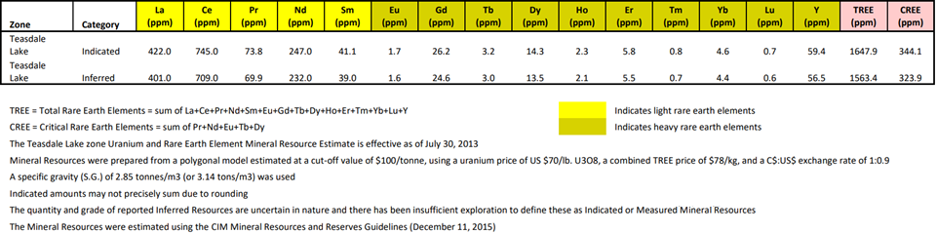
Appendix B
Alces Lake Lithogeochemical Results for Drill Hole IV-19-012
Zone | DDH | From (m) | To (m) | Interval (m) | La₂O₃ (wt%) | CeO₂ (wt%) | Pr₆O₁₁ (wt%) | Nd₂O₃ (wt%) | Sm₂O₃ (wt%) | Eu₂O₃ (wt%) | Gd₂O₃ (wt%) | Tb₄O₇ (wt%) | Dy₂O₃ (wt%) | Ho₂O₃ (wt%) | Er₂O₃ (wt%) | Yb₂O₃ (wt%) | Lu₂O₃ (wt%) | Y₂O₃ (wt%) | ThO₂ (wt%) | U₃O₈ (wt%) | TREO (wt%) | CREO (wt%)
Ivan | IV-19-012 | 8.70 | 24.25 | 15.55 | 3.653 | 7.798 | 0.889 | 2.946 | 0.413 | 0.005 | 0.205 | 0.014 | 0.036 | 0.004 | 0.006 | 0.001 | 0.000 | 0.089 | 2.081 | 0.054 | 16.059 | 3.890
includes |  | 9.70 | 17.60 | 7.90 | 7.130 | 15.219 | 1.735 | 5.748 | 0.805 | 0.010 | 0.400 | 0.027 | 0.071 | 0.007 | 0.012 | 0.002 | 0.000 | 0.173 | 4.058 | 0.105 | 31.339 | 7.591
includes |  | 9.70 | 13.40 | 3.70 | 11.233 | 23.833 | 2.753 | 8.996 | 1.258 | 0.016 | 0.626 | 0.042 | 0.110 | 0.011 | 0.019 | 0.002 | 0.001 | 0.266 | 6.365 | 0.164 | 49.165 | 11.918
Elliot Lake’s Teasdale Lake Zone REE Resource Summary Chart

